Slide 1
A ToolKit for Scientific Visualization on Many-Core Processors
Hank Childs Kenneth Moreland David Pugmire Robert Maynard
University of Oregon Sandia National Laboratories Oak Ridge National Laboratory Kitware, Inc.
More Advanced Algorithm #2
Sandia National Laboratories is a multi-mission laboratory managed and operated by National Technology and Engineering Solutions of Sandia, LLC., a wholly owned subsidiary of Honeywell International, Inc., for the U.S. Department of Energy’s National Nuclear Security Administration under contract DE-NA0003525. SAND 2019-12482 PE

Slide 2
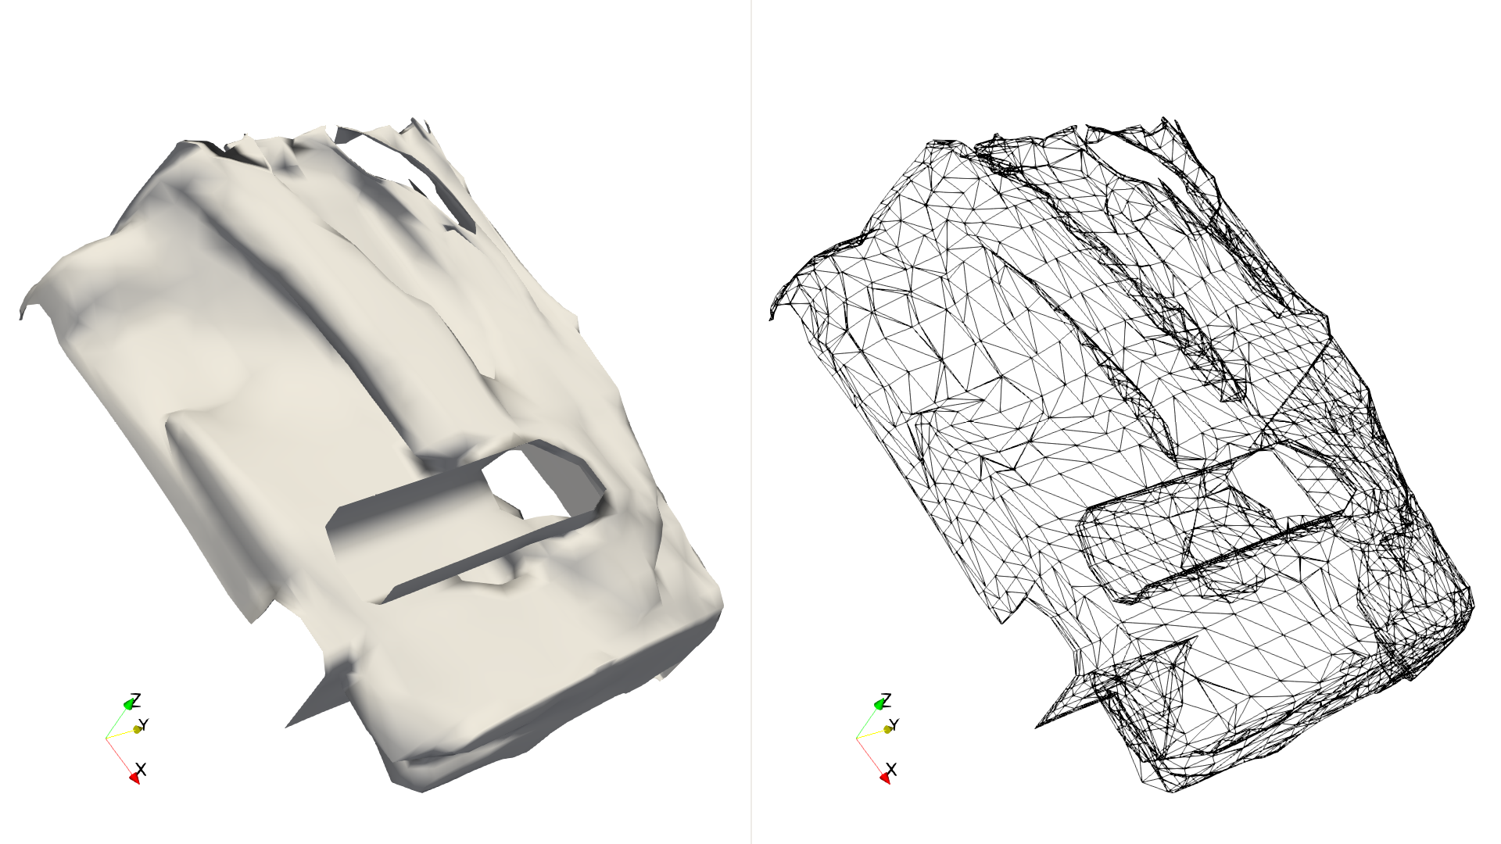
Motivating Example: Extract Edges

Slide 3
To follow along…
The source code shown in this session is in the tut_extract_edges.cxx file.

Slide 4
Pseudocode
Serial Approach
Parallel Approach (many threads)
for each cell in data set do:
for each edge in cell do:
write edge to output
3
2
4
0
1

Slide 5
Pseudocode
Serial Approach
Parallel Approach (many threads)
for each cell in data set do:
for each edge in cell do:
write edge to output
for each cell in data set do in parallel:
for each edge in cell do:
write edge to output
3
2
4
0
1

Slide 6
Pseudocode
Serial Approach
Parallel Approach (many threads)
for each cell in data set do:
for each edge in cell do:
write edge to output
for each cell in data set do in parallel:
for each edge in cell do:
write edge to output
3
2
4
0
1

Slide 7
Pseudocode
Serial Approach
Parallel Approach (many threads)
for each cell in data set do:
for each edge in cell do:
write edge to output
for each cell in data set do in parallel:
record number of edges in cell
build output data structures
for each cell in data set do in parallel:
for each edge in cell do in parallel:
write edge to output
3
2
4
0
1

Slide 8
Pseudocode
Serial Approach
Parallel Approach (many threads)
for each cell in data set do:
for each edge in cell do:
write edge to output
for each cell in data set do in parallel:
record number of edges in cell
build output data structures
for each cell in data set do in parallel:
for each edge in cell do in parallel:
write edge to output
Not trivial, but VTK-m does this for you.
3
2
4
0
1

Slide 9
Pseudocode
Serial Approach
Parallel Approach (many threads)
for each cell in data set do:
for each edge in cell do:
write edge to output
for each cell in data set do in parallel:
record number of edges in cell
build output data structures
for each cell in data set do in parallel:
for each edge in cell do in parallel:
write edge to output
3
2
4
0
1

Slide 10
Record number of edges in each cell
struct CountEdgesWorklet : vtkm::worklet::WorkletVisitCellsWithPoints
{
using ControlSignature = void(CellSetIn cellSet, FieldOut numEdges);
using ExecutionSignature = _2(CellShape, PointCount);
template<typename CellShapeTag>
VTKM_EXEC_CONT vtkm::IdComponent operator()(
CellShapeTag cellShape,
vtkm::IdComponent numPointsInCell) const
{
return vtkm::exec::CellEdgeNumberOfEdges(numPointsInCell, cellShape, *this);
}
};

Slide 11
Record number of edges in each cell
struct CountEdgesWorklet : vtkm::worklet::WorkletVisitCellsWithPoints
{
using ControlSignature = void(CellSetIn cellSet, FieldOut numEdges);
using ExecutionSignature = _2(CellShape, PointCount);
template<typename CellShapeTag>
VTKM_EXEC_CONT vtkm::IdComponent operator()(
CellShapeTag cellShape,
vtkm::IdComponent numPointsInCell) const
{
return vtkm::exec::CellEdgeNumberOfEdges(numPointsInCell, cellShape, *this);
}
};
We can use special tags to get data that is not a simple mapping of input field.

Slide 12
Record number of edges in each cell
struct CountEdgesWorklet : vtkm::worklet::WorkletVisitCellsWithPoints
{
using ControlSignature = void(CellSetIn cellSet, FieldOut numEdges);
using ExecutionSignature = _2(CellShape, PointCount);
template<typename CellShapeTag>
VTKM_EXEC_CONT vtkm::IdComponent operator()(
CellShapeTag cellShape,
vtkm::IdComponent numPointsInCell) const
{
return vtkm::exec::CellEdgeNumberOfEdges(numPointsInCell, cellShape, *this);
}
};
You can specify a return value for the ExecutionSignature

Slide 13
Record number of edges in each cell
struct CountEdgesWorklet : vtkm::worklet::WorkletVisitCellsWithPoints
{
using ControlSignature = void(CellSetIn cellSet, FieldOut numEdges);
using ExecutionSignature = _2(CellShape, PointCount);
template<typename CellShapeTag>
VTKM_EXEC_CONT vtkm::IdComponent operator()(
CellShapeTag cellShape,
vtkm::IdComponent numPointsInCell) const
{
return vtkm::exec::CellEdgeNumberOfEdges(numPointsInCell, cellShape, *this);
}
};
Function to get cell/edge information.

Slide 14
Pseudocode
Serial Approach
Parallel Approach (many threads)
for each cell in data set do:
for each edge in cell do:
write edge to output
for each cell in data set do in parallel:
record number of edges in cell
build output data structures
for each cell in data set do in parallel:
for each edge in cell do in parallel:
write edge to output
3
2
4
0
1

Slide 15
Pseudocode
Serial Approach
Parallel Approach (many threads)
for each cell in data set do:
for each edge in cell do:
write edge to output
for each cell in data set do in parallel:
record number of edges in cell
build output data structures
for each cell in data set do in parallel:
for each edge in cell do in parallel:
write edge to output
3
2
4
0
1

Slide 16
Write Edges
struct EdgeIdsWorklet : vtkm::worklet::WorkletVisitCellsWithPoints
{
using ControlSignature = void(CellSetIn cellSet, FieldOut canonicalIds);
using ExecutionSignature = void(CellShape cellShape,
PointIndices globalPointIndices,
VisitIndex localEdgeIndex,
_2 canonicalIdOut);
using ScatterType = vtkm::worklet::ScatterCounting;

Slide 17
Write Edges
struct EdgeIdsWorklet : vtkm::worklet::WorkletVisitCellsWithPoints
{
using ControlSignature = void(CellSetIn cellSet, FieldOut canonicalIds);
using ExecutionSignature = void(CellShape cellShape,
PointIndices globalPointIndices,
VisitIndex localEdgeIndex,
_2 canonicalIdOut);
using ScatterType = vtkm::worklet::ScatterCounting;
A scatter lets you create more (or less) than 1 output for every input. Allows us to write many edges for each cell.

Slide 18
Scheduling with No Scatter (1 input to 1 output)
Input Array #1
Input Array #2
W
W
W
W
W
W
W
W
W
W
Output Array #1

Slide 19
Scheduling with a Count Scatter
Count Array
3 | 0 | 1 | 2 | 0 | 0 | 0 | 4 | 1 | 2
Input Array #1
Input Array #2
W
W
W
W
W
W
Output Array #1

Slide 20
Scheduling with a Count Scatter
Count Array
3 | 0 | 1 | 2 | 0 | 0 | 0 | 4 | 1 | 2
Input Array #1
Input Array #2
W
W
W
W
W
W
Output Array #1
Worklet called 3 times (in parallel) on this input.

Slide 21
Scheduling with a Count Scatter
Count Array
3 | 0 | 1 | 2 | 0 | 0 | 0 | 4 | 1 | 2
Input Array #1
Input Array #2
W
W
W
W
W
W
Output Array #1
Worklet called 3 times (in parallel) on this input.
Worklet called once on this input.

Slide 22
Scheduling with a Count Scatter
Worklet never called on this input.
Count Array
3 | 0 | 1 | 2 | 0 | 0 | 0 | 4 | 1 | 2
Input Array #1
Input Array #2
W
W
W
W
W
W
Output Array #1
Worklet called 3 times (in parallel) on this input.
Worklet called once on this input.

Slide 23
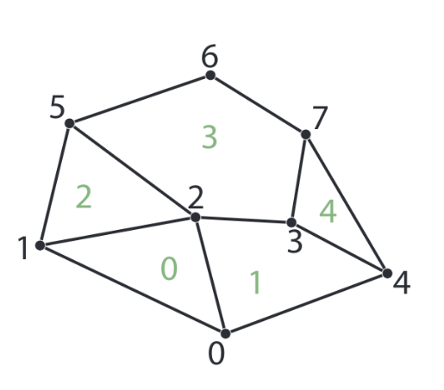
VTK-m Parallel Pattern: Visit Cells with Points
Input Array #1
0 | 1 | 2 | 3 | 4 | 5 | 6 | 7
W
W
W
W
W
Output Array #1
0 | 1 | 2 | 3 | 4

Slide 24
Using Count Scatter to Visit Cell Edges
Count Array
3 | 4 | 3 | 5 | 3
Input Array #1
0 | 1 | 2 | 3 | 4 | 5 | 6 | 7
W
W
W
W
W
Output Array #1
0,0 | 0,1 | 0,2 | 1,0 | 1,1 | 1,2 | 1,3 | 2,0 | 2,1 | 2,2 | 3,0 | 3,1 | 3,2 | 3,3 | 3,4 | 4,0 | 4,1 | 4,2

Slide 25
Using Count Scatter to Visit Cell Edges
Count Array
3 | 4 | 3 | 5 | 3
Input Array #1
0 | 1 | 2 | 3 | 4 | 5 | 6 | 7
W
W
W
W
W
Output Array #1
0,0 | 0,1 | 0,2 | 1,0 | 1,1 | 1,2 | 1,3 | 2,0 | 2,1 | 2,2 | 3,0 | 3,1 | 3,2 | 3,3 | 3,4 | 4,0 | 4,1 | 4,2

Slide 26
Using Count Scatter to Visit Cell Edges
Count Array
3 | 4 | 3 | 5 | 3
Input Array #1
0 | 1 | 2 | 3 | 4 | 5 | 6 | 7
W
W
W
W
W
Output Array #1
0,0 | 0,1 | 0,2 | 1,0 | 1,1 | 1,2 | 1,3 | 2,0 | 2,1 | 2,2 | 3,0 | 3,1 | 3,2 | 3,3 | 3,4 | 4,0 | 4,1 | 4,2

Slide 27
Using Count Scatter to Visit Cell Edges
Count Array
3 | 4 | 3 | 5 | 3
Input Array #1
0 | 1 | 2 | 3 | 4 | 5 | 6 | 7
W
W
W
W
W
Output Array #1
0,0 | 0,1 | 0,2 | 1,0 | 1,1 | 1,2 | 1,3 | 2,0 | 2,1 | 2,2 | 3,0 | 3,1 | 3,2 | 3,3 | 3,4 | 4,0 | 4,1 | 4,2

Slide 28
Using Count Scatter to Visit Cell Edges
Count Array
3 | 4 | 3 | 5 | 3
Input Array #1
0 | 1 | 2 | 3 | 4 | 5 | 6 | 7
W
W
W
W
W
Output Array #1
0,0 | 0,1 | 0,2 | 1,0 | 1,1 | 1,2 | 1,3 | 2,0 | 2,1 | 2,2 | 3,0 | 3,1 | 3,2 | 3,3 | 3,4 | 4,0 | 4,1 | 4,2
How do we know which edge the worklet is computing?

Slide 29
Write Edges
struct EdgeIdsWorklet : vtkm::worklet::WorkletVisitCellsWithPoints
{
using ControlSignature = void(CellSetIn cellSet, FieldOut canonicalIds);
using ExecutionSignature = void(CellShape cellShape,
PointIndices globalPointIndices,
VisitIndex localEdgeIndex,
_2 canonicalIdOut);
using ScatterType = vtkm::worklet::ScatterCounting;

Slide 30
Write Edges
struct EdgeIdsWorklet : vtkm::worklet::WorkletVisitCellsWithPoints
{
using ControlSignature = void(CellSetIn cellSet, FieldOut canonicalIds);
using ExecutionSignature = void(CellShape cellShape,
PointIndices globalPointIndices,
VisitIndex localEdgeIndex,
_2 canonicalIdOut);
using ScatterType = vtkm::worklet::ScatterCounting;
VisitIndex lets you know which instance (in this case which edge) the worklet is run for.

Slide 31
struct EdgeIdsWorklet : vtkm::worklet::WorkletVisitCellsWithPoints
{
using ControlSignature = void(CellSetIn cellSet, FieldOut canonicalIds);
using ExecutionSignature = void(CellShape cellShape,
PointIndices globalPointIndices,
VisitIndex localEdgeIndex,
_2 canonicalIdOut);
using ScatterType = vtkm::worklet::ScatterCounting;
template<typename CellShapeTag, typename PointIndexVecType>
VTKM_EXEC void operator()(CellShapeTag cellShape,
const PointIndexVecType& globalPointIndicesForCell,
vtkm::IdComponent localEdgeIndex,
vtkm::Id2& canonicalIdOut) const
{
vtkm::IdComponent numPointsInCell =
globalPointIndicesForCell.GetNumberOfComponents();
canonicalIdOut = vtkm::exec::CellEdgeCanonicalId(
numPointsInCell, localEdgeIndex, cellShape, globalPointIndicesForCell, *this);
}
};

Slide 32
struct EdgeIdsWorklet : vtkm::worklet::WorkletVisitCellsWithPoints
{
using ControlSignature = void(CellSetIn cellSet, FieldOut canonicalIds);
using ExecutionSignature = void(CellShape cellShape,
PointIndices globalPointIndices,
VisitIndex localEdgeIndex,
_2 canonicalIdOut);
using ScatterType = vtkm::worklet::ScatterCounting;
template<typename CellShapeTag, typename PointIndexVecType>
VTKM_EXEC void operator()(CellShapeTag cellShape,
const PointIndexVecType& globalPointIndicesForCell,
vtkm::IdComponent localEdgeIndex,
vtkm::Id2& canonicalIdOut) const
{
vtkm::IdComponent numPointsInCell =
globalPointIndicesForCell.GetNumberOfComponents();
canonicalIdOut = vtkm::exec::CellEdgeCanonicalId(
numPointsInCell, localEdgeIndex, cellShape, globalPointIndicesForCell, *this);
}
};
Function to get cell/edge information.

Slide 33
Setting up the Scatter (in the Filter)
vtkm::worklet::ScatterCounting scatter(edgeCounts);
vtkm::cont::ArrayHandle<vtkm::Id2> canonicalIds;
this->Invoke(vtkm::worklet::EdgeIdsWorklet{}, scatter, inCellSet, canonicalIds);

Slide 34
Setting up the Scatter (in the Filter)
Create a scatter object
vtkm::worklet::ScatterCounting scatter(edgeCounts);
vtkm::cont::ArrayHandle<vtkm::Id2> canonicalIds;
this->Invoke(vtkm::worklet::EdgeIdsWorklet{}, scatter, inCellSet, canonicalIds);
Pass the scatter object as the second argument to the Invoker.

Slide 35
Pseudocode
Serial Approach
Parallel Approach (many threads)
for each cell in data set do:
for each edge in cell do:
write edge to output
for each cell in data set do in parallel:
record number of edges in cell
build output data structures
for each cell in data set do in parallel:
for each edge in cell do in parallel:
write edge to output
3
2
4
0
1

Slide 36
Pseudocode
Serial Approach
Parallel Approach (many threads)
for each cell in data set do:
for each edge in cell do:
write edge to output
for each cell in data set do in parallel:
record number of edges in cell
build output data structures
for each cell in data set do in parallel:
for each edge in cell do in parallel:
write edge to output
Some edges duplicated
3
2
4
0
1

Slide 37
Pseudocode
Serial Approach
Parallel Approach (many threads)
for each cell in data set do:
for each edge in cell do:
if edge not already written:
write edge to output
for each cell in data set do in parallel:
record number of edges in cell
build output data structures
for each cell in data set do in parallel:
for each edge in cell do in parallel:
if edge not already written:
write edge to output
3
2
4
0
1

Slide 38
Pseudocode
Serial Approach
Parallel Approach (many threads)
for each cell in data set do:
for each edge in cell do:
if edge not already written:
write edge to output
for each cell in data set do in parallel:
record number of edges in cell
build output data structures
for each cell in data set do in parallel:
for each edge in cell do in parallel:
if edge not already written:
write edge to output
3
2
4
0
1

Slide 39
Pseudocode
Serial Approach
Parallel Approach (many threads)
for each cell in data set do:
for each edge in cell do:
if edge not already written:
write edge to output
for each cell in data set do in parallel:
record number of edges in cell
build output data structures
for each cell in data set do in parallel:
for each edge in cell do in parallel:
record edge id to output
group identical edge ids
for each unique edge id do in parallel:
write edge to output
3
2
4
0
1

Slide 40
Pseudocode
Serial Approach
Parallel Approach (many threads)
for each cell in data set do:
for each edge in cell do:
if edge not already written:
write edge to output
for each cell in data set do in parallel:
record number of edges in cell
build output data structures
for each cell in data set do in parallel:
for each edge in cell do in parallel:
record edge id to output
group identical edge ids
for each unique edge id do in parallel:
write edge to output
3
2
4
0
1

Slide 41
Like items (such as edge identifiers) are grouped by Keys object
vtkm::worklet::ScatterCounting scatter(edgeCounts);
vtkm::cont::ArrayHandle<vtkm::Id2> canonicalIds;
this->Invoke(vtkm::worklet::EdgeIdsWorklet{}, scatter, inCellSet, canonicalIds);
this->CellToEdgeKeys = vtkm::worklet::Keys<vtkm::Id2>(canonicalIds);
Create a Keys object with the canonical edge identifiers

Slide 42
Pseudocode
Serial Approach
Parallel Approach (many threads)
for each cell in data set do:
for each edge in cell do:
if edge not already written:
write edge to output
for each cell in data set do in parallel:
record number of edges in cell
build output data structures
for each cell in data set do in parallel:
for each edge in cell do in parallel:
record edge id to output
group identical edge ids
for each unique edge id do in parallel:
write edge to output
3
2
4
0
1

Slide 43
struct EdgeIndicesWorklet : vtkm::worklet::WorkletReduceByKey
{
using ControlSignature = void(KeysIn keys,
WholeCellSetIn<> inputCells,
ValuesIn originCells,
ValuesIn originEdges,
ReducedValuesOut connectivityOut);
using ExecutionSignature = void(_2 inputCells,
_3 originCell,
_4 originEdge,
_5 connectivityOut);
template<typename CellSetType,
typename OriginCellsType,
typename OriginEdgesType>
VTKM_EXEC void operator()(const CellSetType& cellSet,
const OriginCellsType& originCells,
const OriginEdgesType& originEdges,
vtkm::Id2& connectivityOut) const
{

Slide 44
struct EdgeIndicesWorklet : vtkm::worklet::WorkletReduceByKey
{
using ControlSignature = void(KeysIn keys,
WholeCellSetIn<> inputCells,
ValuesIn originCells,
ValuesIn originEdges,
ReducedValuesOut connectivityOut);
using ExecutionSignature = void(_2 inputCells,
_3 originCell,
_4 originEdge,
_5 connectivityOut);
template<typename CellSetType,
typename OriginCellsType,
typename OriginEdgesType>
VTKM_EXEC void operator()(const CellSetType& cellSet,
const OriginCellsType& originCells,
const OriginEdgesType& originEdges,
vtkm::Id2& connectivityOut) const
{
Reduce-by-key worklet used to collapse elements of the same type.

Slide 45
struct EdgeIndicesWorklet : vtkm::worklet::WorkletReduceByKey
{
using ControlSignature = void(KeysIn keys,
WholeCellSetIn<> inputCells,
ValuesIn originCells,
ValuesIn originEdges,
ReducedValuesOut connectivityOut);
using ExecutionSignature = void(_2 inputCells,
_3 originCell,
_4 originEdge,
_5 connectivityOut);
template<typename CellSetType,
typename OriginCellsType,
typename OriginEdgesType>
VTKM_EXEC void operator()(const CellSetType& cellSet,
const OriginCellsType& originCells,
const OriginEdgesType& originEdges,
vtkm::Id2& connectivityOut) const
{
Reduce-by-key worklet takes a Keys object as its input domain.
Worklet gets called once for every unique key.

Slide 46
struct EdgeIndicesWorklet : vtkm::worklet::WorkletReduceByKey
{
using ControlSignature = void(KeysIn keys,
WholeCellSetIn<> inputCells,
ValuesIn originCells,
ValuesIn originEdges,
ReducedValuesOut connectivityOut);
using ExecutionSignature = void(_2 inputCells,
_3 originCell,
_4 originEdge,
_5 connectivityOut);
template<typename CellSetType,
typename OriginCellsType,
typename OriginEdgesType>
VTKM_EXEC void operator()(const CellSetType& cellSet,
const OriginCellsType& originCells,
const OriginEdgesType& originEdges,
vtkm::Id2& connectivityOut) const
{
ValuesIn parameters produce a Vec-like containing all values that had the same key.

Slide 47
struct EdgeIndicesWorklet : vtkm::worklet::WorkletReduceByKey
{
using ControlSignature = void(KeysIn keys,
WholeCellSetIn<> inputCells,
ValuesIn originCells,
ValuesIn originEdges,
ReducedValuesOut connectivityOut);
using ExecutionSignature = void(_2 inputCells,
_3 originCell,
_4 originEdge,
_5 connectivityOut);
template<typename CellSetType,
typename OriginCellsType,
typename OriginEdgesType>
VTKM_EXEC void operator()(const CellSetType& cellSet,
const OriginCellsType& originCells,
const OriginEdgesType& originEdges,
vtkm::Id2& connectivityOut) const
{
ReducedValuesOut records a single (reduced) value for each unique key.

Slide 48
VTKM_EXEC void operator()(const CellSetType& cellSet,
const OriginCellsType& originCells,
const OriginEdgesType& originEdges,
vtkm::Id2& connectivityOut) const
{
// Collect info of edge associated with key
vtkm::IdComponent numPointsInCell = cellSet.GetNumberOfIndices(originCells[0]);
vtkm::IdComponent edgeIndex = originEdges[0];
auto cellShape = cellSet.GetCellShape(originCells[0]);
// Get local indices for edge
vtkm::IdComponent pointInCellIndex0 = vtkm::exec::CellEdgeLocalIndex(
numPointsInCell, 0, edgeIndex, cellShape, *this);
vtkm::IdComponent pointInCellIndex1 = vtkm::exec::CellEdgeLocalIndex(
numPointsInCell, 1, edgeIndex, cellShape, *this);
// Record point indices for edge
auto globalPointIndicesForCell = cellSet.GetIndices(originCells[0]);
connectivityOut[0] = globalPointIndicesForCell[pointInCellIndex0];
connectivityOut[1] = globalPointIndicesForCell[pointInCellIndex1];
}

Slide 49
Converting Flat Connection Array to Id2 Array
this->CellToEdgeKeys = vtkm::worklet::Keys<vtkm::Id2>(canonicalIds);
vtkm::cont::ArrayHandle<vtkm::Id> connectivityArray;
this->Invoke(vtkm::worklet::EdgeIndicesWorklet{},
this->CellToEdgeKeys,
inCellSet,
this->OutputToInputCellMap,
outputToInputEdgeMap,
vtkm::cont::make_ArrayHandleGroupVec<2>(connectivityArray));
Use ArrayhandleGroupVec to make a flat array of vtkm::Id look like an array of vtkm::Id2

Slide 50
Use the Computed Connectivity to Build a CellSetSingleType
vtkm::cont::CellSetSingleType<> outCellSet;
outCellSet.Fill(
inCellSet.GetNumberOfPoints(), vtkm::CELL_SHAPE_LINE, 2, connectivityArray);
vtkm::cont::DataSet outData;
outData.SetCellSet(outCellSet);
for (vtkm::IdComponent coordSystemIndex = 0;
coordSystemIndex < inData.GetNumberOfCoordinateSystems();
++coordSystemIndex)
{
outData.AddCoordinateSystem(inData.GetCoordinateSystem(coordSystemIndex));
}
return outData;

Slide 51
Q&A
Sandia National Laboratories is a multi-mission laboratory managed and operated by National Technology and Engineering Solutions of Sandia, LLC., a wholly owned subsidiary of Honeywell International, Inc., for the U.S. Department of Energy’s National Nuclear Security Administration under contract DE-NA0003525. SAND NO. 2019-XXXXP

