Slide 1
Tutorial Schedule
25m
65m
30m
20m
60m
10m
Introduction / software install
Using VTK-m (+hands on)
Break
Concepts behind VTK-m development
3 VTK-m filters (description + hands on)
Discussion of upcoming activities / wrap up / Q&A

Slide 2
Design of VTK-m (SLIDE REPEAT)
VTK-m split into two environments: control and execution
Each has its own API
Direct interaction between the environments is disallowed

Slide 3
Execution Environment (SLIDE REPEAT)
Where computational portion of algorithms are executed
Code for the execution environment is designed to always execute on a very large number of threads
VTK-m supports multiple parallel processing patterns
Each pattern is customized via a “worklet” (sometimes called functors)
VTK-m algorithm developers decide which patterns to use and write worklets for these patterns
→ this is the subject of the tutorial after the break (NOW!)

Slide 4
Typical pattern for developing code
Select parallel pattern
Write worklet to customize parallel pattern
Invoke parallel pattern with worklets, input and outputs

Slide 5
Let’s start with a very simple example
Select parallel pattern --- map
Write worklet to customize parallel pattern --- plus
Invoke parallel pattern with worklets, input and outputs

Slide 6
What is the map pattern?
Half of “Map-Reduce”
Given “m” input, X_{i}, of size N
Y = F(X_{i}) where:
“M” inputs: X_{i} of size N
Output Y of size N
→ Key point: Y_{i} depends only on X_{1,i}, X_{2,i}, … X_{M,i}.
Why is this good?
Each element can be calculated independently
X_{1,0} | X_{1,1} | ….. | X_{1,N-2} | X_{1,N-1}
M Inputs
X_{2,0} | X_{2,1} | ….. | X_{2,N-2} | X_{2,N-1}
.
.
X_{M,0} | X_{M,1} | ….. | X_{M,N-2} | X_{M,N-1}
F( )
……..
F( )
Y₀ | Y₁ | ….. | Y_{N-2} | Y_{N-1}

Slide 7
Worklet for Map: Plus
int Plus(int A_i, int B_i)
{
return A_i + B_i;
}

Slide 8
Invoking Map Parallel Pattern With Plus Worklet (Notional)
IntArray A = { 1, 3, 5, 9, 11 };
IntArray B = { 2, 4, 6, 10, 12 };
IntArray C;
C = InvokeMap<Plus>(A, B);

Slide 9
Invoking Map Parallel Pattern With Plus Worklet (Notional)
Map
{ 1, 3, 5, 9, 11 }
Invoke
+
on
{ 2, 4, 6, 10, 12 }
IntArray A = { 1, 3, 5, 9, 11 };
IntArray B = { 2, 4, 6, 10, 12 };
IntArray C;
C = InvokeMap<Plus>(A, B);
Many-Core
Device
Get inputs to each worklet
arranged on each core
1 2 3 4 5 6 9 10 11 12
Get worklet code on each core of the
many-core device
+
+
+
+
+
…
Cause worklet to execute on each core,
creating outputs that are placed in C
3 7 11 19 23
Core 0
Core 1
Core 2
Core 3
Core 4

Slide 10
What is a worklet? (1/2)
Worklet in VTK-m: a programming construct
small functor or kernel designed to operate on a small element of data
What is a functor? – a C struct/class with an overloaded ::operator()
::operator() must be declared const – cannot modify state in main instance
And: significant metadata alongside functor
How data is managed
How execution is structured
The name “worklet” is meant to apply a small amount of work
But: for VTK-m, amount of data is small,
… *not* necessarily the amount of instructions performed

Slide 11
What is a worklet? (2/2)
For VTK-m, worklets must be serial and stateless functions
… but this serial worklet code is invoked in parallel on many cores
Serial/stateless enables three critical goals:
Pervasive parallelism. Allows VTK-m to schedule worklet invocations on many independent concurrent threads.
Thread safety. By controlling the memory access the toolkit can insure that no worklet will have any memory collisions, false sharing, or other parallel programming pitfalls.
Good programming practices. The worklet model provides a natural approach to visualization algorithm design that also has good general performance characteristics.

Slide 12
How do worklets become usable code in VTK-m? (1/3)
Developers write worklets as serial components
This worklet corresponds to a parallel pattern
VTK-m has “invokers” that launch a parallel pattern with a given worklet
VTK-m handles whatever layers of concurrency are necessary, thereby removing the onus from the visualization algorithm developer
Concurrency within CUDA, TBB, OpenMP, etc.

Slide 13
How do worklets become usable code in VTK-m? (2/3)
A VTK-m “algorithm”:
Applies sequence of parallel patterns on inputs to produce outputs
Inputs/Outputs can be vtkm ArrayHandles and/or DataSet
I₁
Pattern₁
Step 1
O₁
I₂
I₃
Pattern₂
Step 2
O₂
I₄
I₅
.
.
.
I_{M-1}
Pattern_{M}
Step N
O_{M}
I_{M}

Slide 14
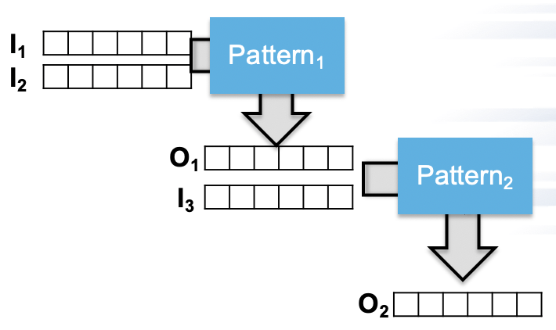
How do worklets become usable code in VTK-m? (3/3)
I₁
Pattern₁
Key observations:
Can use a pattern multiple times with different worklets
Output of one invocation can be used as input in another invocation
Filters encapsulate a sequence of worklets intended for users of VTK-m
Invocations happen in control environment, but they spawn worklets in the execution environment
I₂
O₁
Pattern₂
I₃
O₂
Filter
Inputs
Output

Slide 15
Array Handles
Array handles:
a link in the control environment to arrays that exist in the execution environment
automate data transfers between host and device
Use cases
Invoking parallel patterns
This occurs in control environment
Invokers take array handles as input
Data access
get results from execution environment back to control environment

Slide 16
What are the parallel patterns?
5 parallel patterns set up to work with worklets (simplifies programming)
Map Field (upcoming slide)
Visit Point With Cells (upcoming slide)
Visit Cell With Points (upcoming slide)
Point Neighborhood
Reduce By Key
Also a wide range of parallel primitive algorithms, but with a lower level API
Copy, CopyIf, CopySubRange, CountSetBits, Fill, LowerBounds, Reduce, ReduceByKey, ScanInclusive, ScanInclusiveByKey, ScanExclusive, ScanExclusiveByKey, ScanExtended, Sort, SortByKey, Synchronize, Transform, Unique, UpperBounds

Slide 17
VTK-m Parallel Pattern: Map Field
Input Array #1
Input Array #2
W
W
W
W
W
W
W
W
W
W
W
W
Output Array #1
All arrays must be the same size.
Arrays can come from cells or points.

Slide 18
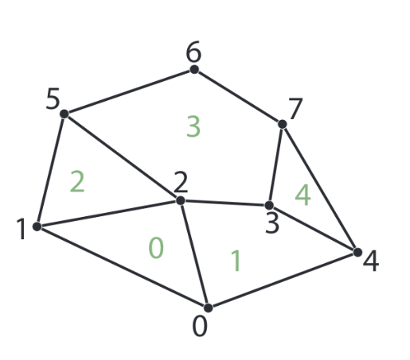
VTK-m Parallel Pattern: Visit Point With Cells
0
1
2
3
4
Input Array #1
W
W
W
W
W
W
W
W
Create output for each point.
Values from incident cells are available to worklet.
Output Array #1
0
1
2
3
4
5
6
7

Slide 19
VTK-m Parallel Pattern: Visit Point With Cells
0
1
2
3
4
Input Array #1
W
W
W
W
W
W
W
W
Create output for point #3.
Values from incident cells --- #’s 1, 3, and 4 --- are available to worklet.
Output Array #1
0
1
2
3
4
5
6
7

Slide 20
VTK-m Parallel Pattern: Visit Cell With Points
0
1
2
3
4
5
6
7
Input Array #1
W
W
W
W
W
Create output for each cell.
Values from incident points are available to worklet.
Output Array #1
0
1
2
3
4

Slide 21
VTK-m Parallel Pattern: Visit Cell With Points
0
1
2
3
4
5
6
7
Input Array #1
W
W
W
W
W
Create output for cell #2.
Values from incident points --- #’s 1, 2, and 5 --- are available to worklet.
Output Array #1
0
1
2
3
4

Slide 22
Tutorial Schedule
25m
65m
30m
20m
60m
10m
Introduction / software install
Using VTK-m (+hands on)
Break
Concepts behind VTK-m development
3 VTK-m filters (description + hands on)
Discussion of upcoming activities / wrap up / Q&A

Slide 23
New filter that calculates magnitude of a vector field
Code: tut_mag_grad.cxx
Worklet called ComputeMagnitude
Uses MapField pattern
Filter called FieldMagnitude
Uses Magnitude worklet
Main function
Uses FieldMagnitudeFilter

Slide 24
New filter that calculates magnitude of a vector field
Code: tut_mag_grad.cxx
Worklet called ComputeMagnitude
Uses MapField pattern
Filter called FieldMagnitude
Uses Magnitude worklet
Main function
Uses FieldMagnitudeFilter

Slide 25
3 components to developing a worklet
Decide what parallel pattern to use
Define code for your operation
Provide hints to VTK-m for how your worklet will run

Slide 26
3 components to developing a worklet
Decide what parallel pattern to use
Define code for your operation
Provide hints to VTK-m for how your worklet will run

Slide 27
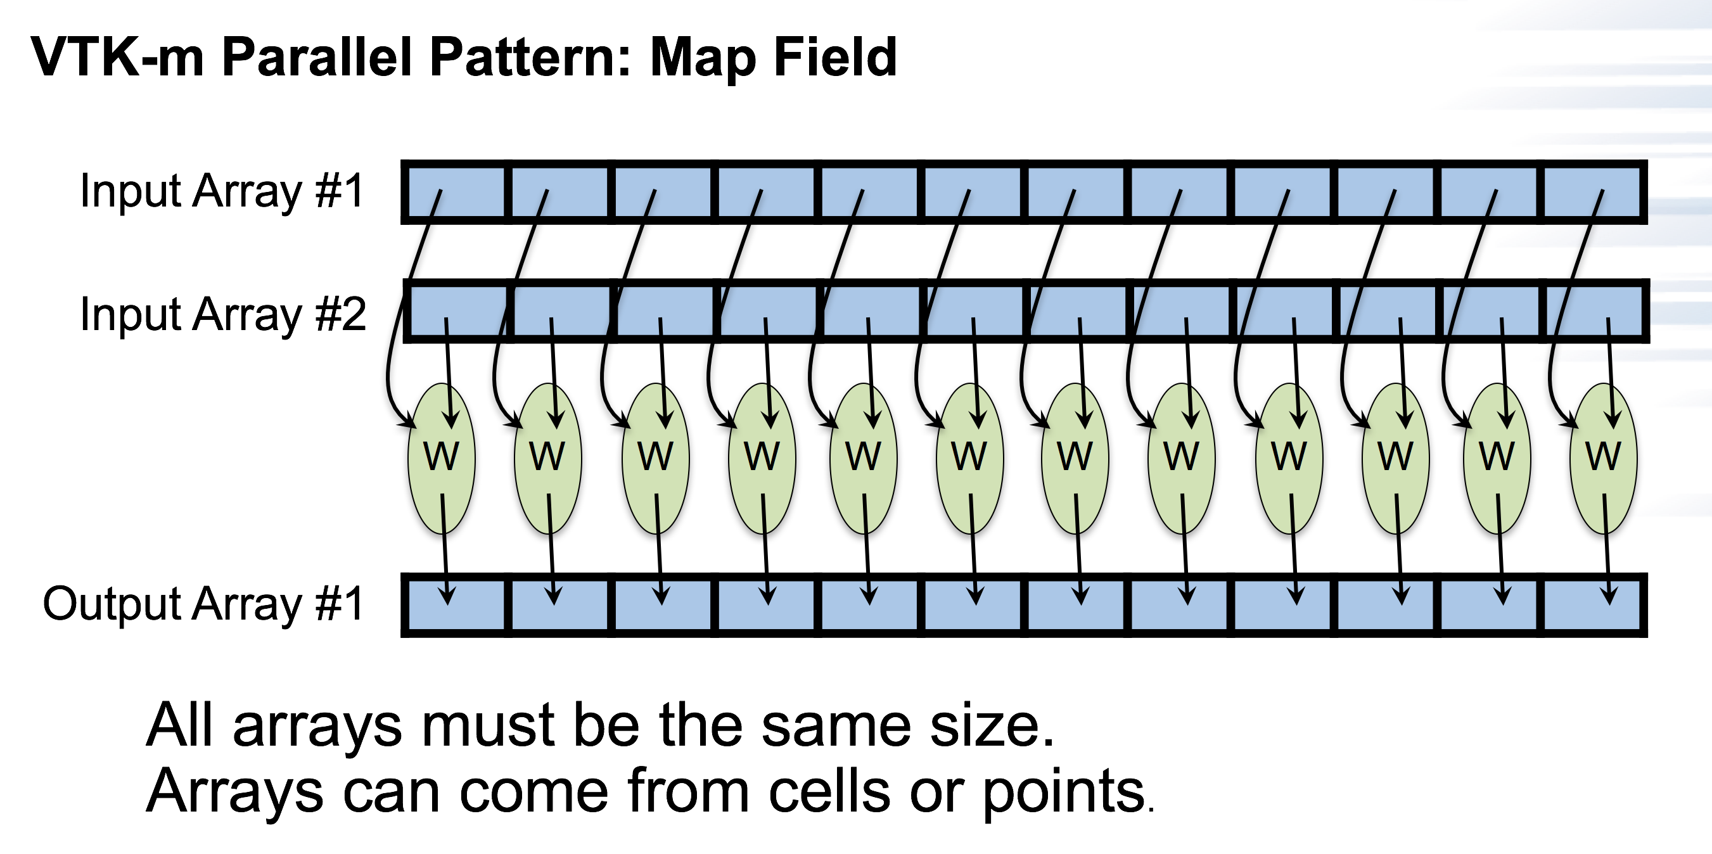
Worklet development: decide what parallel pattern to use
This is done via inheritance
Defines parallel pattern for worklet
struct ComputeMagnitude : vtkm::worklet::WorkletMapField
{
...
};

Slide 28
3 components to developing a worklet
Decide what parallel pattern to use
Define code for your operation
Provide hints to VTK-m for how your worklet will run

Slide 29
Worklet development: defining code for your operation
struct ComputeMagnitude : vtkm::worklet::WorkletMapField
{
...
VTKM_EXEC void operator()(const vtkm::Vec3f& inVector,
vtkm::FloatDefault& outMagnitude) const
{
outMagnitude = vtkm::Magnitude(inVector);
}
};

Slide 30
Worklet development: defining code for your operation
struct ComputeMagnitude : vtkm::worklet::WorkletMapField
{
...
VTKM_EXEC void operator()(const vtkm::Vec3f& inVector,
vtkm::FloatDefault& outMagnitude) const
{
outMagnitude = vtkm::Magnitude(inVector);
}
};
Method must be const (thread safety)
Specifies device code
Use operator() for functor syntax
Don’t forget that output parameters must be references
The operating function of the worklet

Slide 31
VTKM_EXEC, VTKM_CONT, VTKM_EXEC_CONT
These are C macros that instruct compiler what architecture to compile for
VTKM_EXEC: execution environment
VTKM_CONT: control environment
VTKM_EXEC_CONT: both environments

Slide 32
3 components to developing a worklet
Decide what parallel pattern to use
Define code for your operation
Provide hints to VTK-m for how your worklet will run

Slide 33
Worklet development: providing hints to VTK-m for how your worklet will run
struct ComputeMagnitude : vtkm::worklet::WorkletMapField
{
using ControlSignature = void(FieldIn inputVectors,
FieldOut outputMagnitudes);
VTKM_EXEC void operator()(const vtkm::Vec3f& inVector,
vtkm::FloatDefault& outMagnitude) const
{
outMagnitude = vtkm::Magnitude(inVector);
}
};
Input Array
Defines signature
Output Array
The VTK-m team is actively exploring ways to simplify this step
(get audience feedback in Q&A?)

Slide 34
Worklet Example: Putting It All Together
Defines worklet pattern
Defines input arrays
struct ComputeMagnitude : vtkm::worklet::WorkletMapField
{
using ControlSignature = void(FieldIn inputVectors,
FieldOut outputMagnitudes);
VTKM_EXEC void operator()(const vtkm::Vec3f& inVector,
vtkm::FloatDefault& outMagnitude) const
{
outMagnitude = vtkm::Magnitude(inVector);
}
};
Method must be const (thread safety)
Specifies device code
Use operator() for functor syntax
Don’t forget that output parameters must be references
The operating function of the worklet

Slide 35
New filter that calculates magnitude of a vector field
Code: tut_mag_grad.cxx
Worklet called ComputeMagnitude
Uses MapField pattern
Filter called FieldMagnitude
Uses Magnitude worklet
Main function
Uses FieldMagnitudeFilter

Slide 36
class FieldMagnitude : public vtkm::filter::FilterField<FieldMagnitude>
{
...
};
This tutorial hasn’t discussed the base types for filters.
There are three base types.
This is the base type for a filter that operates on a field.
This is the “curiously recurring template pattern.”
Familiar to those that do a lot of template programming.

Slide 37
class FieldMagnitude : public vtkm::filter::FilterField<FieldMagnitude>
{
public:
using SupportedTypes = vtkm::ListTagBase<vtkm::Vec3f>;
...
};
Declare the types this filter can work with
This filter will work on Vec3f (vectors of 3 floats)

Slide 38
class FieldMagnitude : public vtkm::filter::FilterField<FieldMagnitude>
{
public:
using SupportedTypes = vtkm::ListTagBase<vtkm::Vec3f>;
template<typename ArrayHandleType, typename Policy>
VTKM_CONT vtkm::cont::DataSet DoExecute(
...
)
{
...
}
};
Method templates:
ArrayHandleType ... ????
Policy is internal for VTK-m
Method name
Return type

Slide 39
Array Handles in VTK-m
ConstantArrays
CountingArrays
CastArrays
DiscardArrays
PermutedArrays
ZippedArrays
CoordinateSystemArrays
CompositeVectorArrays
ExtractComponentArrays
SwizzleArrays
GroupedVectorArrays
…
There are many types of array handles, used for different circumstances
→ save performance or memory
For the most part, developers can ignore the variants
(but we do need to add a template argument)

Slide 40
class FieldMagnitude : public vtkm::filter::FilterField<FieldMagnitude>
{
public:
using SupportedTypes = vtkm::ListTagBase<vtkm::Vec3f>;
template<typename ArrayHandleType, typename Policy>
VTKM_CONT vtkm::cont::DataSet DoExecute(
const vtkm::cont::DataSet& inDataSet,
const ArrayHandleType& inField,
const vtkm::filter::FieldMetadata& fieldMetadata,
vtkm::filter::PolicyBase<Policy>)
{
...
}
};
Data set to operate on
Field within that data set to operate on
Stuff VTK-m needs

Slide 41
class FieldMagnitude : public vtkm::filter::FilterField<FieldMagnitude>
{
public:
using SupportedTypes = vtkm::ListTagBase<vtkm::Vec3f>;
template<typename ArrayHandleType, typename Policy>
VTKM_CONT vtkm::cont::DataSet DoExecute(
const vtkm::cont::DataSet& inDataSet,
const ArrayHandleType& inField,
const vtkm::filter::FieldMetadata& fieldMetadata,
vtkm::filter::PolicyBase<Policy>)
{
vtkm::cont::ArrayHandle<vtkm::FloatDefault> outField;
this->Invoke(ComputeMagnitude{}, inField, outField);
std::string outFieldName = this->GetOutputFieldName();
if (outFieldName == "")
{
outFieldName = fieldMetadata.GetName() + "_magnitude";
}
return vtkm::filter::CreateResult(
inDataSet, outField, outFieldName, fieldMetadata);
}
};
Make our output array (ArrayHandle!)
Invoke our worklet
Use VTK-m method to
create output DataSet from inDataSet and our new field

Slide 42
New filter that calculates magnitude of a vector field
Code: tut_mag_grad.cxx
Worklet called ComputeMagnitude
Uses MapField pattern
Filter called FieldMagnitude
Uses Magnitude worklet
Main function
Uses FieldMagnitudeFilter

Slide 43
int main(int argc, char** argv)
{
auto opts = vtkm::cont::InitializeOptions::DefaultAnyDevice;
vtkm::cont::InitializeResult config =
vtkm::cont::Initialize(argc, argv, opts);
vtkm::io::reader::VTKDataSetReader reader("data/kitchen.vtk");
vtkm::cont::DataSet ds_from_file = reader.ReadDataSet();
vtkm::filter::Gradient grad;
grad.SetActiveField("c1");
vtkm::cont::DataSet ds_from_grad = grad.Execute(ds_from_file);
FieldMagnitude mag;
mag.SetActiveField("Gradients");
vtkm::cont::DataSet mag_grad = mag.Execute(ds_from_grad);
vtkm::io::writer::VTKDataSetWriter writer("out_mag_grad.vtk");
writer.WriteDataSet(mag_grad);
return 0;
}

Slide 44
Hands-On #1
Modify code tut_mag_grad.cxx
Worklet currently calculates magnitude of a vector
Instead, modify worket to calculate the maximum component.

