Slide 1

A ToolKit for Scientific Visualization on
Many-Core Processors
Hank Childs
Kenneth Moreland
David Pugmire
Robert Maynard
University of Oregon
Sandia National Laboratories
Oak Ridge National Laboratory
Kitware, Inc.

Slide 2
Tutorial Presenters
Contributor | Hank Childs | Kenneth Moreland | David Pugmire | Robert Maynard
Affiliation
Software Projects | VTK-m, VisIt, Ascent | VTK-m (PI), ParaView, Ice-T | VTK-m (Deputy PI), VisIt, ADIOS | VTK-m (Chief Developer), ParaView, VTK, CMake
And Two Great Tutorial Assistants
Ph.D.
Students @
Abhishek Yenpure
Samuel Schwartz

Slide 3
VTK-m: the ‘m’ is for many-core
VTK:
  popular, open source, supported by a community, lots of features
  … but primarily single core only
VTK-m:
  name chosen to evoke the positive attributes of VTK
  … but supports multi-core and many-core
Why is many-core so important?
(brief motivation)

Slide 4
My new computer's got the clocks, it rocks
But it was obsolete before I opened the box
− “Weird” Al Yankovic, It’s All About the Pentiums, circa 1999
Moore’s Law is dead.
− Gordon Moore, circa 2005
Notes:
Why is this happening now?
In previous years we enjoyed a doubling of clock rate every 18 months
Frustrating to computer buyers but great for HPC
(Technically, it’s Dennard scaling, that power in transistors drops as they shrink, that is dead.)
Now, clock rates have leveled off at 2-4 GHz
Manufactures compensate by adding more cores, more parallelism

Slide 5
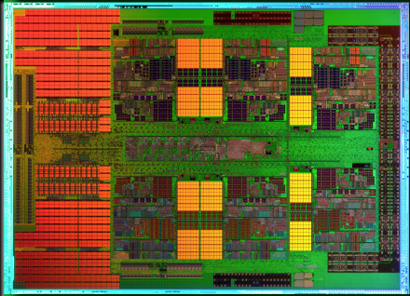
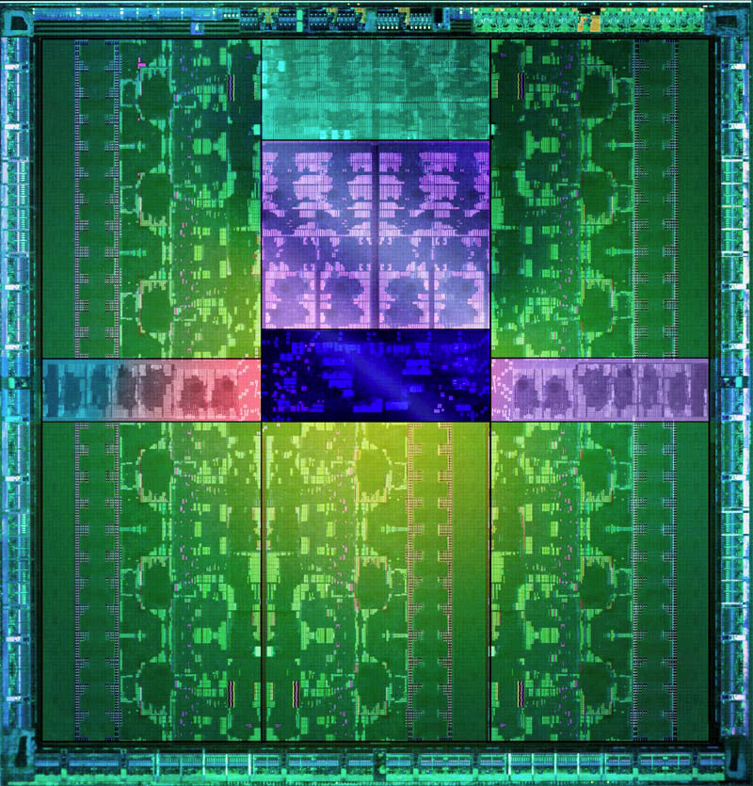
1mm
AMD x86
Full x86 Core
+ Associated Cache
8 cores per die
MPI-Only feasible
1 x86
core
1 Kepler
core
NVIDIA GPU
2,880 cores collected in 15 SMX
Shared PC, Cache, Mem Fetches
Reduced control logic
MPI-Only not feasible
Notes:
What I want to emphasize is the difference between the cores on Cielo and those on accelerators of the type being considered for Trinity.
Each core on Cielo is a fully featured traditional x86 architecture and all the optimizations associated with it.
An accelerator core, in contrast, is significantly stripped down.
You cannot treat them like a symmetric multiprocessor. They are more like SIMD (but not quite as restrictive).
Unlike Cielo, running on Trinity will not simply be “scaling up”.
AMD Magny-Cours. Half of 12 core shown. 8 core used in Cielo.
NVIDIA Kepler GK110. 15 SMX streaming multiprocessor extreme, 192 cores per SMX. 2,880 total cores.

Slide 6
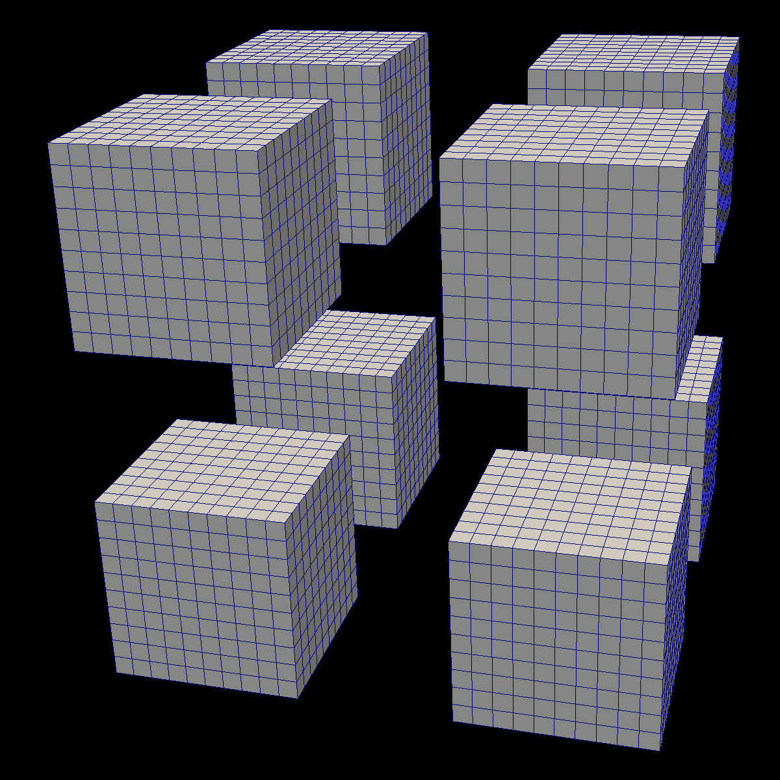
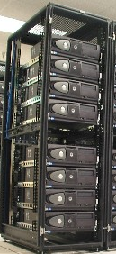
Distributed
Parallelism
On Node
Parallelism

Slide 7

VTK-m’s main thrust: a write-once-run-everywhere framework
Contour
Streams
Clip
Render
Surface
Normals
Ghost Cells
Warp
…
x86
CUDA
Xeon Phi
Radeon
Xe
Demonstrated
Upcoming

Slide 8
Tutorial Purpose
We believe VTK-m has become useful software
We are hopeful visualization researchers will considering using and perhaps even developing VTK-m
  (We would like the project to expand beyond the Department of Energy / beyond the USA, much like VTK, ParaView, and VisIt.)
At the end of this tutorial:
  Understand how to use VTK-m
  Understand the design behind VTK-m
  Understand basics of developing VTK-m

Slide 9
Tutorial Schedule
25m
65m
30m
20m
60m
10m
Introduction / software install
Using VTK-m (+hands on)
Break
Concepts behind VTK-m development
3 VTK-m filters (description + hands on)
Discussion of upcoming activities / wrap up / Q&A

Slide 10
Tutorial Schedule
25m
65m
30m
20m
60m
10m
Introduction / software install
Using VTK-m (+hands on)
Break
Concepts behind VTK-m development
3 VTK-m filters (description + hands on)
Discussion of upcoming activities / wrap up / Q&A

Slide 11
Software Install
2 options
  Download and build VTK-m + examples
  Use a VM with VTK-m and examples already built

Slide 12
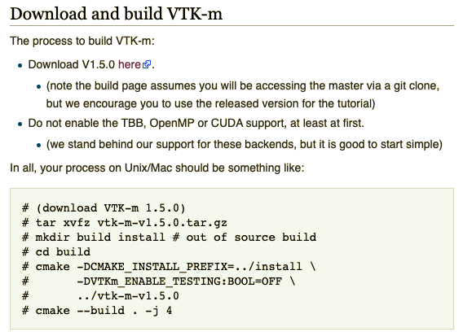
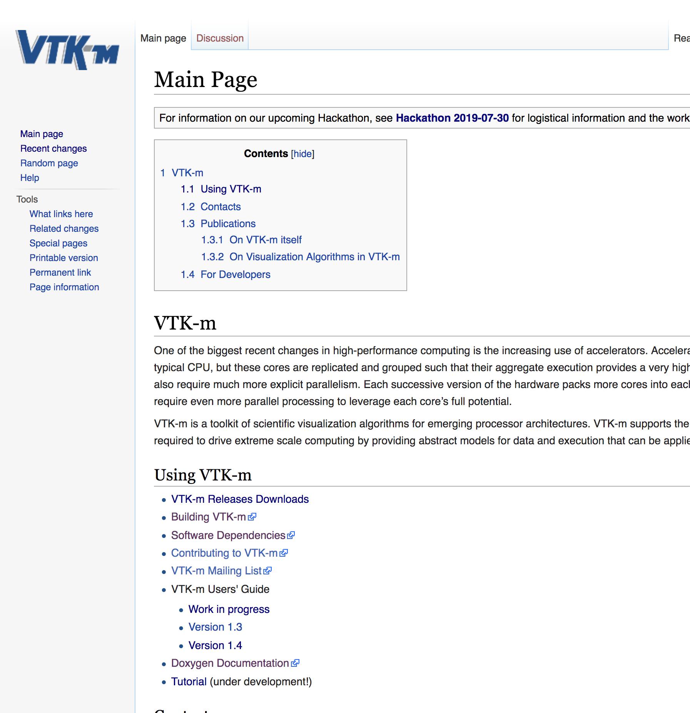
Download & build VTK-m
Find tutorial instructions:
  Go to m.vtk.org
  Click on “Tutorials” link
Follow instructions for VTK-m build:

Slide 13
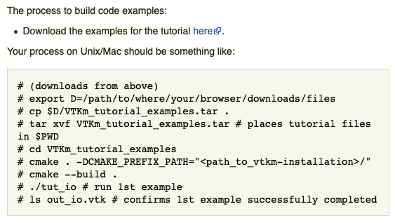
Build example code, run first project
(from webpage)

Slide 14
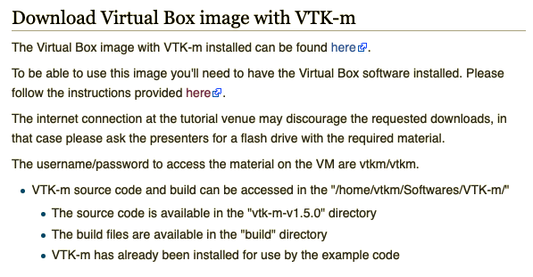
Download Virtual Box image
(from webpage)

Slide 15
VTK-m: Project Overview

Slide 16
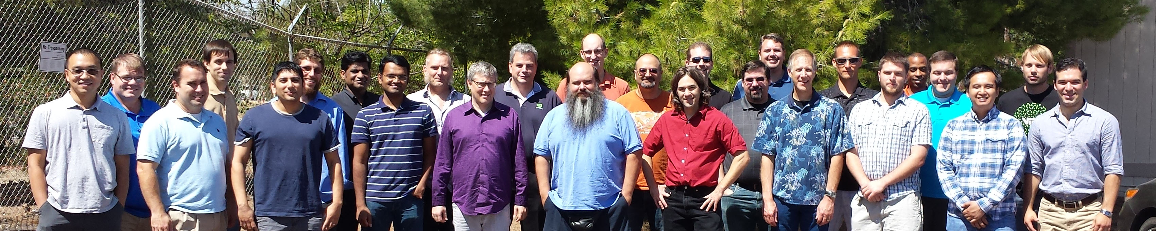
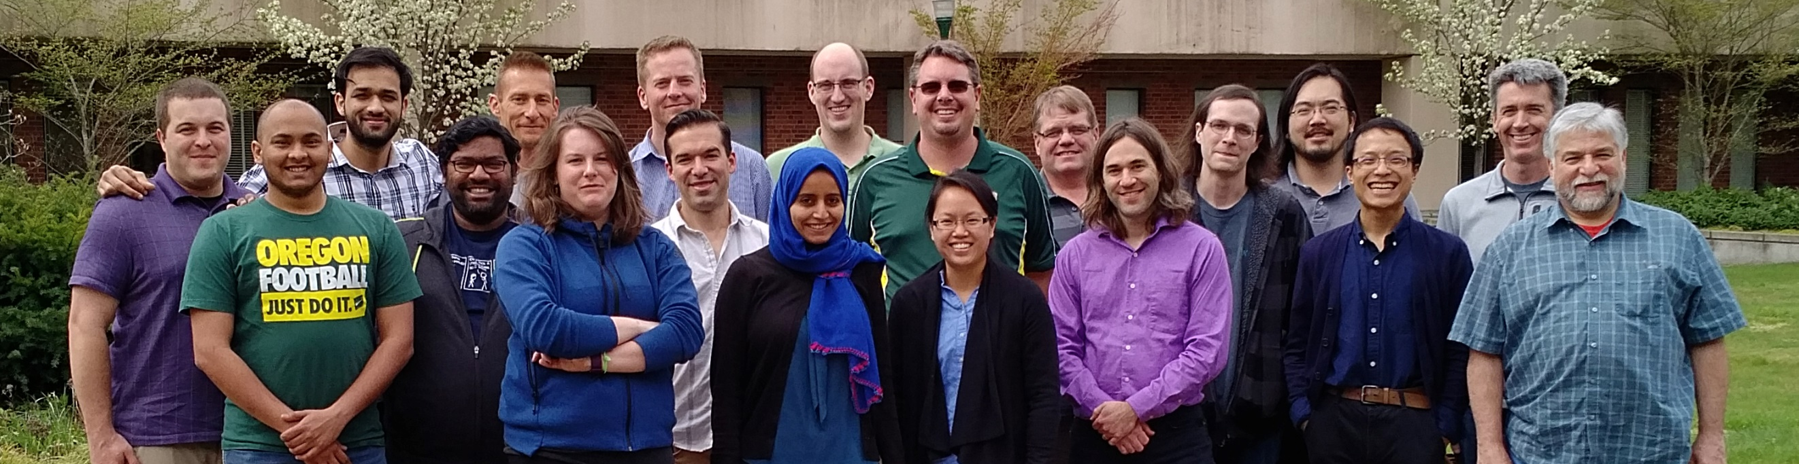
Big Picture
is a library for visualization and analysis on many-core devices
  Emphasis on platform portability: write once, use on different architectures
  Emphasis on performance: match performance of hardware-specific implementations
Who is making it?
  Developers of ParaView, VTK, and VisIt
    Will include pathways to these products
  Development hubs: Sandia, Oak Ridge, Los Alamos, Lawrence Livermore, Univ. of Oregon
  USA “Exascale Computing Project” funding ~$2M (US) per year towards project
2015 VTK-m Code Sprint (Livermore, CA, USA)
2017 VTK-m Code Sprint (Eugene, OR, USA)
2019 VTK-m Code Sprint (Albuquerque, USA): camera shy

Slide 17
VTK-m Use Cases / Benefits

Slide 18
VTK-m Use Cases
Usage:
  use VTK-m via ParaView, VisIt, Catalyst, LibSim, Ascent, etc.
  use VTK-m directly as a library
Development:
  Deploy algorithms that can be used by many people
  Do research on many-core visualization performance
  Do visualization research & want fast path to running on many-core devices

Slide 19
VTK-m Benefits – Users and Developers
Performance
  Optimized to perform well on many-core platforms
  Multiple peer-reviewed studies demonstrating comparable performance to hardware-specific implementations (next slide)
Future-proofing
  Support for a new hardware architecture is done by core VTK-m team
  Team is already funded to add support for popular upcoming accelerators
Supported
  documentation, mailing list, testing, etc. (next slide)
Community
  Open source
  Multiple development hubs

Slide 20
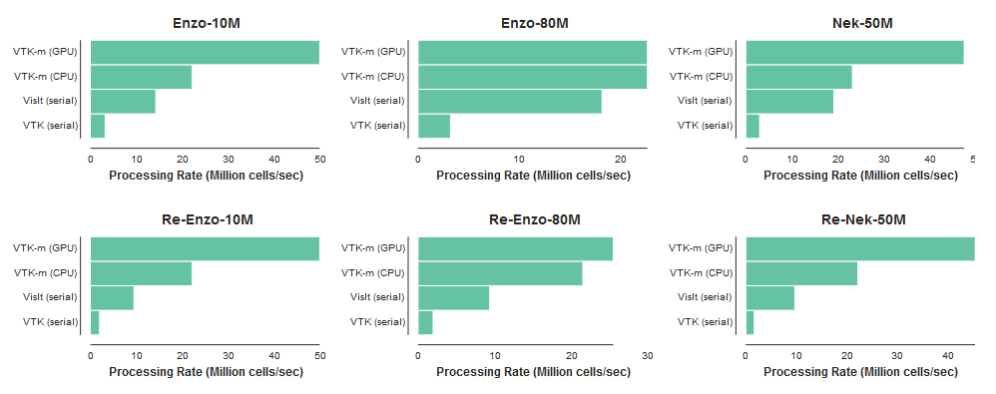
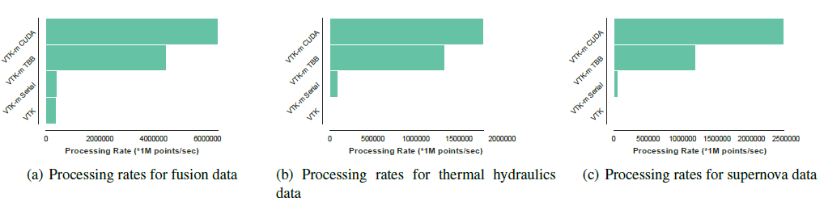
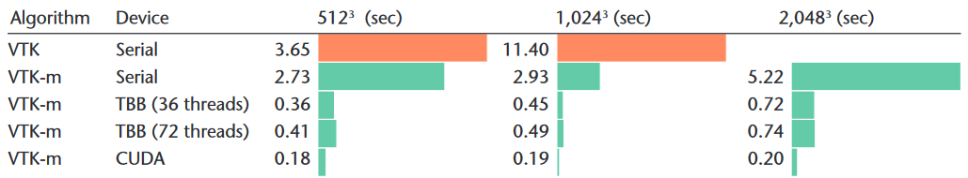
VTK-m benefits: significant investment in many-core performance
External Surface (bigger is better) Lessley, et al., “External Facelist Calculation with Data-Parallel Primitives,” 2016
Point Merging (bigger is better) Yenpure, et al., “Efficient Point Merging Using Data Parallel Techniques,” 2019
Particle Advection (bigger is better) Pugmire, et al., “Performance-Portable Particle Advection with VTK-m,” 2018
Surface Simplification (smaller is better) Moreland, et al., “VTK-m: Accelerating the Visualization Toolkit for Massively Threaded Applications, 2016

Slide 21
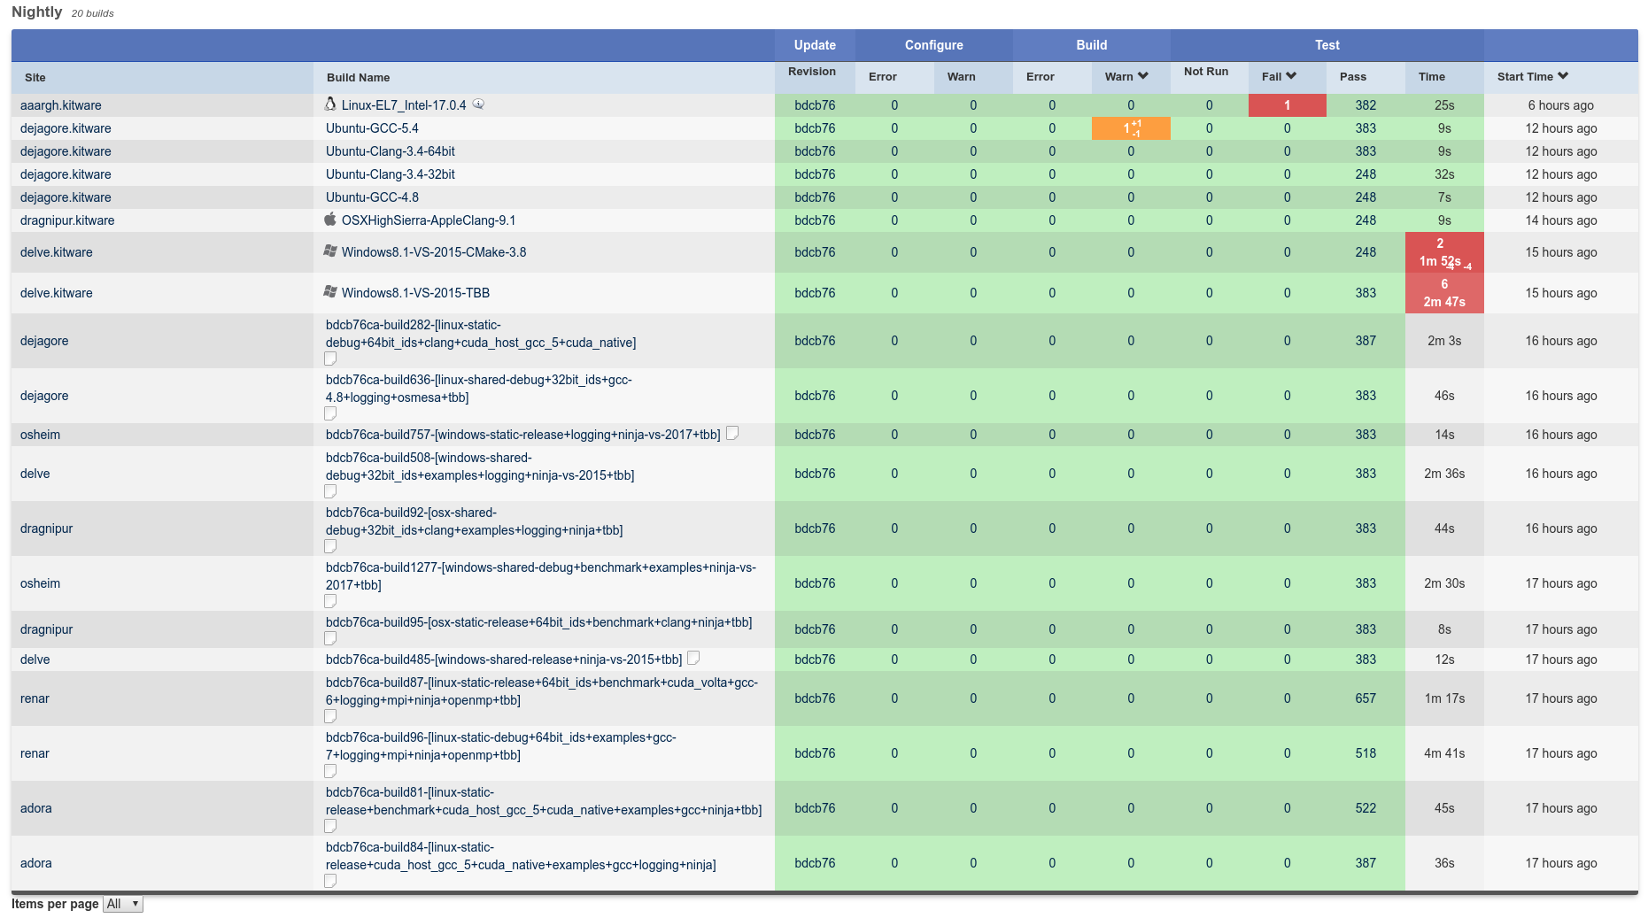
VTK-m benefit: heavy investment in software engineering --- revision control, documentation, testing, etc.

Slide 22
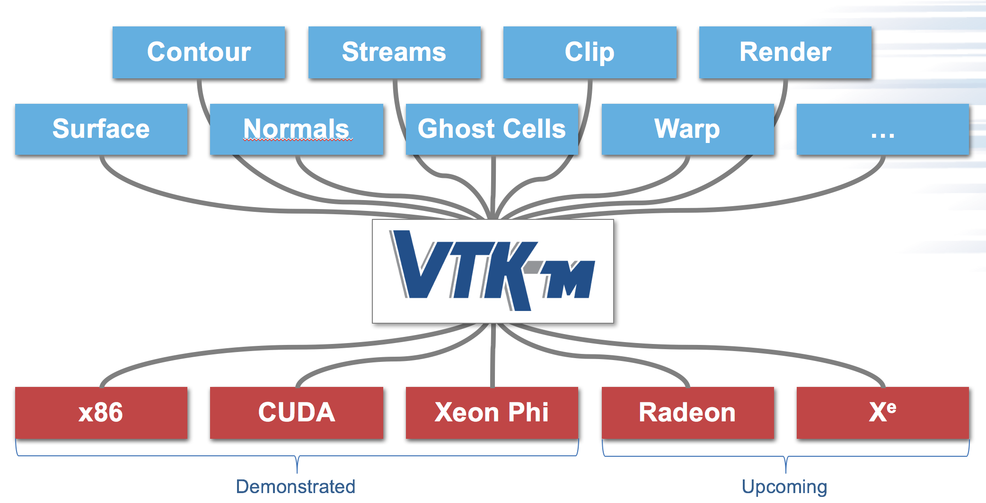
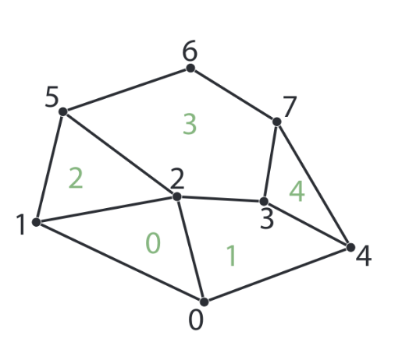
VTK-m Developer Benefits: During Algorithm Development
Write-once-use-anywhere
Visualization-specific parallel building blocks
  Common parallelism approaches are too simplistic for visualization algorithms (“parallel for”)
    Example: want to iterate over cells, but have to wrangle mesh topology to get field data on vertices
  VTK-m addresses this by providing visualization-specific parallel building blocks
Benefits:
  Faster development time
  Faster execution time (since parallel building blocks are highly optimized by core team)
When working on cell 2, data for vertices 1, 2, and 5 can be automatically delivered by VTK-m infrastructure

Slide 23
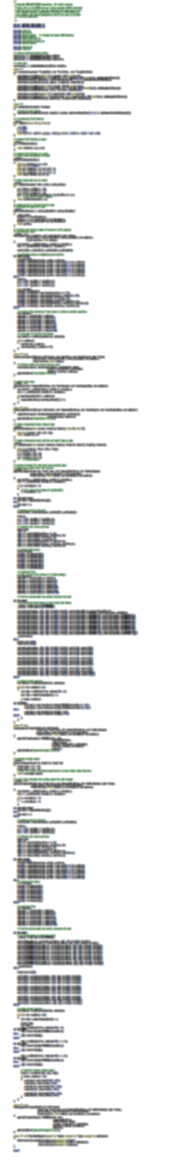
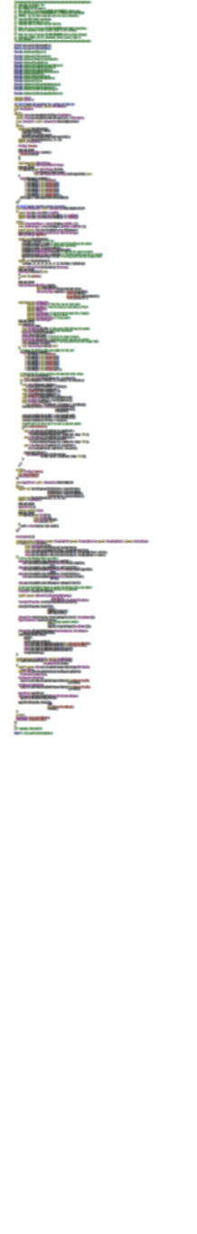
VTK-m Benefits – Specific to Developers
VTK-m
283 Lines
CUDA SDK
561 Lines
Notes:
The source code of Marching Cubes in three different packages. Case tables removed (all essentially the same).
CUDA SDK: marchingCubes_kernel.cu
VTK-m: IsosurfaceUniformGrid.h

Slide 24
VTK-m Benefits: After Developing an Algorithm
Future-proofing:
  when core VTK-m team adds support for a new hardware architecture, your algorithm code does not change
  Core VTK-m team regularly audits and improves performance on existing architectures

Slide 25
How VTK-m fits into current visualization software

Slide 26



Distributed
Parallelism
On Node
Parallelism

Slide 27
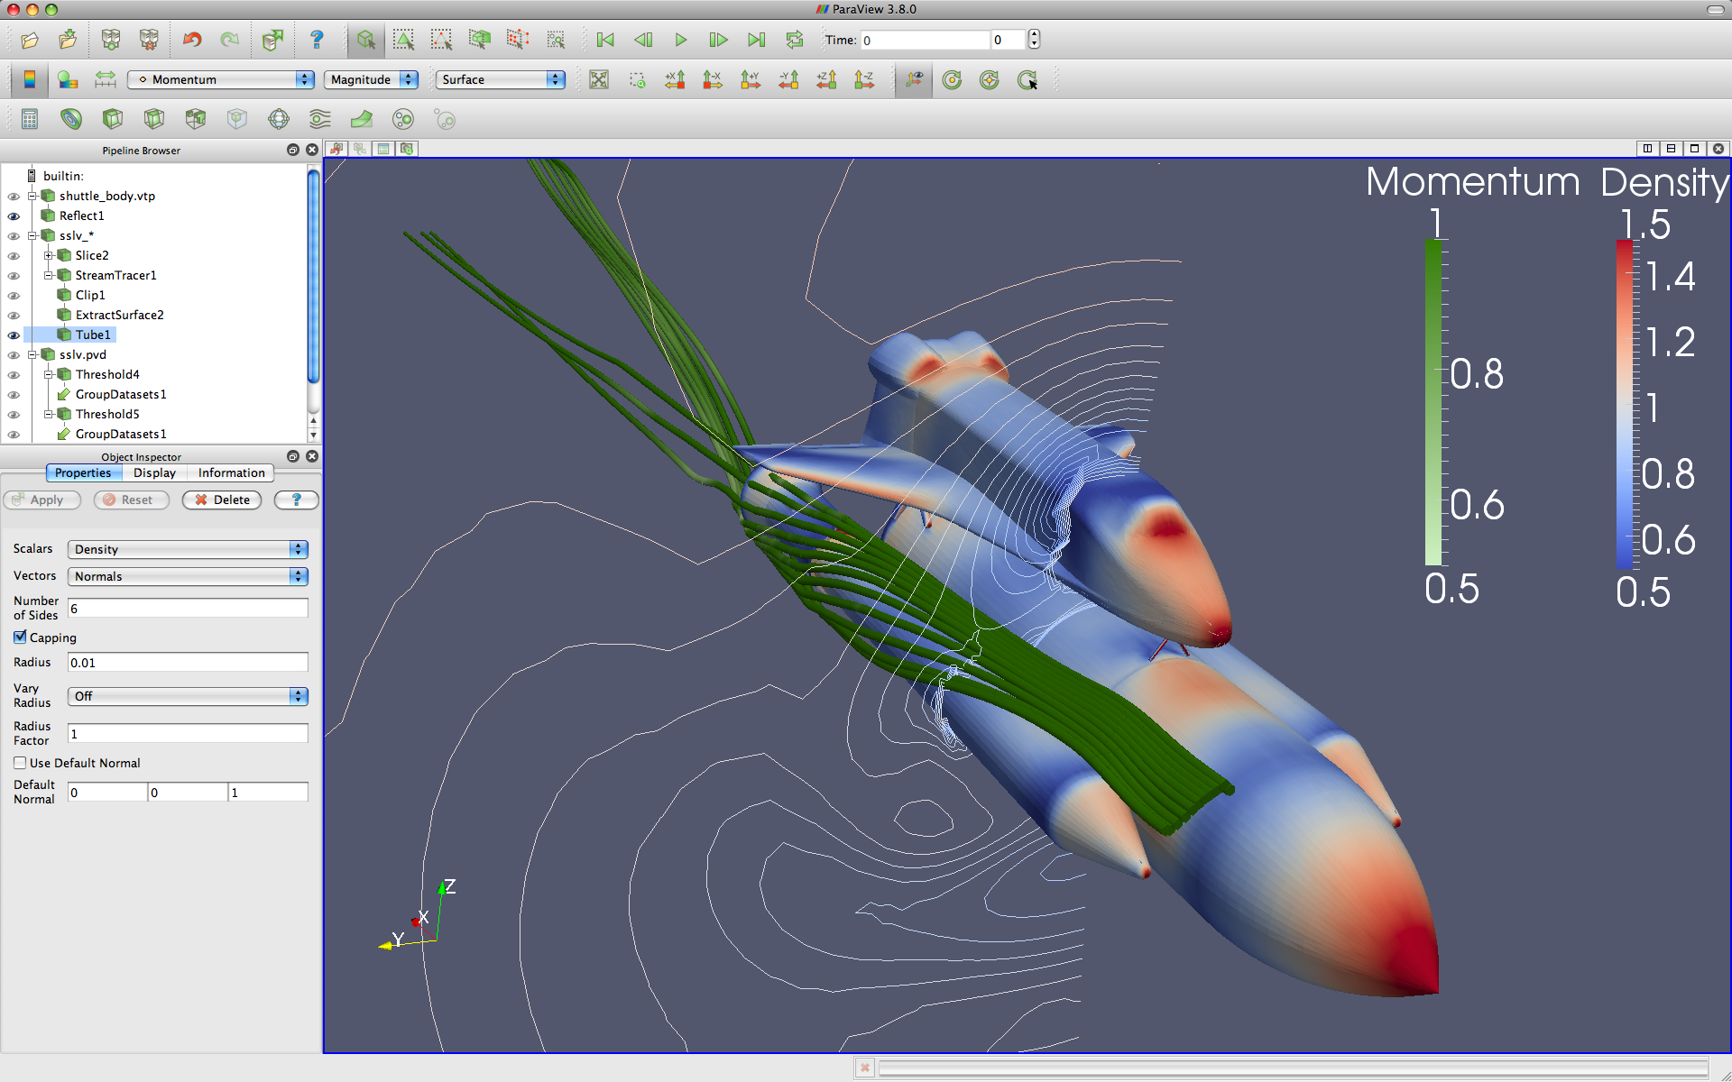



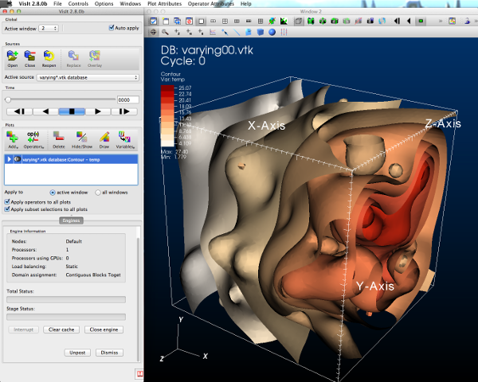



GUI / Parallel Management
In Situ Vis Library
(Integration with Sim)
Base Vis Library
(Algorithm Implementation)
Simulations
Libsim
Multithreaded Algorithms
Processor Portability

Slide 28

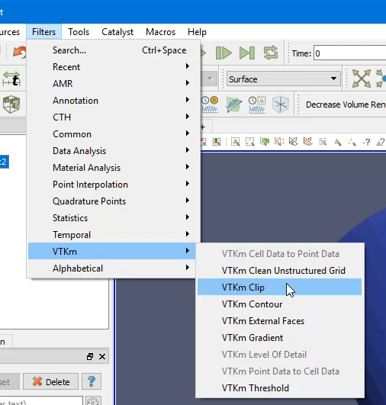
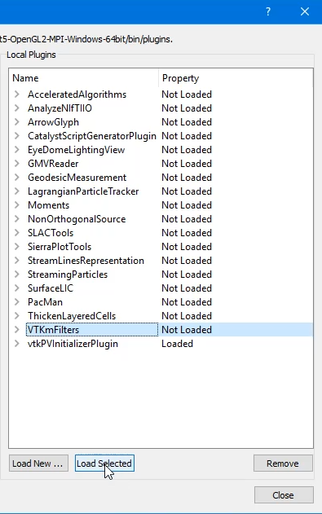
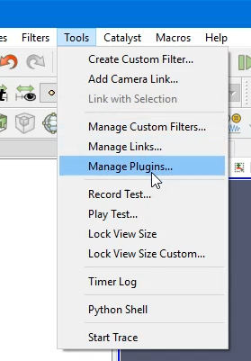
In ParaView
2. Use a VTK-m filter like any other
1. Load VTK-m Plugin
Slide Credit: Ken Moreland

Slide 29
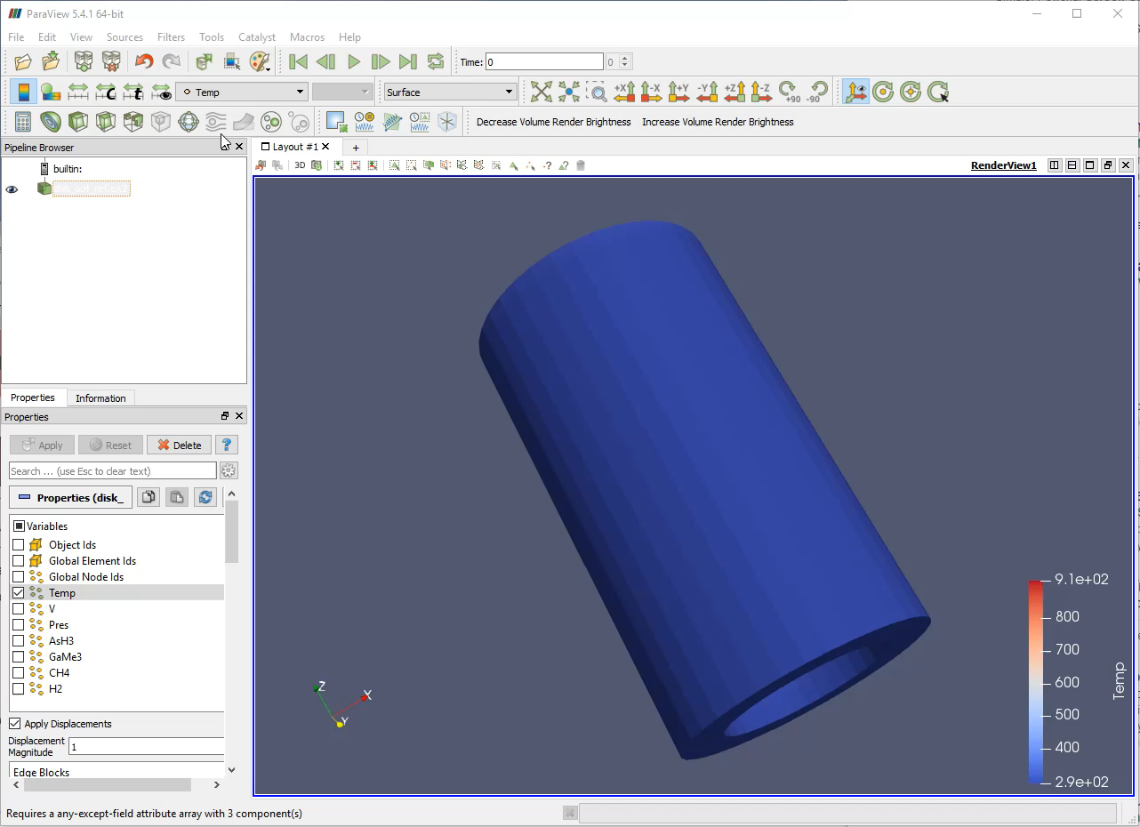
Slide Credit: Ken Moreland

Slide 30
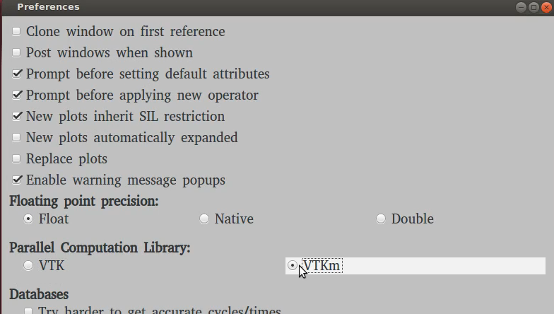
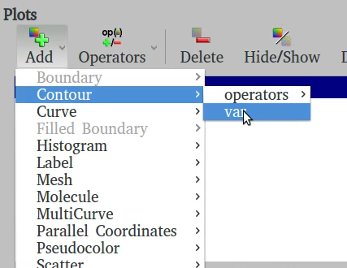
In VisIt
1. Turn on VTK-m in Preferences
2. Use VTK-m enabled plots as normal
Slide Credit: David Pugmire

Slide 31
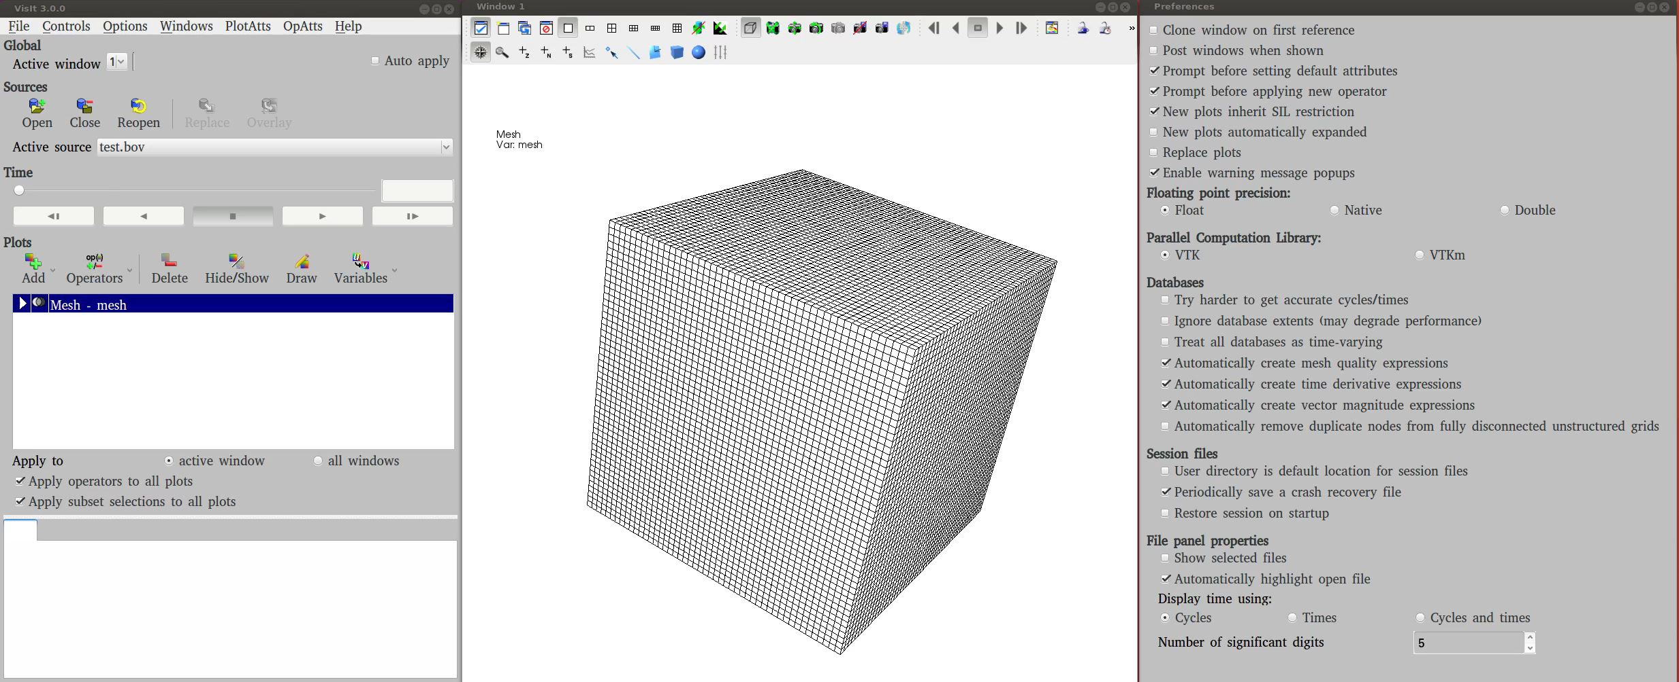
Slide Credit: David Pugmire

Slide 32

VTK-m is a critical part of USA Department of Energy visualization strategy
Apps
In situ
Infrastructure
In situ
Algorithms
Output/Artifacts
Post
Processing
ALPINE
New
Algorithms
ParaView
Cinema
VisIt
Libsim
Traditional
Algorithms
Traditional
Output
VisIt
Rendering
…
…
ParaView
Catalyst
Rover
VTKm

Slide 33
VTK-m: Quick Project Overview
Most of the details about the project will come in the remaining sections of the tutorial

Slide 34
Design of VTK-m
VTK-m split into two environments: control and execution
Each has its own API
Direct interaction between the environments is disallowed

Slide 35
Control Environment
API is for people that want to use VTK-m’s existing functionality
Used to:
  interface with applications
  interface with I/O devices
  schedule parallel execution of the algorithms
Code for the control environment is designed to run on a single thread per data block

Slide 36
Execution Environment
Where computational portion of algorithms are executed
Code for the execution environment is designed to always execute on a very large number of threads
VTK-m supports multiple parallel processing patterns
Each pattern is customized via a “worklet”
VTK-m algorithm developers decide which patterns to use and write worklets for these patterns
→ this is the subject of the tutorial after the break

Slide 37
Bridges between control and execution environments
Data!
  Need to refer to data in control environment, but have it accessible in execution environment
  Need to get results from execution environment back to control environment
  Key concept in VTK-m: Array Handles
Many-core device:
  Need to have control environment select which architecture execution environment should run on
  Need to have control environment invoke code on execution environment
  Key concept in VTK-m: Device Adaptors

Slide 38
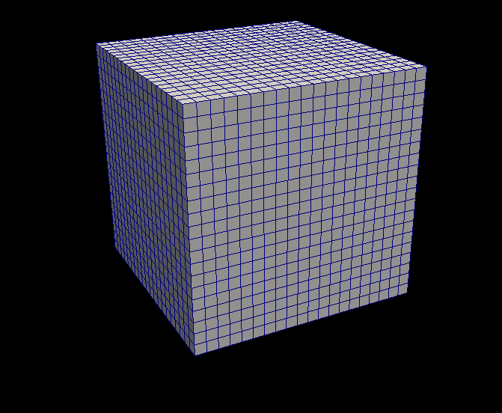
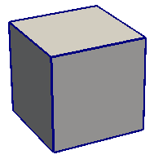
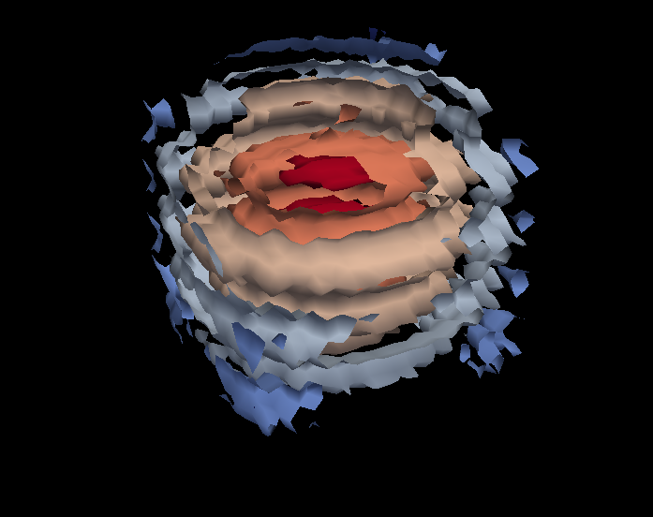
Control Environment
Grid Topology
Array Handle
Invoke
Execution Environment
Cell Operations
Field Operations
Basic Math
Make Cells
Device Adapter
Allocate
Transfer
Schedule
Sort
…
Worklet

Slide 39
Tutorial Schedule
25m
65m
30m
20m
60m
10m
Introduction / software install
Using VTK-m (+hands on)
Break
Concepts behind VTK-m development
3 VTK-m filters (description + hands on)
Discussion of upcoming activities / wrap up / Q&A

Slide 40
Our first program: tut_io.cxx
This is effectively a “copy” program for VTK files.
// Example 1: very simple VTK-m program.
// Read data set, write it out.
#include <vtkm/io/reader/VTKDataSetReader.h>
#include <vtkm/io/writer/VTKDataSetWriter.h>
int main()
{
const char *input = “data/kitchen.vtk";
vtkm::io::reader::VTKDataSetReader reader(input);
vtkm::cont::DataSet ds = reader.ReadDataSet();
vtkm::io::writer::VTKDataSetWriter writer("out_io.vtk");
writer.WriteDataSet(ds);
return 0;
}
Instantiate a module that reads VTK files.
Constructor takes a file name (“data/kitchen.vtk”).
Instruct the reader module to read the data set from the file.
The “ReadDataSet” method returns a vtkm DataSet.
Instantiate a module that writes VTK files.
Constructor takes a file name (“out_io.vtk”).
Instruct the writer module to write the data set to a file.
The “writeDataSet” method takes a vtkm DataSet.
Let’s run it!

Slide 41
➜ vtk-m-tutorial git:(master) ✗ make tut_io
Scanning dependencies of target tut_io
[ 50%] Building CXX object CMakeFiles/tut_io.dir/tut_io.cxx.o
[100%] Linking CXX executable tut_io
[100%] Built target tut_io
➜ vtk-m-tutorial git:(master) ✗ ls *.vtk
zsh: no matches found: *.vtk
➜ vtk-m-tutorial git:(master) ✗ ./tut_io
➜ vtk-m-tutorial git:(master) ✗ ls *.vtk
out_io.vtk
➜ vtk-m-tutorial git:(master) ✗ diff data/kitchen.vtk out_io.vtk
5,6c5
< DIMENSIONS 28 24 17
< POINTS 11424 float
---
> DIMENSIONS 28 24 17 POINTS 11424 float
Now let’s focus on smaller details of the program.

Slide 42
Our first program: tut_io.cxx
// Example 1: very simple VTK-m program.
// Read data set, write it out.
#include <vtkm/io/reader/VTKDataSetReader.h>
#include <vtkm/io/writer/VTKDataSetWriter.h>
int main()
{
const char *input = “data/kitchen.vtk";
vtkm::io::reader::VTKDataSetReader reader(input);
vtkm::cont::DataSet ds = reader.ReadDataSet();
vtkm::io::writer::VTKDataSetWriter writer("out_io.vtk");
writer.WriteDataSet(ds);
return 0;
}
Header files are organized hierarchically.
Let’s learn more about how the header files are organized

Slide 43
Organization of header files
Directory vtk-m-v1.5.0/vtkm has 10 subdirectories:
Directory | Theme | Type
cont/ | Control environment: base objects used to ‘cont’rol VTK-m | Beginning usage
filter/ | Contains filters | Beginning usage
io/ | I/O – readers and writers | Beginning usage
rendering/ | Rendering modules | Beginning usage
interop/ | Interoperation between GPGPU and OpenGL memory | Advanced usage
exec/ | Execution environment: “execution objects” needed for advanced development use cases for defining better data structures for worklets | Development
worklet/ | Worklets | Development
internal/ | Internals for VTK-m | Advanced development
testing/ | Unit tests | Advanced development
thirdparty/ | Third party libraries | Advanced development

Slide 44
Our first program: tut_io.cxx
// Example 1: very simple VTK-m program.
// Read data set, write it out.
#include <vtkm/io/reader/VTKDataSetReader.h>
#include <vtkm/io/writer/VTKDataSetWriter.h>
int main()
{
const char *input = “data/kitchen.vtk";
vtkm::io::reader::VTKDataSetReader reader(input);
vtkm::cont::DataSet ds = reader.ReadDataSet();
vtkm::io::writer::VTKDataSetWriter writer("out_io.vtk");
writer.WriteDataSet(ds);
return 0;
}
VTK-m makes heavy use of namespaces.
So what are the namespaces?
This means the type (class) VTKDataSetReader.
And VTKDataSetReader is within the “reader” namespace.
And reader is within the “io” namespace.
And io is within the “vtkm” namespace.

Slide 45
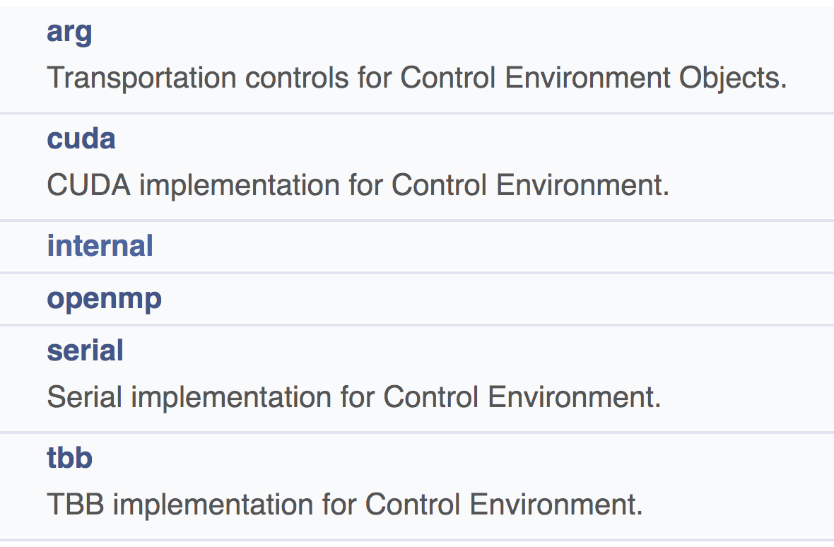
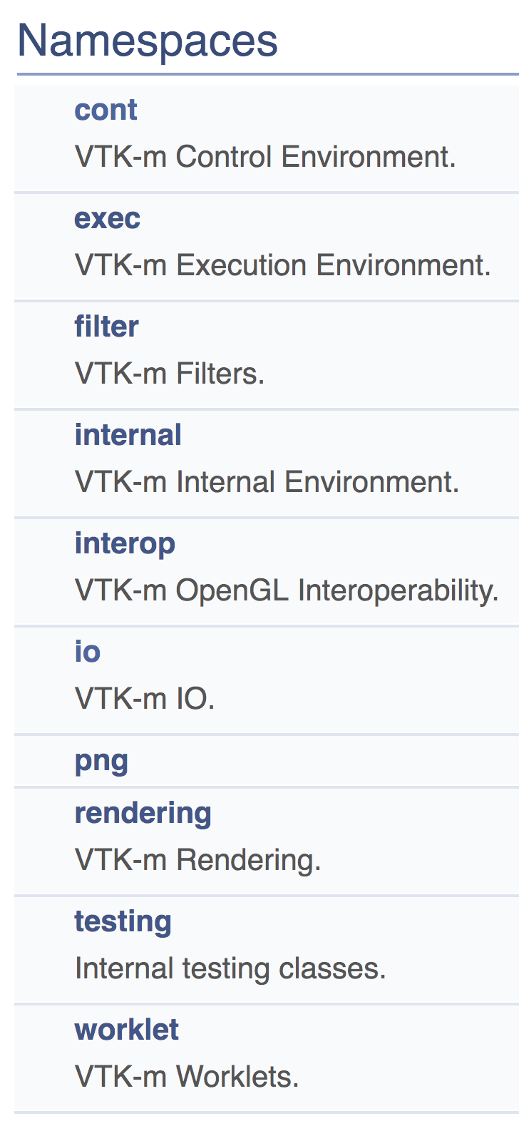
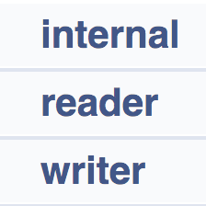
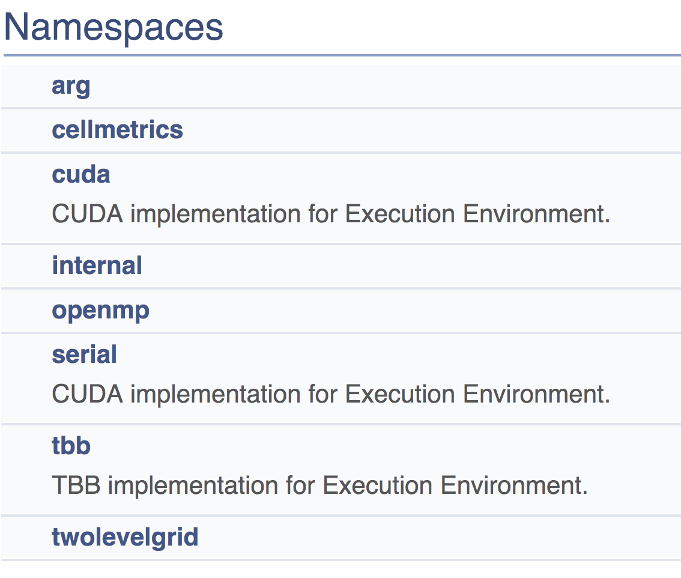
VTK-m namespaces
exec, filter, internal, interop, png, rendering, testing, and worklet contain zero or few namespaces

Slide 46
VTK-m namespaces
During Q&A at the end of this tutorial, we’d like feedback on how to make namespaces simpler.
exec, filter, internal, interop, png, rendering, testing, and worklet contain zero or few namespaces

Slide 47
Our first program: tut_io.cxx
This execution model is different than VTK.
VTK is demand-driven: “Update()” / “Execute()”
With VTK-m, certain calls prompt modules to Execute.
The user (you!) manages when things execute.
// Example 1: very simple VTK-m program.
// Read data set, write it out.
#include <vtkm/io/reader/VTKDataSetReader.h>
#include <vtkm/io/writer/VTKDataSetWriter.h>
int main()
{
const char *input = “data/kitchen.vtk";
vtkm::io::reader::VTKDataSetReader reader(input);
vtkm::cont::DataSet ds = reader.ReadDataSet();
vtkm::io::writer::VTKDataSetWriter writer("out_io.vtk");
writer.WriteDataSet(ds);
return 0;
}
ReadDataSet does I/O work when you call it.
DataSet ds is then resident in memory (on the execution device).
WriteDataSet does I/O work when you call it.

Slide 48
VTK-m Data Model

Slide 49
3 Fundamental Concepts for vtkm::cont::DataSet
Cell Set | Describes topological connections, i.e., how points connect to form cells
Fields | Describes numerical data associated with the topological elements in a cell set. e.g., scalars, vectors, etc.
Coordinate System | Describes a special field that describes physical locations

Slide 50
3 Fundamental Concepts for vtkm::cont::DataSet
Cell Set | Describes topological connections, i.e., how points connect to form cells
Fields | Describes numerical data associated with the topological elements in a cell set. e.g., scalars, vectors, etc.
Coordinate System | Describes a special field that describes physical locations

Slide 51
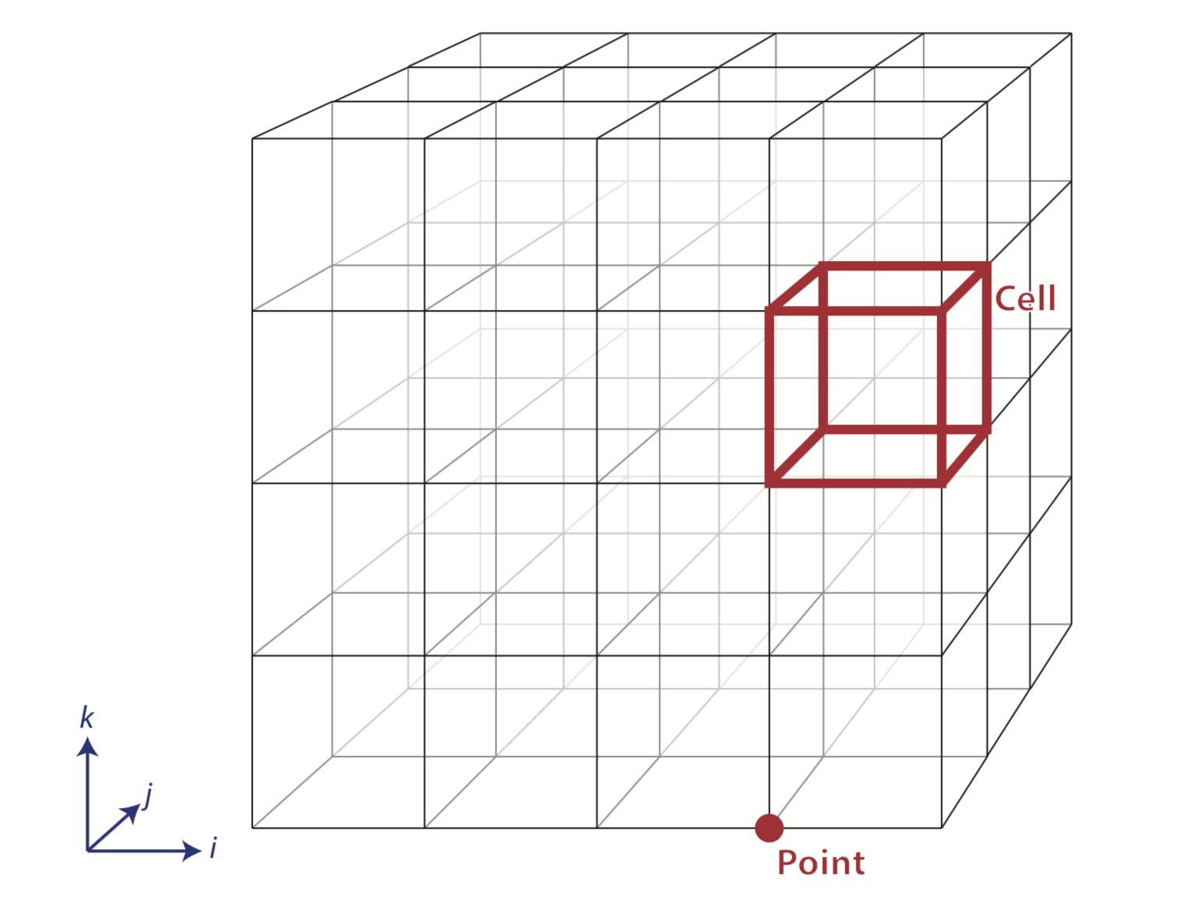
Types of Cell Sets (1/2):
Structured Cell Sets

Slide 52
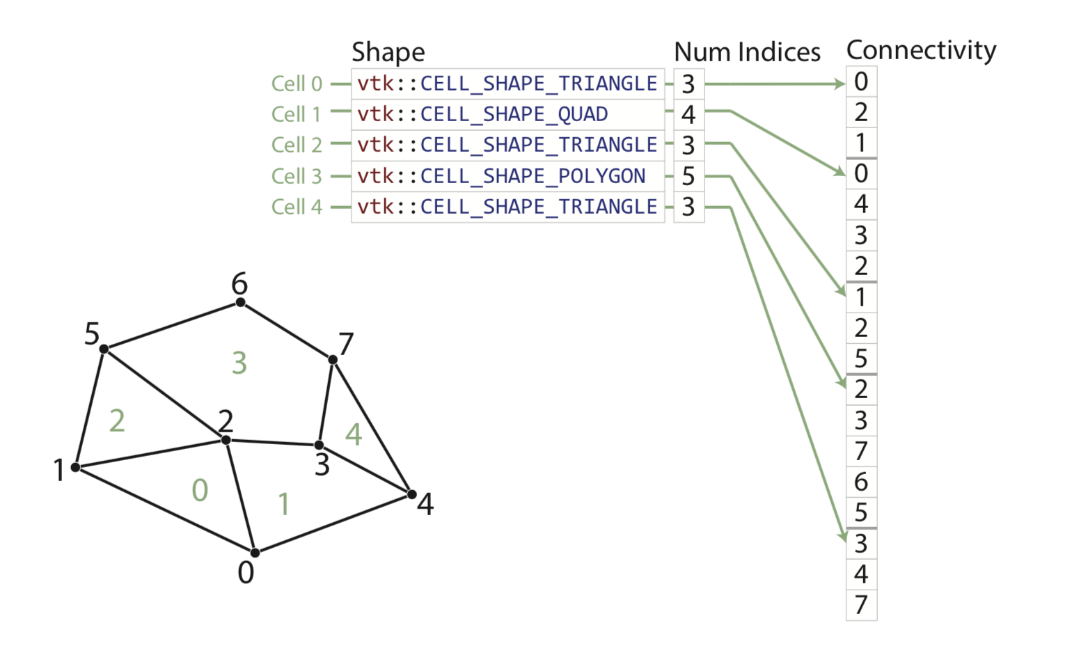
Types of Cell Sets (2.1/2.2.):
Explicit Cell Sets

Slide 53
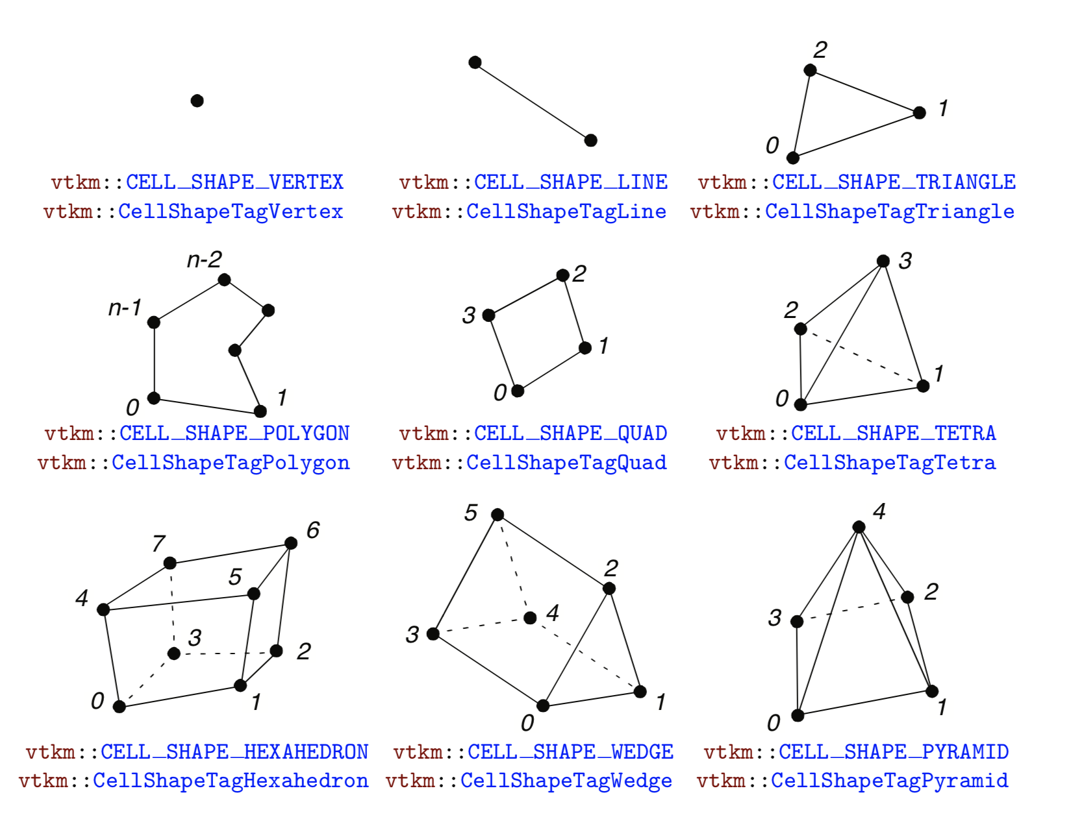
Types of Cell Sets (2.2/2.2):
Explicit Cell Sets – cell types

Slide 54
3 Fundamental Concepts for vtkm::cont::DataSet
Cell Set | Describes topological connections, i.e., how points connect to form cells
Fields | Describes numerical data associated with the topological elements in a cell set. e.g., scalars, vectors, etc.
Coordinate System | Describes a special field that describes physical locations

Slide 55
Fields
Field: provides a value on every point in space on the mesh
  Example: temperature, pressure, density, velocity
In VTK-m, vtkm::cont::Field
Implemented with Array Handles
  Array Handles were briefly described in the intro --- mechanism to have data live in execution environment and accessible via control environment

Slide 56
3 Fundamental Concepts for vtkm::cont::DataSet
Cell Set | Describes topological connections, i.e., how points connect to form cells
Fields | Describes numerical data associated with the topological elements in a cell set. e.g., scalars, vectors, etc.
Coordinate System | Describes a special field that describes physical locations

Slide 57
Coordinate Systems
Location of mesh’s elements (scivis use case)
3D vector at each point
vtkm::cont::CoordinateSystem class manages this
More details: need to know about ArrayHandles … tricks so that implicit point orderings don’t require a lot of storage

Slide 58
How many of each type for a single vtkm::cont::DataSet?
Concept | # for a given vtkm::cont::DataSet | Explanation
Cell Set | 1 | Always one
Fields | Any | 0 fields means there is no data on the mesh. Can be any number of fields. (Often ten or more.)
Coordinate System | 0, 1, or more | 0: no spatial locations (infovis) 1: typical >1: (example) geospatial data has 3D position, lat-long, multiple projections, etc.

Slide 59
3 Fundamental Concepts for vtkm::cont::DataSet
Cell Set | Describes topological connections, i.e., how points connect to form cells
Fields | Describes numerical data associated with the topological elements in a cell set. e.g., scalars, vectors, etc.
Coordinate System | Describes a special field that describes physical locations
+ two important notes:
  Helper functions to build data sets for you (see next slides)
  Also a vtkm::cont::PartitionedDataSet for partitioned (distributed) data

Slide 60
Creating VTK-m Data Sets (vtkm::cont::DataSet)
Structured data set
  Uniform data set
  Rectilinear data set
Explicit data set

Slide 61
Creating VTK-m Data Sets (vtkm::cont::DataSet)
Structured data set
  Uniform data set
  Rectilinear data set
Explicit data set

Slide 62
Creating Uniform Data Set: Zero Origin, Unit Spacing
#include <vtkm/cont/DataSet.h>
#include <vtkm/cont/DataSetBuilderUniform.h>
int main()
{
vtkm::cont::DataSetBuilderUniform dataSetBuilder;
// Create a data set with dimensions of 101^3.
// This dataset will contain 101^3 points and 100^3 cells
vtkm::Id3 dimensions(101, 101, 101);
vtkm::cont::DataSet dataSet = dataSetBuilder.Create(dimensions);
return 0;
}
Note : Uniform datasets are created using vtkm::cont::DataSetBuilderUniform
Specify required parameters for generating the required uniform data set.
1 arguments needed : dimensions
Here, origin is assumed (0, 0, 0)
and spacing is (1, 1, 1)

Slide 63
Creating Uniform Data Set: Non-Zero Origin, Custom Spacing
#include <vtkm/cont/DataSet.h>
#include <vtkm/cont/DataSetBuilderUniform.h>
int main()
{
vtkm::cont::DataSetBuilderUniform dataSetBuilder;
// Create a data set with dimensions of 101^3.
// This dataset will contain 101^3 points and 100^3 cells.
// We have a custom origin and spacing for this data set.
vtkm::Id3 dimensions(101, 101, 101);
vtkm::Vec<vtkm::FloatDefault, 3> origin(-50.0, -50.0, -50.0);
vtkm::Vec<vtkm::FloatDefault, 3> spacing(1.0, 1.0, 1.0);
vtkm::cont::DataSet dataSet = dataSetBuilder.Create(dimensions, origin, spacing);
return 0;
}
Specify required parameters for generating the required uniform data set.
3 arguments needed : dimensions, spacing, and origin

Slide 64
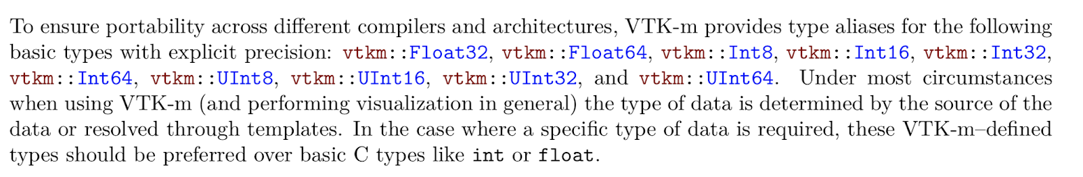
vtkm::Id3 dimensions(101, 101, 101);
vtkm::Vec<vtkm::FloatDefault, 3> origin(-50.0, -50.0, -50.0);
vtkm::Vec<vtkm::FloatDefault, 3> spacing(1.0, 1.0, 1.0);
vtkm::cont::DataSet dataSet = dataSetBuilder.Create(dimensions, origin, spacing);

Slide 65
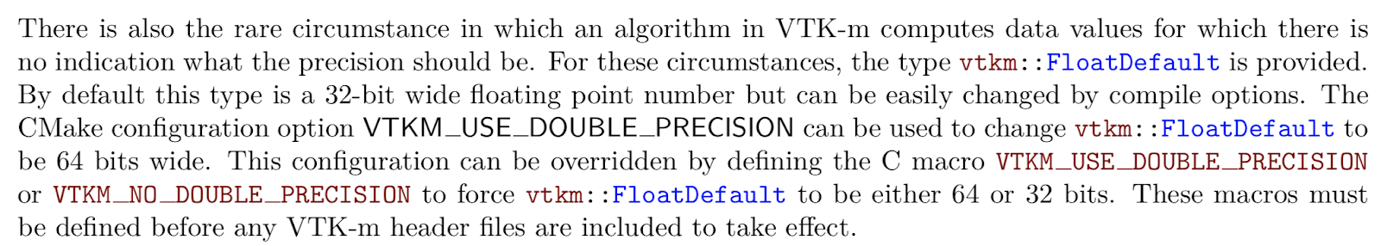
vtkm::Id3 dimensions(101, 101, 101);
vtkm::Vec<vtkm::FloatDefault, 3> origin(-50.0, -50.0, -50.0);
vtkm::Vec<vtkm::FloatDefault, 3> spacing(1.0, 1.0, 1.0);
vtkm::cont::DataSet dataSet = dataSetBuilder.Create(dimensions, origin, spacing);

Slide 66
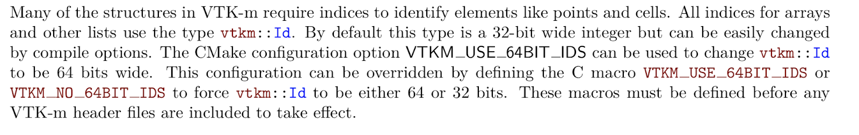
vtkm::Id3 dimensions(101, 101, 101);
vtkm::Vec<vtkm::FloatDefault, 3> origin(-50.0, -50.0, -50.0);
vtkm::Vec<vtkm::FloatDefault, 3> spacing(1.0, 1.0, 1.0);
vtkm::cont::DataSet dataSet = dataSetBuilder.Create(dimensions, origin, spacing);

Slide 67
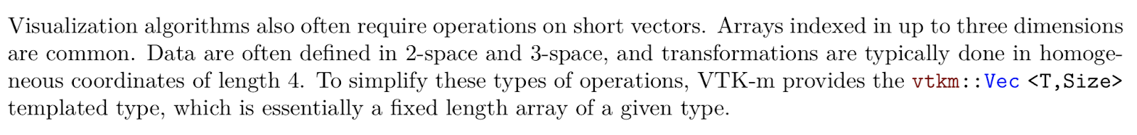
vtkm::Id3 dimensions(101, 101, 101);
vtkm::Vec<vtkm::FloatDefault, 3> origin(-50.0, -50.0, -50.0);
vtkm::Vec<vtkm::FloatDefault, 3> spacing(1.0, 1.0, 1.0);
vtkm::cont::DataSet dataSet = dataSetBuilder.Create(dimensions, origin, spacing);
→ vtkm::Vec3f

Slide 68
Creating VTK-m Data Sets (vtkm::cont::DataSet)
Structured data set
  Uniform data set
  Rectilinear data set
Explicit data set

Slide 69
Creating a Rectilinear Data Set
Note : Rectilinear datasets are created using vtkm::cont::DataSetBuilderRectilinear
vtkm::cont::DataSetBuilderRectilinear dataSetBuilderRectilinear;
// Create a dataset by providing X, Y, and Z locations.
// The data set builder builds creates points as the cartesian
// product of these X, Y, and Z locations.
std::vector<vtkm::FloatDefault> xCoords;
std::vector<vtkm::FloatDefault> yCoords;
std::vector<vtkm::FloatDefault> zCoords;
// Make x coordinates range from -4 to 4 with tighter spacing near 0
for(vtkm::Float32 x = -2.0f; x <= 2.0f; x += 0.02f)
{
xCoords.push_back(vtkm::CopySign(x * x, x));
}
// Make y coordinates range from 0 to 2 with tighter spacing near 2
for(vtkm::Float32 y = 0.0f; y <= 4.0f; y += 0.02f)
{
yCoords.push_back(vtkm::Sqrt(y));
}
// Make z coordinates range from -1 to 1 with even spacing
for(vtkm::Float32 z = -1.0f; z <= 1.0f; z += 0.02f)
{
zCoords.push_back(z);
}
vtkm::cont::DataSet dataset = dataSetBuilderRectilinear.Create(xCoords, yCoords, zCoords);
Specify required parameters for generating the required rectilinear data set.
3 arguments needed :
x, y, and z coordinates provided in std::vector

Slide 70
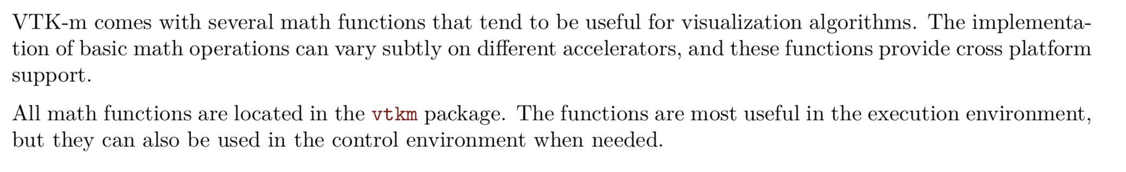
Creating a Rectilinear Data Set
for(vtkm::Float32 x = -2.0f; x <= 2.0f; x += 0.02f)
{
xCoords.push_back(vtkm::CopySign(x * x, x));
}
for(vtkm::Float32 y = 0.0f; y <= 4.0f; y += 0.02f)
{
yCoords.push_back(vtkm::Sqrt(y));
}

Slide 71
Create and Add Fields to Data Set
vtkm::cont::DataSetBuilderUniform dataSetBuilder;
const vtkm::Id3 pointDimensions(20, 20, 20);
vtkm::cont::DataSet dataSet = dataSetBuilder.Create(dimensions);
vtkm::cont::DataSetFieldAdd dataSetFieldAdd;
// Create a field that identifies points on the boundary
std::vector<vtkm::UInt8> boundaryPoints;
for(vtkm::Id z = 0; z < pointDimensions[2]; z++)
{
for(vtkm::Id y = 0; y < pointDimensions[1]; y++)
{
for(vtkm::Id x = 0; x < pointDimensions[0]; x++)
{
if( (x == 0 || x == pointDimensions[0] - 1 ) ||
(y == 0 || y == pointDimensions[1] - 1 ) ||
(z == 0 || z == pointDimensions[2] - 1 ))
{
boundaryPoints.push_back(1);
}
else
{
boundaryPoints.push_back(0);
}
}
}
}
dataSetFieldAdd.AddPointField(dataset, "boundary_points", boundaryPoints);
Note : Point and Cell fields are added using the class vtkm::cont::DataSetFieldAdd
Specify required parameters to add the new field to data set.
Note: For cell fields use AddCellField
3 arguments needed :
dataset, field name, and field data

Slide 72
Creating VTK-m Data Sets (vtkm::cont::DataSet)
Structured data set
  Uniform data set
  Rectilinear data set
Explicit data set

Slide 73
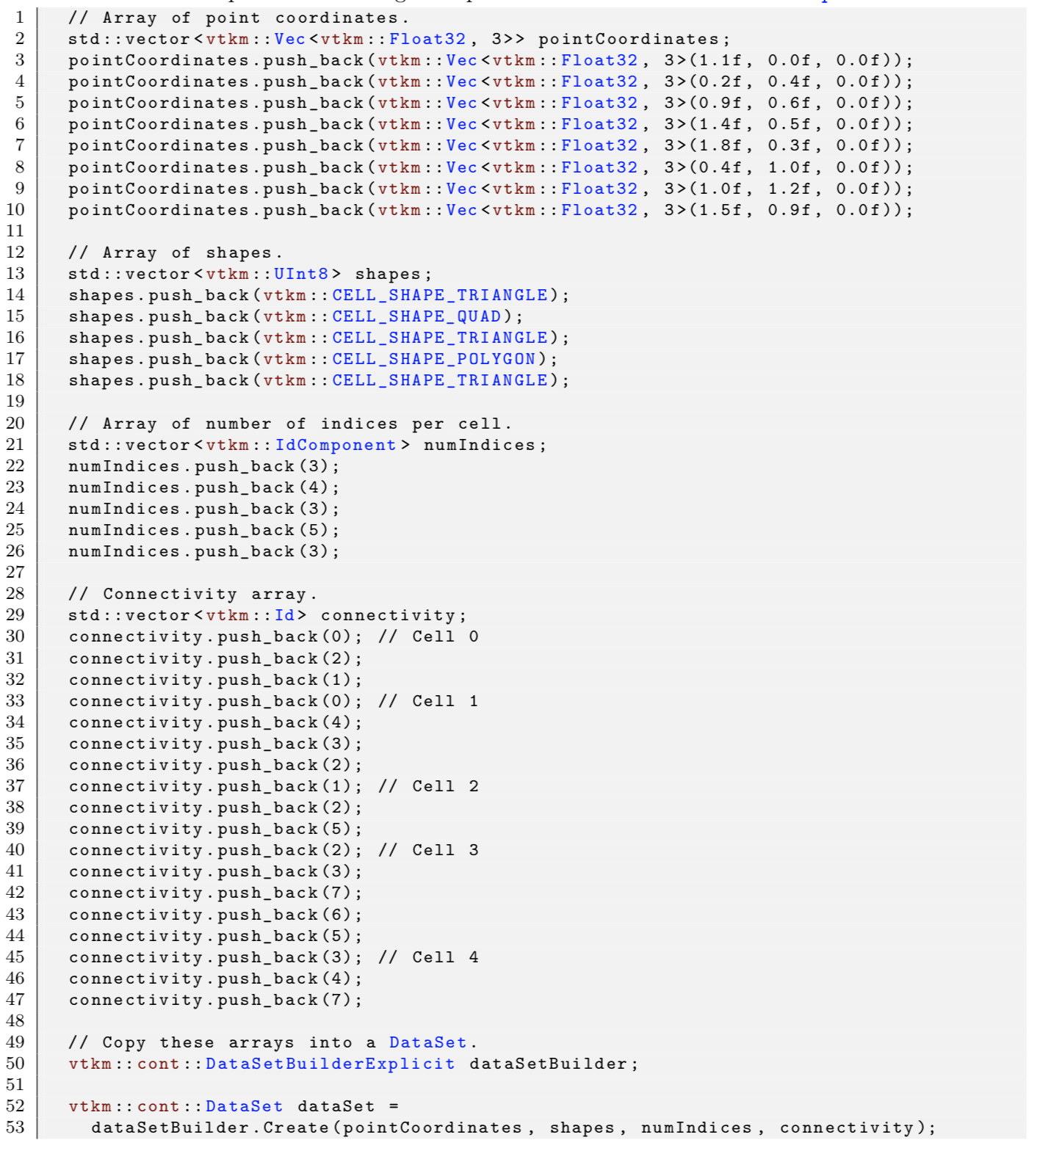
Create Unstructured Grids With vtkm::cont::
DataSetBuilderExplicit
(SEE MANUAL)

Slide 74
VTK-m Filters

Slide 75
VTK-m Filters
What is a filter?
  definition #1: encodes an algorithm
  definition #2: modules that take data as input and create new data as output
      Data type is always vtkm::cont::DataSet (or its cousin for “multi-block”)
Methods:
  Many methods for setting algorithm parameters (e.g., set isovalues for contouring algorithm)
  Execute(): input is passed as argument(s) and output is returned by function call
    Again: this is different than VTK’s Update()/Execute()
  Note: must set algorithm parameters before calling Execute()
    It does the work when Execute() is called
Let’s consider a simple example.

Slide 76
Our second program: tut_mc.cxx
// Example 2: do a contour!, write it out.
#include <vtkm/io/reader/VTKDataSetReader.h>
#include <vtkm/io/writer/VTKDataSetWriter.h>
#include <vtkm/filter/Contour.h>
int main()
{
const char *input = “data/kitchen.vtk";
vtkm::io::reader::VTKDataSetReader reader(input);
vtkm::cont::DataSet ds_from_file = reader.ReadDataSet();
vtkm::filter::Contour contour;
contour.SetActiveField("c1");
contour.SetNumberOfIsoValues(3);
contour.SetIsoValue(0, 0.05);
contour.SetIsoValue(1, 0.10);
contour.SetIsoValue(2, 0.15);
vtkm::cont::DataSet ds_from_mc = contour.Execute(ds_from_file);
vtkm::io::writer::VTKDataSetWriter writer("out_mc.vtk");
writer.WriteDataSet(ds_from_mc);
return 0;
}
Include header for Contour filter
Same as before: read from file
Contour is in the filter namespace
Set parameters: isosurface by field “c1” and use isovalues 0.05, 0.10, and 0.15.
Explicitly force execution
Same as before: write to file

Slide 77
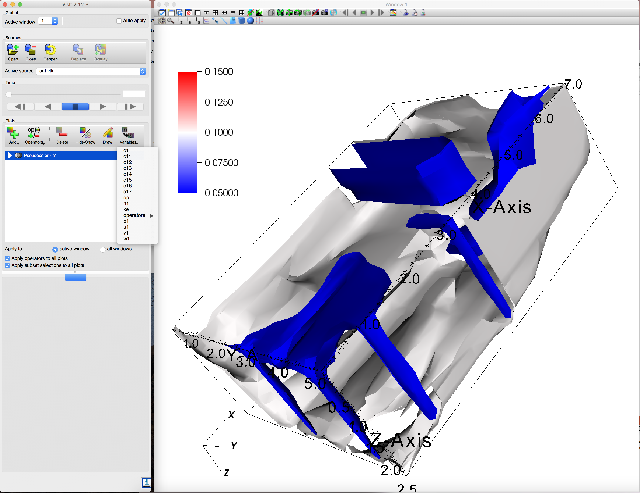
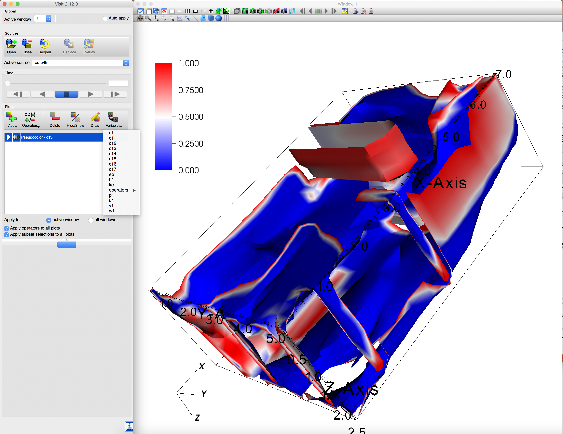
kitchen.vtk contains many fields
Each of these fields was interpolated onto the isosurface
Many fields written to out_mc.vtk
Field c1 (isosurfaces at c1 == 0.05, 0.1, 0.15)
Field c13 (isosurfaces at c1 == 0.05, 0.1, 0.15)

Slide 78
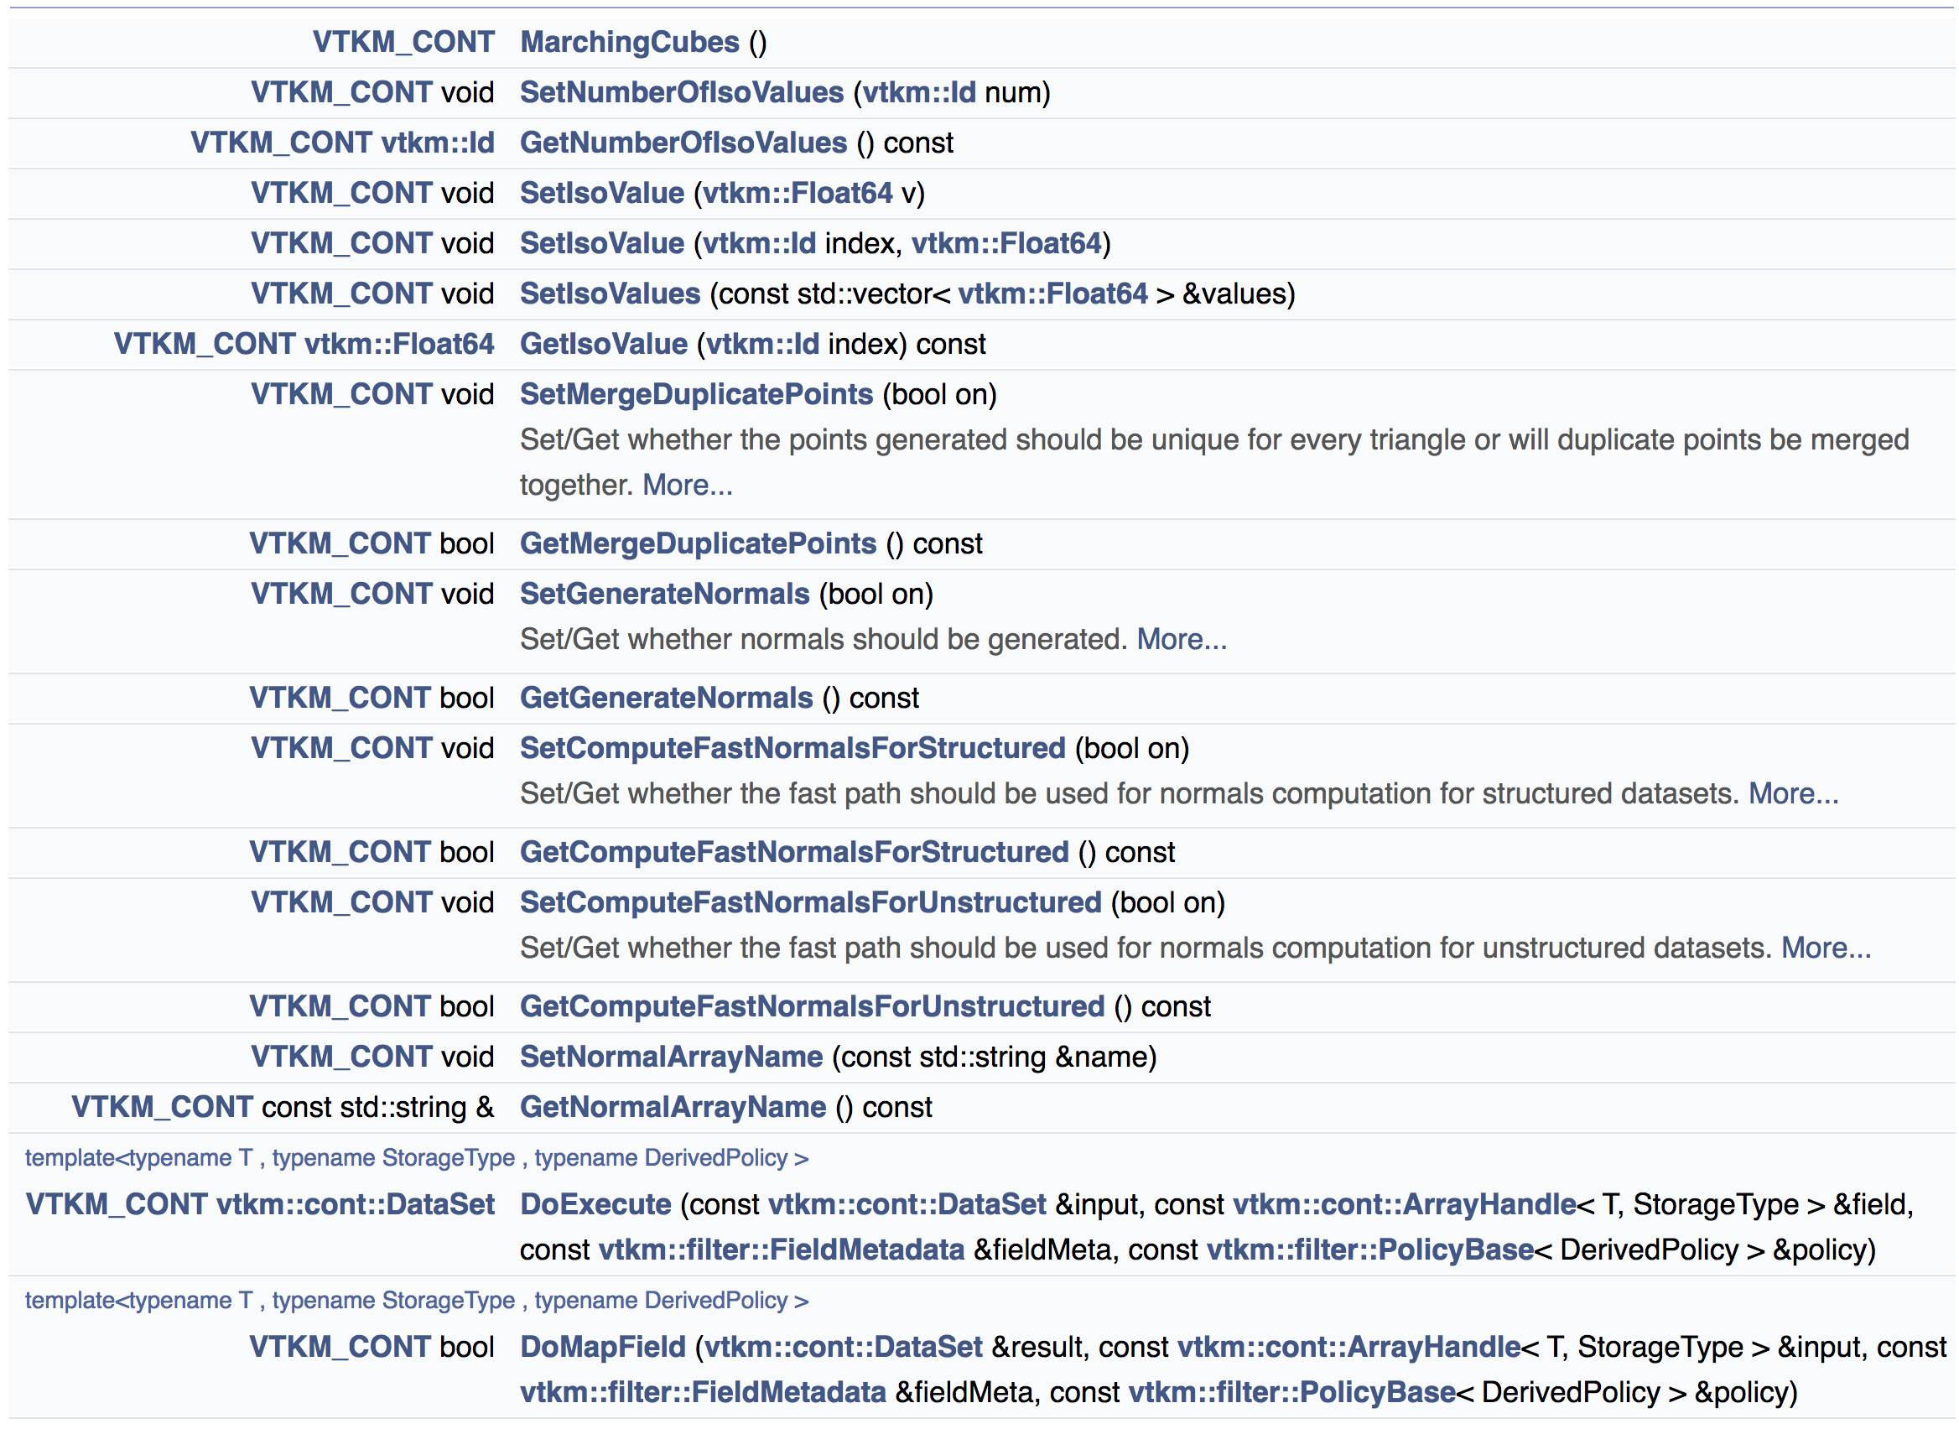
Each filter has many attributes, which can be set by calling methods before Execute()
Methods for
Contour

Slide 79
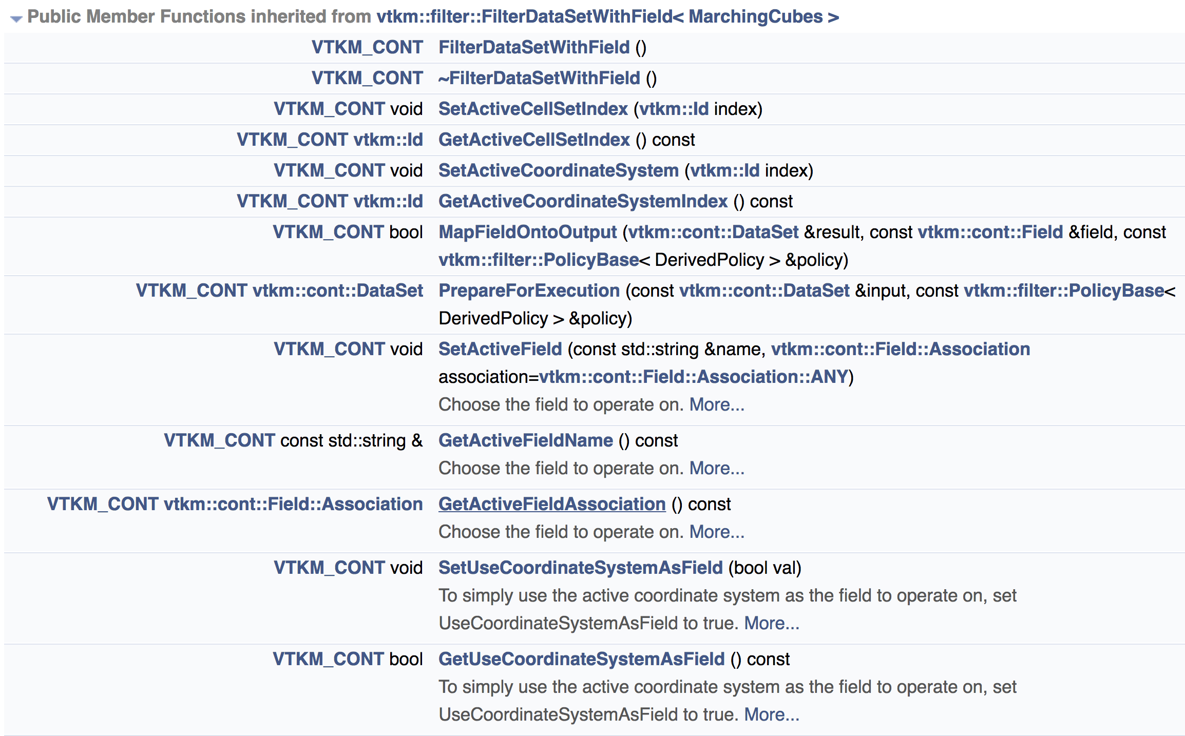
Each filter has many attributes, which can be set by calling methods before Execute()
Methods from
Contour’s base class
(1/2)

Slide 80
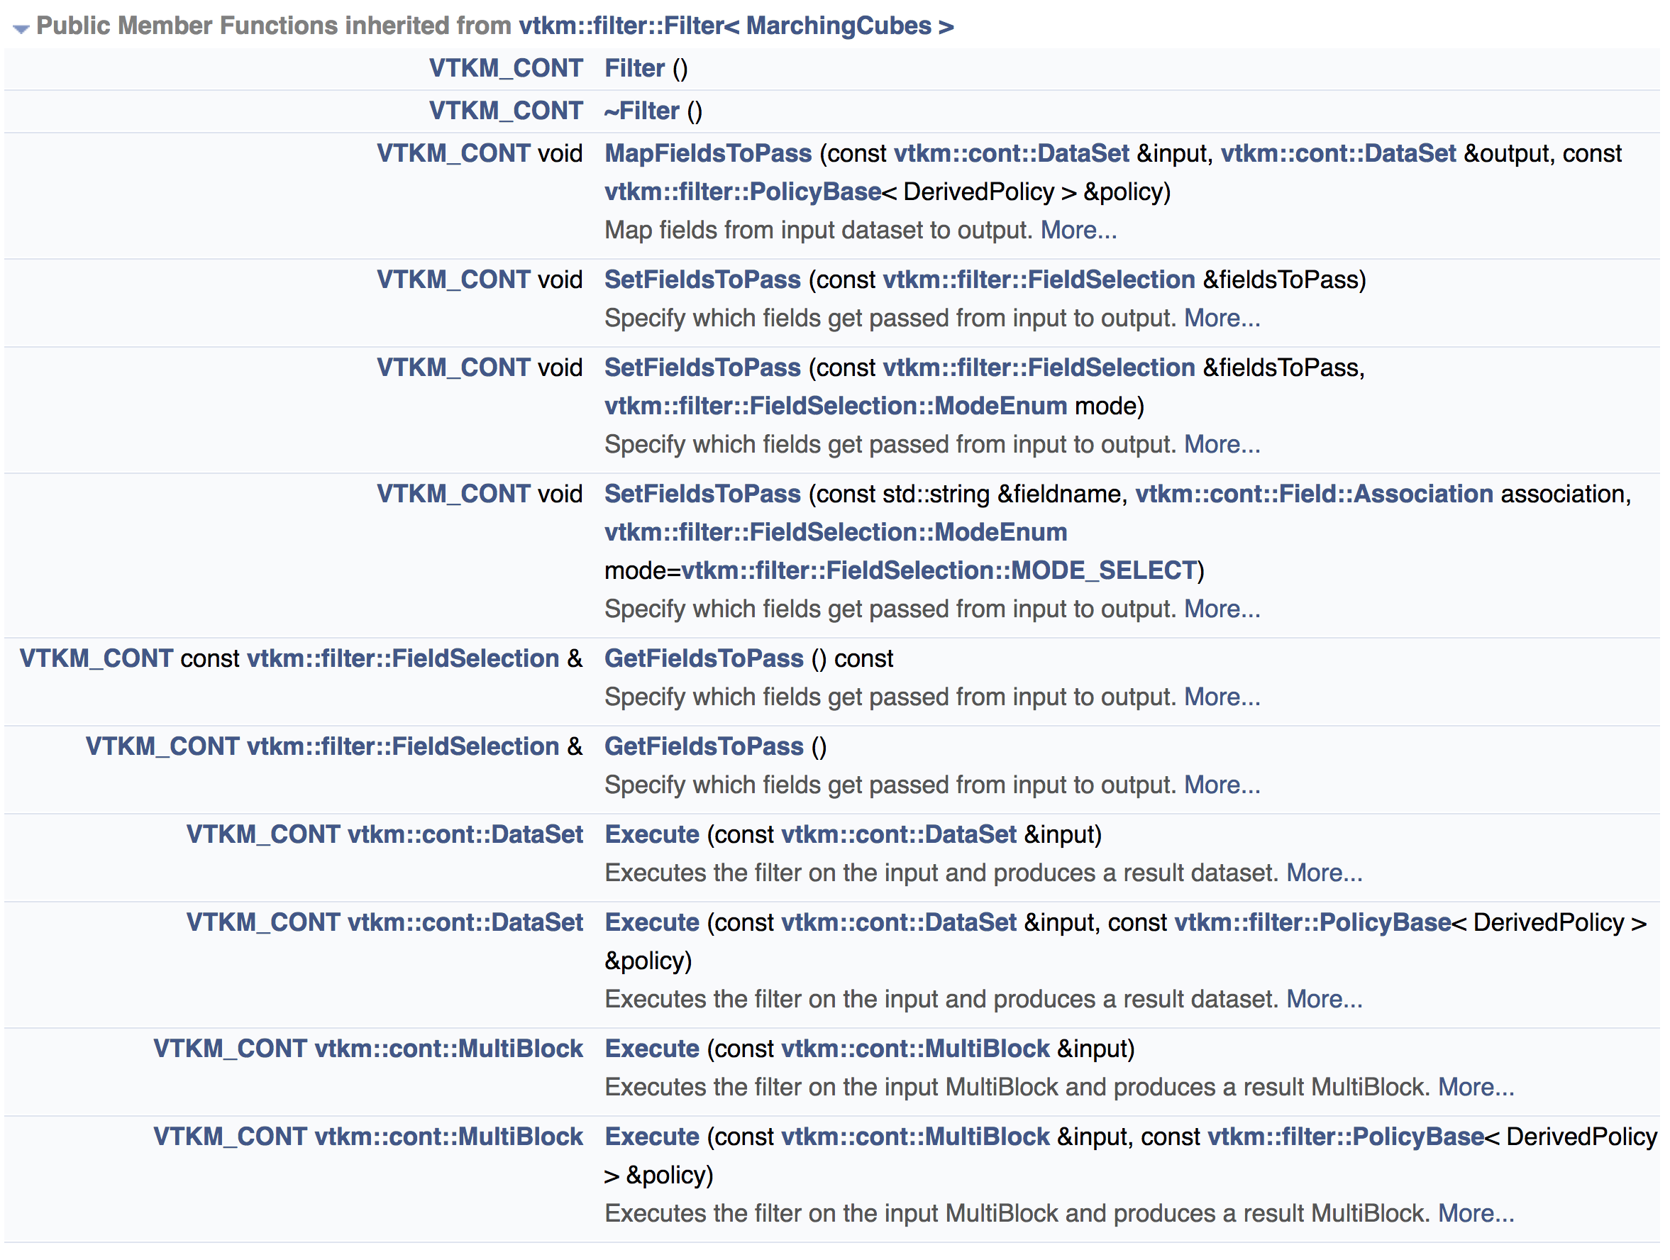
Each filter has many attributes, which can be set by calling methods before Execute()
Methods from
Contour’s base class
(2/2)
Let’s use this
But how to learn more?

Slide 81
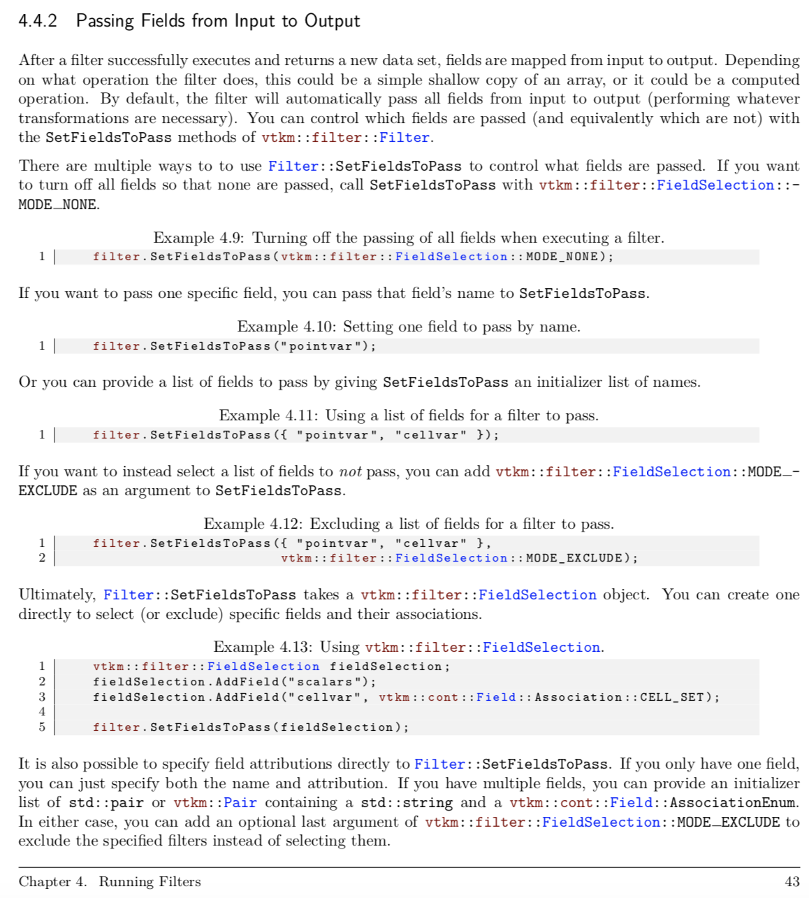
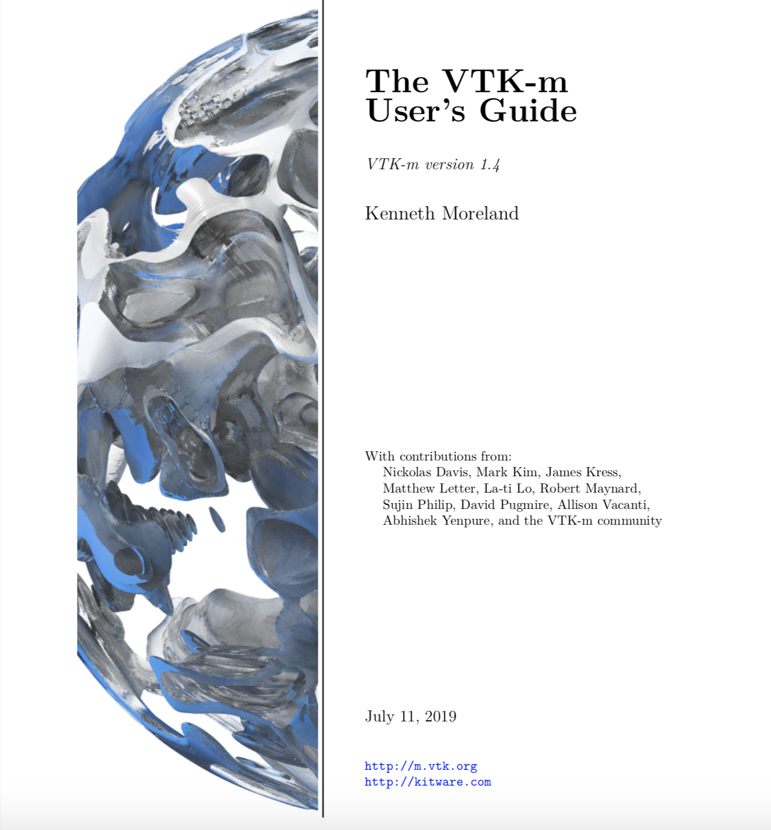
User’s Guide has extensive documentation
TOO SMALL TO READ

Slide 82

Contents of User’s Guide: Passing Fields (1/3)

Slide 83

Contents of User’s Guide: Passing Fields (2/3)
We will do this one for our next example.

Slide 84

Contents of User’s Guide: Passing Fields (3/3)
Gets increasingly complex.
Let’s skip this.
(Read the manual for more.)

Slide 85
Our third program: tut_mc_2fields.cxx
// Example 3: do a contour (but only evaluate two fields), write it out.
#include <vtkm/io/reader/VTKDataSetReader.h>
#include <vtkm/io/writer/VTKDataSetWriter.h>
#include <vtkm/filter/Contour.h>
int main()
{
const char *input = ”data/kitchen.vtk";
vtkm::io::reader::VTKDataSetReader reader(input);
vtkm::cont::DataSet ds_from_file = reader.ReadDataSet();
vtkm::filter::Contour contour;
contour.SetActiveField("c1");
contour.SetFieldsToPass({ "c1", "ke" });
contour.SetNumberOfIsoValues(3);
contour.SetIsoValue(0, 0.05);
contour.SetIsoValue(1, 0.10);
contour.SetIsoValue(2, 0.15);
vtkm::cont::DataSet ds_from_mc = contour.Execute(ds_from_file);
vtkm::io::writer::VTKDataSetWriter writer("out_mc_2fields.vtk");
writer.WriteDataSet(ds_from_mc);
return 0;
}
New function call
(rest is the same)

Slide 86

Now only two fields calculated, written out.
(operators is a VisIt thing)

Slide 87
Our fourth program: tut_mc_2filters.cxx
// Example 4: do a contour and a clip-with-field, and write it out.
#include <vtkm/io/reader/VTKDataSetReader.h>
#include <vtkm/io/writer/VTKDataSetWriter.h>
#include <vtkm/filter/Contour.h>
#include <vtkm/filter/ClipWithField.h>
int main()
{
const char *input = ”data/kitchen.vtk";
vtkm::io::reader::VTKDataSetReader reader(input);
vtkm::cont::DataSet ds_from_file = reader.ReadDataSet();
vtkm::filter::Contour contour;
contour.SetActiveField("c1");
contour.SetFieldsToPass({ "c1", "ke" });
contour.SetNumberOfIsoValues(3);
contour.SetIsoValue(0, 0.05);
contour.SetIsoValue(1, 0.10);
contour.SetIsoValue(2, 0.15);
vtkm::cont::DataSet ds_from_mc = contour.Execute(ds_from_file);
vtkm::filter::ClipWithField clip;
clip.SetActiveField("ke");
clip.SetClipValue(1e-7);
//clip.SetInvertClip(true); // <1e-7 instead of >1e-7
vtkm::cont::DataSet ds_from_clip = clip.Execute(ds_from_mc);
vtkm::io::writer::VTKDataSetWriter writer("out_2filters.vtk");
writer.WriteDataSet(ds_from_clip);
return 0;
}
Good thing we passed “ke”
Now do a clip-with-field
Call Execute() a second time, input to Execute() is output from MarchingCube::Execute()

Slide 88
Filters available in VTK-m
Cell Average | Extract Structured | Point Elevation
Cell Measure | Field to Colors | Point Transform
Clean Grid | Ghost Cell Classification | Probe
Clip With Field | Ghost Cell Removal | Streamlines
Clip With Implicit Function | Gradients | Stream Surface
Compute Moments | Histogram | Surface Normals
Coordinate System Transform | Image Connectivity | Tetrahedralize
Contour | Image Median | Threshold
Connected Components | Lagrangian Trajectories | Triangulate
Cross Product | Lagrangian Structures | Tube
Dot Product | Mask Cells | Vector Magnitude
Entropy | Mask Points | Vertex Clustering
External Faces | Mesh Quality | Warp Scalar
Extract Geometry | Pathlines | Warp Vector
Extract Points | Point Average | ZFP

Slide 89
Rendering

Slide 90
“Hello World” for Rendering
int main()
{
// Loading .vtk File
const char *input = "kitchen.vtk";
vtkm::io::reader::VTKDataSetReader reader(input);
vtkm::cont::DataSet ds_from_file = reader.ReadDataSet();
// Creating Actor
vtkm::cont::ColorTable colorTable("viridis");
vtkm::rendering::Actor actor(ds_from_file.GetCellSet(),
ds_from_file.GetCoordinateSystem(),
ds_from_file.GetField("c1"), colorTable);
// Creating Scene and adding Actor
vtkm::rendering::Scene scene;
scene.AddActor(actor);
// Creating and initializing the View using the Canvas,
// Ray Tracer Mappers, and Scene
vtkm::rendering::MapperRayTracer mapper;
vtkm::rendering::CanvasRayTracer canvas(1920, 1080);
vtkm::rendering::View3D view(scene, mapper, canvas);
view.Initialize();
// Setting the background and foreground colors; optional.
view.SetBackgroundColor(vtkm::rendering::Color(1.0f, 1.0f, 1.0f));
view.SetForegroundColor(vtkm::rendering::Color(0.0f, 0.0f, 0.0f));
// Painting View
view.Paint();
// Saving View
view.SaveAs("BasicRendering.ppm");
return 0;
}

Slide 91
Rendering
Four mandatory components for each render:
Actors
Scenes
Canvas
View

Slide 92
Rendering
Four mandatory components for each render:
Actors
Scenes
Canvas
View

Slide 93
Rendering - Actors
Each vtkm::cont::DataSet usually constitutes 1 actor
Actors require a cell set, coordinate system, and scalars for each location (coloring will be based on these scalars)
Optional color mapping, with some common continuous presets included
(e.g., Viridis, Inferno)

Slide 94

Rendering - Actors

Slide 95
Rendering - Actors
#include <vtkm/cont/ColorTable.h>
#include <vtkm/cont/DataSet.h>
#include <vtkm/cont/Initialize.h>
#include <vtkm/io/reader/VTKDataSetReader.h>
#include <vtkm/io/writer/VTKDataSetWriter.h>
#include <vtkm/rendering/Actor.h>
#include <vtkm/rendering/CanvasRayTracer.h>
#include <vtkm/rendering/MapperRayTracer.h>
#include <vtkm/rendering/Scene.h>
#include <vtkm/rendering/View3D.h>
int main()
{
// Loading .vtk File
const char *input = "kitchen.vtk";
vtkm::io::reader::VTKDataSetReader reader(input);
vtkm::cont::DataSet ds_from_file = reader.ReadDataSet();
// Creating Actor
vtkm::cont::ColorTable colorTable("viridis");
vtkm::rendering::Actor actor(ds_from_file.GetCellSet(),
ds_from_file.GetCoordinateSystem(),
ds_from_file.GetField("c1"), colorTable);
// Creating Scene and adding Actor
vtkm::rendering::Scene scene;
scene.AddActor(actor);
// Creating and initializing the View using the Canvas, Ray Tracer Mappers,
// and Scene
vtkm::rendering::MapperRayTracer mapper;
vtkm::rendering::CanvasRayTracer canvas(1920, 1080);
vtkm::rendering::View3D view(scene, mapper, canvas);
view.Initialize();
// Setting the background and foreground colors; optional.
view.SetBackgroundColor(vtkm::rendering::Color(1.0f, 1.0f, 1.0f));
view.SetForegroundColor(vtkm::rendering::Color(0.0f, 0.0f, 0.0f));
// Painting View
view.Paint();
// Saving View
view.SaveAs("BasicRendering.ppm");
return 0;
}
// Loading .vtk File
const char *input = "kitchen.vtk";
vtkm::io::reader::VTKDataSetReader reader(input);
vtkm::cont::DataSet ds_from_file = reader.ReadDataSet();
// Creating Actor
vtkm::cont::ColorTable colorTable("viridis");
vtkm::rendering::Actor actor(ds_from_file.GetCellSet(),
ds_from_file.GetCoordinateSystem(),
ds_from_file.GetField("c1"), colorTable);

Slide 96
Rendering
Four mandatory components for each render:
Actors
Scenes
Canvas
View

Slide 97

Rendering – Scenes: a container for actors

Slide 98
Rendering - Scenes
#include <vtkm/cont/ColorTable.h>
#include <vtkm/cont/DataSet.h>
#include <vtkm/cont/Initialize.h>
#include <vtkm/io/reader/VTKDataSetReader.h>
#include <vtkm/io/writer/VTKDataSetWriter.h>
#include <vtkm/rendering/Actor.h>
#include <vtkm/rendering/CanvasRayTracer.h>
#include <vtkm/rendering/MapperRayTracer.h>
#include <vtkm/rendering/Scene.h>
#include <vtkm/rendering/View3D.h>
int main()
{
// Loading .vtk File
const char *input = "kitchen.vtk";
vtkm::io::reader::VTKDataSetReader reader(input);
vtkm::cont::DataSet ds_from_file = reader.ReadDataSet();
// Creating Actor
vtkm::cont::ColorTable colorTable("viridis");
vtkm::rendering::Actor actor(ds_from_file.GetCellSet(),
ds_from_file.GetCoordinateSystem(),
ds_from_file.GetField("c1"), colorTable);
// Creating Scene and adding Actor
vtkm::rendering::Scene scene;
scene.AddActor(actor);
// Creating and initializing the View using the Canvas, Ray Tracer Mappers,
// and Scene
vtkm::rendering::MapperRayTracer mapper;
vtkm::rendering::CanvasRayTracer canvas(1920, 1080);
vtkm::rendering::View3D view(scene, mapper, canvas);
view.Initialize();
// Setting the background and foreground colors; optional.
view.SetBackgroundColor(vtkm::rendering::Color(1.0f, 1.0f, 1.0f));
view.SetForegroundColor(vtkm::rendering::Color(0.0f, 0.0f, 0.0f));
// Painting View
view.Paint();
// Saving View
view.SaveAs("BasicRendering.ppm");
return 0;
}
// Loading .vtk File
const char *input = "kitchen.vtk";
vtkm::io::reader::VTKDataSetReader reader(input);
vtkm::cont::DataSet ds_from_file = reader.ReadDataSet();
// Creating Actor
vtkm::cont::ColorTable colorTable("viridis");
vtkm::rendering::Actor actor(ds_from_file.GetCellSet(),
ds_from_file.GetCoordinateSystem(),
ds_from_file.GetField("c1"), colorTable);
// Creating Scene and adding Actor
vtkm::rendering::Scene scene;
scene.AddActor(actor);

Slide 99
Rendering
Four mandatory components for each render:
Actors
Scenes
Canvas
View

Slide 100
Rendering - Canvas*
*CanvasRayTracer is the subclass name used for Ray Tracing based visualizations
Some settings
  Foreground and background color
  Width and height (in pixels)
Basic annotations
  Superimposed text
  Augmented lines

Slide 101

Rendering - Canvas
And Even More...

Slide 102
Rendering
Four mandatory components for each render:
Actors
Scenes
Canvas
View

Slide 103

Rendering - View
Comes in 3 flavors: 1D, 2D, 3D
Constructed with 3 things:
  A scene
  A canvas
    Currently only RayTracing canvas is supported
  A mapper

Slide 104

Rendering - View

Slide 105
Rendering - View
3 Important methods
  Paint()
    Forces rendering to occur (“Execute()”)
  SaveAs(filename)
    Saves the view as a .ppm file.
  GetCamera()
    Returns a Camera object that allows you to change the position/clipping range/zoom/roll/etc. of the view
  Also can set foreground and background colors

Slide 106

Rendering - View
And Even More...

Slide 107
Rendering - View
#include <vtkm/cont/ColorTable.h>
#include <vtkm/cont/DataSet.h>
#include <vtkm/cont/Initialize.h>
#include <vtkm/io/reader/VTKDataSetReader.h>
#include <vtkm/io/writer/VTKDataSetWriter.h>
#include <vtkm/rendering/Actor.h>
#include <vtkm/rendering/CanvasRayTracer.h>
#include <vtkm/rendering/MapperRayTracer.h>
#include <vtkm/rendering/Scene.h>
#include <vtkm/rendering/View3D.h>
int main()
{
// Loading .vtk File
const char *input = "kitchen.vtk";
vtkm::io::reader::VTKDataSetReader reader(input);
vtkm::cont::DataSet ds_from_file = reader.ReadDataSet();
// Creating Actor
vtkm::cont::ColorTable colorTable("viridis");
vtkm::rendering::Actor actor(ds_from_file.GetCellSet(),
ds_from_file.GetCoordinateSystem(),
ds_from_file.GetField("c1"), colorTable);
// Creating Scene and adding Actor
vtkm::rendering::Scene scene;
scene.AddActor(actor);
// Creating and initializing the View using the Canvas, Ray Tracer Mappers,
// and Scene
vtkm::rendering::MapperRayTracer mapper;
vtkm::rendering::CanvasRayTracer canvas(1920, 1080);
vtkm::rendering::View3D view(scene, mapper, canvas);
view.Initialize();
// Setting the background and foreground colors; optional.
view.SetBackgroundColor(vtkm::rendering::Color(1.0f, 1.0f, 1.0f));
view.SetForegroundColor(vtkm::rendering::Color(0.0f, 0.0f, 0.0f));
// Painting View
view.Paint();
// Saving View
view.SaveAs("BasicRendering.ppm");
return 0;
}
// Creating and initializing the View using the Canvas, Ray Tracer Mappers,
// and Scene
vtkm::rendering::MapperRayTracer mapper;
vtkm::rendering::CanvasRayTracer canvas(1920, 1080);
vtkm::rendering::View3D view(scene, mapper, canvas);
view.Initialize();
// Setting the background and foreground colors; optional.
view.SetBackgroundColor(vtkm::rendering::Color(1.0f, 1.0f, 1.0f));
view.SetForegroundColor(vtkm::rendering::Color(0.0f, 0.0f, 0.0f));
// Painting View
view.Paint();
// Saving View
view.SaveAs("BasicRendering.ppm");

Slide 108

Rendering - Result
To get more interesting views, adjust Camera settings within View object
BasicRendering.ppm

Slide 109
Advanced Topics in the Control Environment

Slide 110
Advanced Topics in Control Environment
Initialization
Error handling
Logging
Timers
Choosing Devices

Slide 111
Advanced Topics in Control Environment
Initialization
Error handling
Logging
Timers
Choosing Devices

Slide 112
Initialize (1/3)
A method for initializing VTK-m
Used to set up various VTK-m facilities, including:
  Device connections
  Logging
Inputs:
  argc/arvg
  vtkm::cont::InitializeOptions
Outputs:
  vtkm::cont::InitializeResult
Syntax:
Let’s describe these objects

Slide 113


Initialize (2/3): InitializeOptions / InitializeResult
Initialize
Options
Initialize
Result

Slide 114
Initialize (3/3): Example
#include <vtkm/cont/Initialize.h>
int main( int argc ,char** argv)
{
vtkm::cont::InitializeOptions options =
vtkm::cont::InitializeOptions::ErrorOnBadArgument |
vtkm::cont::InitializeOptions::DefaultAnyDevice;
vtkm::cont::InitializeResult config = vtkm::cont::Initialize(argc, argv, options);
if(argc != 2)
{
std::cerr << " USAGE : " << argv [0] << " [ options ] filename " << std::endl;
std::cerr << " Available options are :" << std::endl ;
std::cerr << config.Usage << std::endl ;
return 1;
}
std::string filename = argv[1];
// Do something cool with VTK-m
// ...
return 0;
}

Slide 115
Advanced Topics in Control Environment
Initialization
Error handling
Logging
Timers
Choosing Devices

Slide 116
Error handling occurs via C++ exception handling
Code in try block
try
{
const char* input = "kitchen.vtk";
vtkm::io::reader::VTKDataSetReader reader(input);
// PROBLEM! ... we aren't reading from a file, so we have an empty vtkm::cont::DataSet.
//vtkm::cont::DataSet ds_from_file = reader.ReadDataSet();
vtkm::cont::DataSet ds_from_file;
vtkm::filter::Contour contour;
contour.SetActiveField("c1");
contour.SetNumberOfIsoValues(3);
contour.SetIsoValue(0, 0.05);
contour.SetIsoValue(1, 0.10);
contour.SetIsoValue(2, 0.15);
vtkm::cont::DataSet ds_from_mc = contour.Execute(ds_from_file);
vtkm::io::writer::VTKDataSetWriter writer("out_mc.vtk");
writer.WriteDataSet(ds_from_mc);
}
catch (const vtkm::cont::Error& error)
{
std::cerr << "VTK-m error occurred!: " << error.GetMessage() << std::endl;
return 1;
}
Mistake! … didn’t initialize vtkm::cont::DataSet
Error caught in catch block

Slide 117
Advanced Topics in Control Environment
Initialization
Error handling
Logging
Timers
Choosing Devices

Slide 118
Logging: tut_logging.cxx
VTKM_LOG_F/VTKM_LOG_S: macros for adding log statements
#include <vtkm/cont/Initialize.h>
#include <vtkm/io/reader/VTKDataSetReader.h>
#include <vtkm/io/writer/VTKDataSetWriter.h>
int main(int argc, char** argv)
{
auto opts = vtkm::cont::InitializeOptions::DefaultAnyDevice;
vtkm::cont::InitializeResult config = vtkm::cont::Initialize(argc, argv, opts);
// SetLogLevelName must be called before Initialize
vtkm::cont::SetLogLevelName(vtkm::cont::LogLevel::UserFirst, "tut_log");
vtkm::cont::Initialize(argc, argv);
const char* input = "kitchen.vtk";
vtkm::io::reader::VTKDataSetReader reader(input);
VTKM_LOG_F(vtkm::cont::LogLevel::Info, "Reading from file %s", input);
vtkm::cont::DataSet ds_from_file = reader.ReadDataSet();
VTKM_LOG_F(vtkm::cont::LogLevel::Info, "Done reading from file %s", input);
const char* output = "out_logging.vtk";
VTKM_LOG_S(vtkm::cont::LogLevel::Info, "Writing to file" << output);
vtkm::io::writer::VTKDataSetWriter writer(output);
writer.WriteDataSet(ds_from_file);
VTKM_LOG_S(vtkm::cont::LogLevel::Info, "Done writing to file" << output);
return 0;
}

Slide 119

Logging: tut_logging.cxx
VTKM_LOG_F/VTKM_LOG_S: macros for adding log statements
#include <vtkm/cont/Initialize.h>
#include <vtkm/io/reader/VTKDataSetReader.h>
#include <vtkm/io/writer/VTKDataSetWriter.h>
int main(int argc, char** argv)
{
auto opts = vtkm::cont::InitializeOptions::DefaultAnyDevice;
vtkm::cont::InitializeResult config = vtkm::cont::Initialize(argc, argv, opts);
// SetLogLevelName must be called before Initialize
vtkm::cont::SetLogLevelName(vtkm::cont::LogLevel::UserFirst, "tut_log");
vtkm::cont::Initialize(argc, argv);
const char* input = "kitchen.vtk";
vtkm::io::reader::VTKDataSetReader reader(input);
VTKM_LOG_F(vtkm::cont::LogLevel::Info, "Reading from file %s", input);
vtkm::cont::DataSet ds_from_file = reader.ReadDataSet();
VTKM_LOG_F(vtkm::cont::LogLevel::Info, "Done reading from file %s", input);
const char* output = "out_logging.vtk";
VTKM_LOG_S(vtkm::cont::LogLevel::Info, "Writing to file" << output);
vtkm::io::writer::VTKDataSetWriter writer(output);
writer.WriteDataSet(ds_from_file);
VTKM_LOG_S(vtkm::cont::LogLevel::Info, "Done writing to file" << output);
return 0;
}

Slide 120
Advanced Topics in Control Environment
Initialization
Error handling
Logging
Timers
Choosing Devices

Slide 121
Timers
#include <vtkm/cont/Initialize.h>
#include <vtkm/io/reader/VTKDataSetReader.h>
#include <vtkm/io/writer/VTKDataSetWriter.h>
int main(int argc, char** argv)
{
vtkm::filter::PointElevation elevationFilter;
elevationFilter.SetUseCoordinateSystemAsField(true);
elevationFilter.SetOutputFieldName ("elevation");
vtkm::cont::Timer timer;
timer.Start();
vtkm::cont::DataSet result = elevationFilter.Execute(dataSet);
// This code makes sure data is pulled back to the host in a
// host / device architecture.
vtkm::cont::ArrayHandle<vtkm::Float64> outArray;
result.GetField("elevation").GetData().CopyTo(outArray);
outArray.GetPortalConstControl();
timer.Stop();
vtkm::Float64 elapsedTime = timer.GetElapsedTime();
std::cout << "Time to run : " << elapsedTime << std::endl;
}
Declare and start vtkm::cont::Timer
Stop and query vtkm::cont::Timer for the elapsed time.

Slide 122
Advanced Topics in Control Environment
Initialization
Error handling
Logging
Timers
Choosing Devices

Slide 123
Device Example
Once again: Write once, run anywhere
Contour
Streamline
Clip
Render
Surface
Normals
Ghost Cells
Warp
…
x86
CUDA
Xeon Phi
Radeon
Xe
Demonstrated

Slide 124
Ways to specify the execution device
Set a default to be used by all operations
Specify on a per operation basis

Slide 125
Specify the device for ALL operations
Force device to Cuda while this object in scope
void RunOnCuda()
{
vtkm::cont::ScopedRuntimeDeviceTracker tracker(
vtkm::cont::DeviceAdapterTagCuda{});
DoWork();
}
Subsequent operations will use the device that is set (Cuda)
Devices are restored once execution leaves scope of function
Device selection only takes effect on current thread

Slide 126
Specify the GPU for an operation
vtkm::cont::ArrayHandle<float> input, output;
input = GetSomeInputs();
vtkm::cont::DeviceAdapterTagCuda cuda;
vtkm::worklet::Invoker invoke(cuda); invoke(MyWorklet{}, input, output);
Create a “cuda” invoker
“MyWorklet” will run on the GPU

Slide 127
Specify OpenMP on the CPU for an operation
vtkm::cont::ArrayHandle<float> input, output;
input = GetSomeInputs();
vtkm::cont::DeviceAdapterTagOpenMP openmp;
vtkm::worklet::Invoker invoke(openmp); invoke(MyWorklet{}, input, output);
Create an “OpenMP” invoker
“MyWorklet” will run on multiple CPU cores

Slide 128
Specify Serial CPU for an operation
vtkm::cont::ArrayHandle<float> input, output;
input = GetSomeInputs();
vtkm::cont::DeviceAdapterTagSerial serial;
vtkm::worklet::Invoker invoke(serial); invoke(MyWorklet{}, input, output);
Create a “Serial” invoker
“MyWorklet” will run on a single CPU core

Slide 129
Use multiple devices
vtkm::cont::ArrayHandle<float> input1, input2; vtkm::cont::ArrayHandle<float> output1, output2;
input1 = GetSomeInputs();
input2 = GetSomeOtherInputs();
//Run one worklet with openMP
vtkm::cont::DeviceAdapterTagOpenMP openMP;
vtkm::worklet::Invoker invokeOpenMP(openMP); invokeOpenMP(LightTask{}, input1, output1);
//Run the other worklet with cuda
vtkm::cont::DeviceAdapterTagCuda cuda;
vtkm::worklet::Invoker invokeCuda(cuda);
invokeCuda(HeavyTask{}, input2, output2);
Create an “OpenMP” invoker
Run “LightTask” with openMP
Create a “Cuda” invoker
Run “HeavyTask” with Cuda

Slide 130
Use multiple devices at the same time
using vtkm::cont;
using vtkm::worklet;
void
ompThread(ArrayHandle<Float32> in,
ArrayHandle<Float32> out)
{
ScopedRuntimeDeviceTracker t(
DeviceAdapterTagOpenMP{});
Invoker invoke();
invoke(LightTask{}, in, out);
}
void
cudaThread(ArrayHandle<Float32> in,
ArrayHandle<float32> out)
{
ScopedRuntimeDeviceTracker t(
DeviceAdapterTagCuda{});
Invoker invoke();
invoke(HeavyTask{}, in, out);
}
int main()
{
ArrayHandle<Float32> in1, in2;
ArrayHandle<Float32> out1, out2;
in1 = GetSomeInputs();
in2 = GetSomeOtherInputs();
std::thread t1(ompThread, in1, out1);
std::thread t2(cudaThread, in2, out2);
t1.join();
t2.join();
}
OpenMP Thread
Run two threads
Cuda Thread

Slide 131




Particle Advection: Foundational algorithm for flow visualization
Visualization methods for flows include:
  Streamline, pathline
  Streamsurface, pathsurface
  Lagrangian Coherent Structures
  Poincare plots
These methods are based on particle advection
Image by Philip Dutoint

Slide 132


Streamline Example

Slide 133
Streamline Example
using vtkm::cont;
void main(int argc, char** argv)
{
std::string dataFile, varName;
vtkm::Id numSeeds, numSteps;
vtkm::FloatDefault stepSize;
parseArgs(argc, argv, dataFile, varName
numSeeds, numSteps, stepSize);
DataSet ds = readData(dataFile);
auto seedArray = createSeeds(numSeeds, ds);
Create and execute streamline filter
//compute streamlines
vtkm::filter::Streamline streamline;
streamline.SetStepSize(stepSize);
streamline.SetNumberOfSteps(numSteps);
streamline.SetSeeds(seedArray);
streamline.SetActiveField(varName);
auto t0 = std::chrono::system_clock::now();
auto slOutput = streamline.Execute(ds);
auto t1 = std::chrono::system_clock::now();
std::chrono::duration<double> dt = t1 – t0;
std::cerr<<"Time:"<<dt.count()<<std::endl;
//Apply tube filter and render.
renderIt(slOutput);
return 0;
}
Process arguments (including setting device)
Read dataset
Create seeds
Render results

Slide 134
Live Demo on Summit
Summit is the most powerful supercomputer in the world
Hosted at the Oak Ridge National Laboratory
4608 nodes
  Two IBM Power9 CPUs (22 cores per)
  Six NVIDIA Volta GPUs + NVLink
  512GB DDR4 + 800 GB NVMe per node
  Mellanox EDR 100G Infiniband
  200+ petaflops
  Power: 13 MW

Slide 135
Tutorial Schedule
25m
65m
30m
20m
60m
10m
Introduction / software install
Using VTK-m (+hands on)
Break
Concepts behind VTK-m development
3 VTK-m filters (description + hands on)
Discussion of upcoming activities / wrap up / Q&A

Slide 136
Tutorial Schedule
25m
65m
30m
20m
60m
10m
Introduction / software install
Using VTK-m (+hands on)
Break
Concepts behind VTK-m development
3 VTK-m filters (description + hands on)
Discussion of upcoming activities / wrap up / Q&A

Slide 137
Design of VTK-m (SLIDE REPEAT)
VTK-m split into two environments: control and execution
Each has its own API
Direct interaction between the environments is disallowed

Slide 138
Execution Environment (SLIDE REPEAT)
Where computational portion of algorithms are executed
Code for the execution environment is designed to always execute on a very large number of threads
VTK-m supports multiple parallel processing patterns
Each pattern is customized via a “worklet” (sometimes called functors)
VTK-m algorithm developers decide which patterns to use and write worklets for these patterns
→ this is the subject of the tutorial after the break (NOW!)

Slide 139
Typical pattern for developing code
Select parallel pattern
Write worklet to customize parallel pattern
Invoke parallel pattern with worklets, input and outputs

Slide 140
Let’s start with a very simple example
Select parallel pattern --- map
Write worklet to customize parallel pattern --- plus
Invoke parallel pattern with worklets, input and outputs

Slide 141
What is the map pattern?
Half of “Map-Reduce”
Given “m” input, X_{i}, of size N
Y = F(X_{i}) where:
  “M” inputs: X_{i} of size N
  Output Y of size N
  → Key point: Y_{i} depends only on X_{1,i}, X_{2,i}, … X_{M,i}.
Why is this good?
  Each element can be calculated independently
X_{1,0} | X_{1,1} | ….. | X_{1,N-2} | X_{1,N-1}
M Inputs
X_{2,0} | X_{2,1} | ….. | X_{2,N-2} | X_{2,N-1}
.
.
X_{M,0} | X_{M,1} | ….. | X_{M,N-2} | X_{M,N-1}
F( )
……..
F( )
Y₀ | Y₁ | ….. | Y_{N-2} | Y_{N-1}

Slide 142
Worklet for Map: Plus
int Plus(int A_i, int B_i)
{
return A_i + B_i;
}

Slide 143
Invoking Map Parallel Pattern With Plus Worklet
(Notional)
IntArray A = { 1, 3, 5, 9, 11 };
IntArray B = { 2, 4, 6, 10, 12 };
IntArray C;
C = InvokeMap<Plus>(A, B);

Slide 144
Invoking Map Parallel Pattern With Plus Worklet
(Notional)
Map
{ 1, 3, 5, 9, 11 }
Invoke
+
on
{ 2, 4, 6, 10, 12 }
IntArray A = { 1, 3, 5, 9, 11 };
IntArray B = { 2, 4, 6, 10, 12 };
IntArray C;
C = InvokeMap<Plus>(A, B);
Many-Core
Device
Get inputs to each worklet
arranged on each core
1 2 3 4 5 6 9 10 11 12
Get worklet code on each core of the
many-core device
+
+
+
+
+
…
Cause worklet to execute on each core,
creating outputs that are placed in C
3 7 11 19 23
Core 0
Core 1
Core 2
Core 3
Core 4

Slide 145
What is a worklet? (1/2)
Worklet in VTK-m: a programming construct
  small functor or kernel designed to operate on a small element of data
    What is a functor? – a C struct/class with an overloaded ::operator()
    ::operator() must be declared const – cannot modify state in main instance
  And: significant metadata alongside functor
    How data is managed
    How execution is structured
The name “worklet” is meant to apply a small amount of work
But: for VTK-m, amount of data is small,
… *not* necessarily the amount of instructions performed

Slide 146
What is a worklet? (2/2)
For VTK-m, worklets must be serial and stateless functions
  … but this serial worklet code is invoked in parallel on many cores
Serial/stateless enables three critical goals:
  Pervasive parallelism. Allows VTK-m to schedule worklet invocations on many independent concurrent threads.
  Thread safety. By controlling the memory access the toolkit can insure that no worklet will have any memory collisions, false sharing, or other parallel programming pitfalls.
  Good programming practices. The worklet model provides a natural approach to visualization algorithm design that also has good general performance characteristics.

Slide 147
How do worklets become usable code in VTK-m? (1/3)
Developers write worklets as serial components
  This worklet corresponds to a parallel pattern
VTK-m has “invokers” that launch a parallel pattern with a given worklet
VTK-m handles whatever layers of concurrency are necessary, thereby removing the onus from the visualization algorithm developer
  Concurrency within CUDA, TBB, OpenMP, etc.

Slide 148
How do worklets become usable code in VTK-m? (2/3)
A VTK-m “algorithm”:
  Applies sequence of parallel patterns on inputs to produce outputs
  Inputs/Outputs can be vtkm ArrayHandles and/or DataSet
I₁
Pattern₁
Step 1
O₁
I₂
I₃
Pattern₂
Step 2
O₂
I₄
I₅
.
.
.
I_{M-1}
Pattern_{M}
Step N
O_{M}
I_{M}

Slide 149

How do worklets become usable code in VTK-m? (3/3)
I₁
Pattern₁
Key observations:
  Can use a pattern multiple times with different worklets
  Output of one invocation can be used as input in another invocation
  Filters encapsulate a sequence of worklets intended for users of VTK-m
  Invocations happen in control environment, but they spawn worklets in the execution environment
I₂
O₁
Pattern₂
I₃
O₂
Filter
Inputs
Output

Slide 150
Array Handles
Array handles:
  a link in the control environment to arrays that exist in the execution environment
  automate data transfers between host and device
Use cases
  Invoking parallel patterns
    This occurs in control environment
    Invokers take array handles as input
  Data access
    get results from execution environment back to control environment

Slide 151
What are the parallel patterns?
5 parallel patterns set up to work with worklets (simplifies programming)
  Map Field (upcoming slide)
  Visit Point With Cells (upcoming slide)
  Visit Cell With Points (upcoming slide)
  Point Neighborhood
  Reduce By Key
Also a wide range of parallel primitive algorithms, but with a
lower level API
  Copy, CopyIf, CopySubRange, CountSetBits, Fill, LowerBounds, Reduce, ReduceByKey, ScanInclusive, ScanInclusiveByKey, ScanExclusive, ScanExclusiveByKey, ScanExtended, Sort, SortByKey, Synchronize, Transform, Unique, UpperBounds

Slide 152
VTK-m Parallel Pattern: Map Field
Input Array #1
Input Array #2
W
W
W
W
W
W
W
W
W
W
W
W
Output Array #1
All arrays must be the same size.
Arrays can come from cells or points.

Slide 153
VTK-m Parallel Pattern: Visit Point With Cells
0
1
2
3
4
Input Array #1
W
W
W
W
W
W
W
W
Create output for each point.
Values from incident cells are available to worklet.
Output Array #1
0
1
2
3
4
5
6
7

Slide 154
VTK-m Parallel Pattern: Visit Point With Cells
0
1
2
3
4
Input Array #1
W
W
W
W
W
W
W
W
Create output for point #3.
Values from incident cells --- #’s 1, 3, and 4 --- are available to worklet.
Output Array #1
0
1
2
3
4
5
6
7

Slide 155
VTK-m Parallel Pattern: Visit Cell With Points
0
1
2
3
4
5
6
7
Input Array #1
W
W
W
W
W
Create output for each cell.
Values from incident points are available to worklet.
Output Array #1
0
1
2
3
4

Slide 156
VTK-m Parallel Pattern: Visit Cell With Points
0
1
2
3
4
5
6
7
Input Array #1
W
W
W
W
W
Create output for cell #2.
Values from incident points --- #’s 1, 2, and 5 --- are available to worklet.
Output Array #1
0
1
2
3
4

Slide 157
Tutorial Schedule
25m
65m
30m
20m
60m
10m
Introduction / software install
Using VTK-m (+hands on)
Break
Concepts behind VTK-m development
3 VTK-m filters (description + hands on)
Discussion of upcoming activities / wrap up / Q&A

Slide 158
New filter that calculates magnitude of a vector field
Code: tut_mag_grad.cxx
Worklet called ComputeMagnitude
  Uses MapField pattern
Filter called FieldMagnitude
  Uses Magnitude worklet
Main function
  Uses FieldMagnitudeFilter

Slide 159
New filter that calculates magnitude of a vector field
Code: tut_mag_grad.cxx
Worklet called ComputeMagnitude
  Uses MapField pattern
Filter called FieldMagnitude
  Uses Magnitude worklet
Main function
  Uses FieldMagnitudeFilter

Slide 160
3 components to developing a worklet
Decide what parallel pattern to use
Define code for your operation
Provide hints to VTK-m for how your worklet will run

Slide 161
3 components to developing a worklet
Decide what parallel pattern to use
Define code for your operation
Provide hints to VTK-m for how your worklet will run

Slide 162

Worklet development: decide what parallel pattern to use
This is done via inheritance
Defines parallel pattern for worklet
struct ComputeMagnitude : vtkm::worklet::WorkletMapField
{
...
};

Slide 163
3 components to developing a worklet
Decide what parallel pattern to use
Define code for your operation
Provide hints to VTK-m for how your worklet will run

Slide 164
Worklet development: defining code for your operation
struct ComputeMagnitude : vtkm::worklet::WorkletMapField
{
...
VTKM_EXEC void operator()(const vtkm::Vec3f& inVector,
vtkm::FloatDefault& outMagnitude) const
{
outMagnitude = vtkm::Magnitude(inVector);
}
};

Slide 165
Worklet development: defining code for your operation
struct ComputeMagnitude : vtkm::worklet::WorkletMapField
{
...
VTKM_EXEC void operator()(const vtkm::Vec3f& inVector,
vtkm::FloatDefault& outMagnitude) const
{
outMagnitude = vtkm::Magnitude(inVector);
}
};
Method must be const (thread safety)
Specifies device code
Use operator() for functor syntax
Don’t forget that output parameters must be references
The operating function of the worklet

Slide 166
VTKM_EXEC, VTKM_CONT, VTKM_EXEC_CONT
These are C macros that instruct compiler what architecture to compile for
  VTKM_EXEC: execution environment
  VTKM_CONT: control environment
  VTKM_EXEC_CONT: both environments

Slide 167
3 components to developing a worklet
Decide what parallel pattern to use
Define code for your operation
Provide hints to VTK-m for how your worklet will run

Slide 168
Worklet development: providing hints to VTK-m for how your worklet will run
struct ComputeMagnitude : vtkm::worklet::WorkletMapField
{
using ControlSignature = void(FieldIn inputVectors,
FieldOut outputMagnitudes);
VTKM_EXEC void operator()(const vtkm::Vec3f& inVector,
vtkm::FloatDefault& outMagnitude) const
{
outMagnitude = vtkm::Magnitude(inVector);
}
};
Input Array
Defines signature
Output Array
The VTK-m team is actively exploring ways to simplify this step
(get audience feedback in Q&A?)

Slide 169
Worklet Example: Putting It All Together
Defines worklet pattern
Defines input arrays
struct ComputeMagnitude : vtkm::worklet::WorkletMapField
{
using ControlSignature = void(FieldIn inputVectors,
FieldOut outputMagnitudes);
VTKM_EXEC void operator()(const vtkm::Vec3f& inVector,
vtkm::FloatDefault& outMagnitude) const
{
outMagnitude = vtkm::Magnitude(inVector);
}
};
Method must be const (thread safety)
Specifies device code
Use operator() for functor syntax
Don’t forget that output parameters must be references
The operating function of the worklet

Slide 170
New filter that calculates magnitude of a vector field
Code: tut_mag_grad.cxx
Worklet called ComputeMagnitude
  Uses MapField pattern
Filter called FieldMagnitude
  Uses Magnitude worklet
Main function
  Uses FieldMagnitudeFilter

Slide 171
class FieldMagnitude : public vtkm::filter::FilterField<FieldMagnitude>
{
...
};
This tutorial hasn’t discussed the base types for filters.
There are three base types.
This is the base type for a filter that operates on a field.
This is the “curiously recurring template pattern.”
Familiar to those that do a lot of template programming.

Slide 172
class FieldMagnitude : public vtkm::filter::FilterField<FieldMagnitude>
{
public:
using SupportedTypes = vtkm::ListTagBase<vtkm::Vec3f>;
...
};
Declare the types this filter can work with
This filter will work on Vec3f (vectors of 3 floats)

Slide 173
class FieldMagnitude : public vtkm::filter::FilterField<FieldMagnitude>
{
public:
using SupportedTypes = vtkm::ListTagBase<vtkm::Vec3f>;
template<typename ArrayHandleType, typename Policy>
VTKM_CONT vtkm::cont::DataSet DoExecute(
...
)
{
...
}
};
Method templates:
ArrayHandleType ... ????
Policy is internal for VTK-m
Method name
Return type

Slide 174
Array Handles in VTK-m
ConstantArrays
CountingArrays
CastArrays
DiscardArrays
PermutedArrays
ZippedArrays
CoordinateSystemArrays
CompositeVectorArrays
ExtractComponentArrays
SwizzleArrays
GroupedVectorArrays
…
There are many types of array handles, used for different circumstances
  → save performance or memory
For the most part, developers can ignore the variants
(but we do need to add a template argument)

Slide 175
class FieldMagnitude : public vtkm::filter::FilterField<FieldMagnitude>
{
public:
using SupportedTypes = vtkm::ListTagBase<vtkm::Vec3f>;
template<typename ArrayHandleType, typename Policy>
VTKM_CONT vtkm::cont::DataSet DoExecute(
const vtkm::cont::DataSet& inDataSet,
const ArrayHandleType& inField,
const vtkm::filter::FieldMetadata& fieldMetadata,
vtkm::filter::PolicyBase<Policy>)
{
...
}
};
Data set to operate on
Field within that data set to operate on
Stuff VTK-m needs

Slide 176
class FieldMagnitude : public vtkm::filter::FilterField<FieldMagnitude>
{
public:
using SupportedTypes = vtkm::ListTagBase<vtkm::Vec3f>;
template<typename ArrayHandleType, typename Policy>
VTKM_CONT vtkm::cont::DataSet DoExecute(
const vtkm::cont::DataSet& inDataSet,
const ArrayHandleType& inField,
const vtkm::filter::FieldMetadata& fieldMetadata,
vtkm::filter::PolicyBase<Policy>)
{
vtkm::cont::ArrayHandle<vtkm::FloatDefault> outField;
this->Invoke(ComputeMagnitude{}, inField, outField);
std::string outFieldName = this->GetOutputFieldName();
if (outFieldName == "")
{
outFieldName = fieldMetadata.GetName() + "_magnitude";
}
return vtkm::filter::CreateResult(
inDataSet, outField, outFieldName, fieldMetadata);
}
};
Make our output array (ArrayHandle!)
Invoke our worklet
Use VTK-m method to
create output DataSet from inDataSet and our new field

Slide 177
New filter that calculates magnitude of a vector field
Code: tut_mag_grad.cxx
Worklet called ComputeMagnitude
  Uses MapField pattern
Filter called FieldMagnitude
  Uses Magnitude worklet
Main function
  Uses FieldMagnitudeFilter

Slide 178
int main(int argc, char** argv)
{
auto opts = vtkm::cont::InitializeOptions::DefaultAnyDevice;
vtkm::cont::InitializeResult config =
vtkm::cont::Initialize(argc, argv, opts);
vtkm::io::reader::VTKDataSetReader reader("data/kitchen.vtk");
vtkm::cont::DataSet ds_from_file = reader.ReadDataSet();
vtkm::filter::Gradient grad;
grad.SetActiveField("c1");
vtkm::cont::DataSet ds_from_grad = grad.Execute(ds_from_file);
FieldMagnitude mag;
mag.SetActiveField("Gradients");
vtkm::cont::DataSet mag_grad = mag.Execute(ds_from_grad);
vtkm::io::writer::VTKDataSetWriter writer("out_mag_grad.vtk");
writer.WriteDataSet(mag_grad);
return 0;
}

Slide 179
Hands-On #1
Modify code tut_mag_grad.cxx
Worklet currently calculates magnitude of a vector
Instead, modify worket to calculate the maximum component.

Slide 180
Tutorial Schedule
25m
65m
30m
20m
60m
10m
Introduction / software install
Using VTK-m (+hands on)
Break
Concepts behind VTK-m development
3 VTK-m filters (description + hands on)
Discussion of upcoming activities / wrap up / Q&A

Slide 181
More Advanced Algorithm #1

Slide 182
Motivating Example: Average Point Data to Cells
1.4
2.3
2.6
4.1
4.5
5.0
5.3
6.7

Slide 183
Motivating Example: Average Point Data to Cells
1.4
2.3
2.6
4.1
4.5
5.0
5.3
6.7

Slide 184
Motivating Example: Average Point Data to Cells
1.4
2.3
2.6
3.0
3.8
4.1
4.1
4.5
5.0
5.3
5.1
5.3
6.7

Slide 185
To follow along…
The source code shown in this session is in the tut_point_to_cell.cxx file.

Slide 186
struct ConvertPointFieldToCells
{

Slide 187
struct ConvertPointFieldToCells : vtkm::worklet::WorkletVisitCellsWithPoints
{

Slide 188
struct ConvertPointFieldToCells : vtkm::worklet::WorkletVisitCellsWithPoints
{
Worklet semantics visits a cell in each thread with access to points.
1.4
2.3
2.6
3.0
3.8
4.1
4.1
4.5
5.0
5.3
5.1
5.3
6.7

Slide 189
VTK-m Parallel Pattern: Visit Cells with Points
0
1
2
3
4
5
6
7
Input Array #1
W
W
W
W
W
Output Array #1
0
1
2
3
4

Slide 190
VTK-m Parallel Pattern: Visit Cells with Points
0
1
2
3
4
5
6
7
Input Array #1
W
W
W
W
W
Output Array #1
0
1
2
3
4

Slide 191
struct ConvertPointFieldToCells : vtkm::worklet::WorkletVisitCellsWithPoints
{

Slide 192
struct ConvertPointFieldToCells : vtkm::worklet::WorkletVisitCellsWithPoints
{
using ControlSignature = void(CellSetIn topology,
FieldInPoint inPointField,
FieldOutCell outCellField);

Slide 193
struct ConvertPointFieldToCells : vtkm::worklet::WorkletVisitCellsWithPoints
{
using ControlSignature = void(CellSetIn topology,
FieldInPoint inPointField,
FieldOutCell outCellField);
To follow topology connections, VTK-m must be given the cell set.

Slide 194
struct ConvertPointFieldToCells : vtkm::worklet::WorkletVisitCellsWithPoints
{
using ControlSignature = void(CellSetIn topology,
FieldInPoint inPointField,
FieldOutCell outCellField);
To follow topology connections, VTK-m must be given the cell set.
Field in/out now has to specify whether they come from the points or the cells.

Slide 195
struct ConvertPointFieldToCells : vtkm::worklet::WorkletVisitCellsWithPoints
{
using ControlSignature = void(CellSetIn topology,
FieldInPoint inPointField,
FieldOutCell outCellField);

Slide 196
struct ConvertPointFieldToCells : vtkm::worklet::WorkletVisitCellsWithPoints
{
using ControlSignature = void(CellSetIn topology,
FieldInPoint inPointField,
FieldOutCell outCellField);
using InputDomain = _1;

Slide 197
struct ConvertPointFieldToCells : vtkm::worklet::WorkletVisitCellsWithPoints
{
using ControlSignature = void(CellSetIn topology,
FieldInPoint inPointField,
FieldOutCell outCellField);
using InputDomain = _1;
Specifies which argument of the ControlSignature is used for scheduling.

Slide 198
struct ConvertPointFieldToCells : vtkm::worklet::WorkletVisitCellsWithPoints
{
using ControlSignature = void(CellSetIn topology,
FieldInPoint inPointField,
FieldOutCell outCellField);
using InputDomain = _1;

Slide 199
struct ConvertPointFieldToCells : vtkm::worklet::WorkletVisitCellsWithPoints
{
using ControlSignature = void(CellSetIn topology,
FieldInPoint inPointField,
FieldOutCell outCellField);
using ExecutionSignature = void(_2, _3);
using InputDomain = _1;

Slide 200
struct ConvertPointFieldToCells : vtkm::worklet::WorkletVisitCellsWithPoints
{
using ControlSignature = void(CellSetIn topology,
FieldInPoint inPointField,
FieldOutCell outCellField);
using ExecutionSignature = void(_2, _3);
using InputDomain = _1;
Specifies which arguments of the ControlSignature are passed to the worklet’s operator.

Slide 201
struct ConvertPointFieldToCells : vtkm::worklet::WorkletVisitCellsWithPoints
{
using ControlSignature = void(CellSetIn topology,
FieldInPoint inPointField,
FieldOutCell outCellField);
using ExecutionSignature = void(_2, _3);
using InputDomain = _1;
template <typename InPointFieldVecType, typename OutCellFieldType>
void operator()(const InPointFieldVecType& inPointFieldVec,
OutCellFieldType& outCellField) const
{

Slide 202
struct ConvertPointFieldToCells : vtkm::worklet::WorkletVisitCellsWithPoints
{
using ControlSignature = void(CellSetIn topology,
FieldInPoint inPointField,
FieldOutCell outCellField);
using ExecutionSignature = void(_2, _3);
using InputDomain = _1;
template <typename InPointFieldVecType, typename OutCellFieldType>
void operator()(const InPointFieldVecType& inPointFieldVec,
OutCellFieldType& outCellField) const
{

Slide 203
struct ConvertPointFieldToCells : vtkm::worklet::WorkletVisitCellsWithPoints
{
using ControlSignature = void(CellSetIn topology,
FieldInPoint inPointField,
FieldOutCell outCellField);
using ExecutionSignature = void(_2, _3);
using InputDomain = _1;
template <typename InPointFieldVecType, typename OutCellFieldType>
void operator()(const InPointFieldVecType& inPointFieldVec,
OutCellFieldType& outCellField) const
{
Input point field is passed in a Vec-like object containing the values for all connected points.

Slide 204
struct ConvertPointFieldToCells : vtkm::worklet::WorkletVisitCellsWithPoints
{
using ControlSignature = void(CellSetIn topology,
FieldInPoint inPointField,
FieldOutCell outCellField);
using ExecutionSignature = void(_2, _3);
using InputDomain = _1;
template <typename InPointFieldVecType, typename OutCellFieldType>
void operator()(const InPointFieldVecType& inPointFieldVec,
OutCellFieldType& outCellField) const
{
vtkm::IdComponent numPoints = inPointFieldVec.GetNumberOfComponents();
outCellField = OutCellFieldType(0);
for (vtkm::IdComponent pointIndex = 0; pointIndex < numPoints; ++pointIndex)
{
outCellField = outCellField + inPointFieldVec[pointIndex];
}
outCellField = outCellField / OutCellFieldType(numPoints);
}
};

Slide 205
template<typename ArrayHandleType, typename Policy>
VTKM_CONT cont::DataSet ConvertPointFieldToCells::DoExecute(
const vtkm::cont::DataSet& inDataSet,
const ArrayHandleType& inField,
const vtkm::filter::FieldMetadata& fieldMetadata,
vtkm::filter::PolicyBase<Policy> policy)
{
VTKM_IS_ARRAY_HANDLE(ArrayHandleType);
using ValueType = typename ArrayHandleType::ValueType;
vtkm::cont::ArrayHandle<ValueType> outField;
this->Invoke(vtkm::worklet::ConvertPointFieldToCells{},
vtkm::filter::ApplyPolicyCellSet(inDataSet.GetCellSet(), policy),
inField,
outField);

Slide 206
template<typename ArrayHandleType, typename Policy>
VTKM_CONT cont::DataSet ConvertPointFieldToCells::DoExecute(
const vtkm::cont::DataSet& inDataSet,
const ArrayHandleType& inField,
const vtkm::filter::FieldMetadata& fieldMetadata,
vtkm::filter::PolicyBase<Policy> policy)
{
VTKM_IS_ARRAY_HANDLE(ArrayHandleType);
using ValueType = typename ArrayHandleType::ValueType;
vtkm::cont::ArrayHandle<ValueType> outField;
this->Invoke(vtkm::worklet::ConvertPointFieldToCells{},
vtkm::filter::ApplyPolicyCellSet(inDataSet.GetCellSet(), policy),
inField,
outField);
You should apply the policy to the cell set. (Specifies which cell set types to build for.)

Slide 207


Slide 208
An assignment for you: convert cell data to point data
Can use tut_point_to_cell.cxx as a starting point.

Slide 209
struct ConvertPointFieldToCells : vtkm::worklet::WorkletVisitCellsWithPoints
{
using ControlSignature = void(CellSetIn topology,
FieldInPoint inPointField,
FieldOutCell outCellField);
using ExecutionSignature = void(_2, _3);
using InputDomain = _1;
template <typename InPointFieldVecType, typename OutCellFieldType>
void operator()(const InPointFieldVecType& inPointFieldVec,
OutCellFieldType& outCellField) const
{
vtkm::IdComponent numPoints = inPointFieldVec.GetNumberOfComponents();
outCellField = OutCellFieldType(0);
for (vtkm::IdComponent pointIndex = 0; pointIndex < numPoints; ++pointIndex)
{
outCellField = outCellField + inPointFieldVec[pointIndex];
}
outCellField = outCellField / OutCellFieldType(numPoints);
}
};

Slide 210
struct ConvertPointFieldToCells : vtkm::worklet::WorkletVisitCellsWithPoints
{
using ControlSignature = void(CellSetIn topology,
FieldInPoint inPointField,
FieldOutCell outCellField);
using ExecutionSignature = void(_2, _3);
using InputDomain = _1;
template <typename InPointFieldVecType, typename OutCellFieldType>
void operator()(const InPointFieldVecType& inPointFieldVec,
OutCellFieldType& outCellField) const
{
vtkm::IdComponent numPoints = inPointFieldVec.GetNumberOfComponents();
outCellField = OutCellFieldType(0);
for (vtkm::IdComponent pointIndex = 0; pointIndex < numPoints; ++pointIndex)
{
outCellField = outCellField + inPointFieldVec[pointIndex];
}
outCellField = outCellField / OutCellFieldType(numPoints);
}
};
Need to visit points with cells

Slide 211
struct ConvertPointFieldToCells : vtkm::worklet::WorkletVisitCellsWithPoints
{
using ControlSignature = void(CellSetIn topology,
FieldInPoint inPointField,
FieldOutCell outCellField);
using ExecutionSignature = void(_2, _3);
using InputDomain = _1;
template <typename InPointFieldVecType, typename OutCellFieldType>
void operator()(const InPointFieldVecType& inPointFieldVec,
OutCellFieldType& outCellField) const
{
vtkm::IdComponent numPoints = inPointFieldVec.GetNumberOfComponents();
outCellField = OutCellFieldType(0);
for (vtkm::IdComponent pointIndex = 0; pointIndex < numPoints; ++pointIndex)
{
outCellField = outCellField + inPointFieldVec[pointIndex];
}
outCellField = outCellField / OutCellFieldType(numPoints);
}
};
Need to visit points with cells
Reverse point/cell semantics

Slide 212
More Advanced Algorithm #2

Slide 213

Motivating Example: Extract Edges

Slide 214
To follow along…
The source code shown in this session is in the tut_extract_edges.cxx file.

Slide 215
Pseudocode
Serial Approach
Parallel Approach (many threads)
for each cell in data set do:
  for each edge in cell do:
    write edge to output
3
2
4
0
1

Slide 216
Pseudocode
Serial Approach
Parallel Approach (many threads)
for each cell in data set do:
  for each edge in cell do:
    write edge to output
for each cell in data set do in parallel:
  for each edge in cell do:
    write edge to output
3
2
4
0
1

Slide 217
Pseudocode
Serial Approach
Parallel Approach (many threads)
for each cell in data set do:
  for each edge in cell do:
    write edge to output
for each cell in data set do in parallel:
  for each edge in cell do:
    write edge to output
3
2
4
0
1

Slide 218
Pseudocode
Serial Approach
Parallel Approach (many threads)
for each cell in data set do:
  for each edge in cell do:
    write edge to output
for each cell in data set do in parallel:
  record number of edges in cell
build output data structures
for each cell in data set do in parallel:
  for each edge in cell do in parallel:
    write edge to output
3
2
4
0
1

Slide 219
Pseudocode
Serial Approach
Parallel Approach (many threads)
for each cell in data set do:
  for each edge in cell do:
    write edge to output
for each cell in data set do in parallel:
  record number of edges in cell
build output data structures
for each cell in data set do in parallel:
  for each edge in cell do in parallel:
    write edge to output
Not trivial, but VTK-m does this for you.
3
2
4
0
1

Slide 220
Pseudocode
Serial Approach
Parallel Approach (many threads)
for each cell in data set do:
  for each edge in cell do:
    write edge to output
for each cell in data set do in parallel:
  record number of edges in cell
build output data structures
for each cell in data set do in parallel:
  for each edge in cell do in parallel:
    write edge to output
3
2
4
0
1

Slide 221
Record number of edges in each cell
struct CountEdgesWorklet : vtkm::worklet::WorkletVisitCellsWithPoints
{
using ControlSignature = void(CellSetIn cellSet, FieldOut numEdges);
using ExecutionSignature = _2(CellShape, PointCount);
template<typename CellShapeTag>
VTKM_EXEC_CONT vtkm::IdComponent operator()(
CellShapeTag cellShape,
vtkm::IdComponent numPointsInCell) const
{
return vtkm::exec::CellEdgeNumberOfEdges(numPointsInCell, cellShape, *this);
}
};

Slide 222
Record number of edges in each cell
struct CountEdgesWorklet : vtkm::worklet::WorkletVisitCellsWithPoints
{
using ControlSignature = void(CellSetIn cellSet, FieldOut numEdges);
using ExecutionSignature = _2(CellShape, PointCount);
template<typename CellShapeTag>
VTKM_EXEC_CONT vtkm::IdComponent operator()(
CellShapeTag cellShape,
vtkm::IdComponent numPointsInCell) const
{
return vtkm::exec::CellEdgeNumberOfEdges(numPointsInCell, cellShape, *this);
}
};
We can use special tags to get data that is not a simple mapping of input field.

Slide 223
Record number of edges in each cell
struct CountEdgesWorklet : vtkm::worklet::WorkletVisitCellsWithPoints
{
using ControlSignature = void(CellSetIn cellSet, FieldOut numEdges);
using ExecutionSignature = _2(CellShape, PointCount);
template<typename CellShapeTag>
VTKM_EXEC_CONT vtkm::IdComponent operator()(
CellShapeTag cellShape,
vtkm::IdComponent numPointsInCell) const
{
return vtkm::exec::CellEdgeNumberOfEdges(numPointsInCell, cellShape, *this);
}
};
You can specify a return value for the ExecutionSignature

Slide 224
Record number of edges in each cell
struct CountEdgesWorklet : vtkm::worklet::WorkletVisitCellsWithPoints
{
using ControlSignature = void(CellSetIn cellSet, FieldOut numEdges);
using ExecutionSignature = _2(CellShape, PointCount);
template<typename CellShapeTag>
VTKM_EXEC_CONT vtkm::IdComponent operator()(
CellShapeTag cellShape,
vtkm::IdComponent numPointsInCell) const
{
return vtkm::exec::CellEdgeNumberOfEdges(numPointsInCell, cellShape, *this);
}
};
Function to get cell/edge information.

Slide 225
Pseudocode
Serial Approach
Parallel Approach (many threads)
for each cell in data set do:
  for each edge in cell do:
    write edge to output
for each cell in data set do in parallel:
  record number of edges in cell
build output data structures
for each cell in data set do in parallel:
  for each edge in cell do in parallel:
    write edge to output
3
2
4
0
1

Slide 226
Pseudocode
Serial Approach
Parallel Approach (many threads)
for each cell in data set do:
  for each edge in cell do:
    write edge to output
for each cell in data set do in parallel:
  record number of edges in cell
build output data structures
for each cell in data set do in parallel:
  for each edge in cell do in parallel:
    write edge to output
3
2
4
0
1

Slide 227
Write Edges
struct EdgeIdsWorklet : vtkm::worklet::WorkletVisitCellsWithPoints
{
using ControlSignature = void(CellSetIn cellSet, FieldOut canonicalIds);
using ExecutionSignature = void(CellShape cellShape,
PointIndices globalPointIndices,
VisitIndex localEdgeIndex,
_2 canonicalIdOut);
using ScatterType = vtkm::worklet::ScatterCounting;

Slide 228
Write Edges
struct EdgeIdsWorklet : vtkm::worklet::WorkletVisitCellsWithPoints
{
using ControlSignature = void(CellSetIn cellSet, FieldOut canonicalIds);
using ExecutionSignature = void(CellShape cellShape,
PointIndices globalPointIndices,
VisitIndex localEdgeIndex,
_2 canonicalIdOut);
using ScatterType = vtkm::worklet::ScatterCounting;
A scatter lets you create more (or less) than 1 output for every input. Allows us to write many edges for each cell.

Slide 229
Scheduling with No Scatter (1 input to 1 output)
Input Array #1
Input Array #2
W
W
W
W
W
W
W
W
W
W
Output Array #1

Slide 230
Scheduling with a Count Scatter
Count Array
3 | 0 | 1 | 2 | 0 | 0 | 0 | 4 | 1 | 2
Input Array #1
Input Array #2
W
W
W
W
W
W
Output Array #1

Slide 231
Scheduling with a Count Scatter
Count Array
3 | 0 | 1 | 2 | 0 | 0 | 0 | 4 | 1 | 2
Input Array #1
Input Array #2
W
W
W
W
W
W
Output Array #1
Worklet called 3 times (in parallel) on this input.

Slide 232
Scheduling with a Count Scatter
Count Array
3 | 0 | 1 | 2 | 0 | 0 | 0 | 4 | 1 | 2
Input Array #1
Input Array #2
W
W
W
W
W
W
Output Array #1
Worklet called 3 times (in parallel) on this input.
Worklet called once on this input.

Slide 233
Scheduling with a Count Scatter
Worklet never called on this input.
Count Array
3 | 0 | 1 | 2 | 0 | 0 | 0 | 4 | 1 | 2
Input Array #1
Input Array #2
W
W
W
W
W
W
Output Array #1
Worklet called 3 times (in parallel) on this input.
Worklet called once on this input.

Slide 234
VTK-m Parallel Pattern: Visit Cells with Points
Input Array #1
0 | 1 | 2 | 3 | 4 | 5 | 6 | 7
W
W
W
W
W
Output Array #1
0 | 1 | 2 | 3 | 4

Slide 235
Using Count Scatter to Visit Cell Edges
Count Array
3 | 4 | 3 | 5 | 3
Input Array #1
0 | 1 | 2 | 3 | 4 | 5 | 6 | 7
W
W
W
W
W
Output Array #1
0,0 | 0,1 | 0,2 | 1,0 | 1,1 | 1,2 | 1,3 | 2,0 | 2,1 | 2,2 | 3,0 | 3,1 | 3,2 | 3,3 | 3,4 | 4,0 | 4,1 | 4,2

Slide 236
Using Count Scatter to Visit Cell Edges
Count Array
3 | 4 | 3 | 5 | 3
Input Array #1
0 | 1 | 2 | 3 | 4 | 5 | 6 | 7
W
W
W
W
W
Output Array #1
0,0 | 0,1 | 0,2 | 1,0 | 1,1 | 1,2 | 1,3 | 2,0 | 2,1 | 2,2 | 3,0 | 3,1 | 3,2 | 3,3 | 3,4 | 4,0 | 4,1 | 4,2

Slide 237
Using Count Scatter to Visit Cell Edges
Count Array
3 | 4 | 3 | 5 | 3
Input Array #1
0 | 1 | 2 | 3 | 4 | 5 | 6 | 7
W
W
W
W
W
Output Array #1
0,0 | 0,1 | 0,2 | 1,0 | 1,1 | 1,2 | 1,3 | 2,0 | 2,1 | 2,2 | 3,0 | 3,1 | 3,2 | 3,3 | 3,4 | 4,0 | 4,1 | 4,2

Slide 238
Using Count Scatter to Visit Cell Edges
Count Array
3 | 4 | 3 | 5 | 3
Input Array #1
0 | 1 | 2 | 3 | 4 | 5 | 6 | 7
W
W
W
W
W
Output Array #1
0,0 | 0,1 | 0,2 | 1,0 | 1,1 | 1,2 | 1,3 | 2,0 | 2,1 | 2,2 | 3,0 | 3,1 | 3,2 | 3,3 | 3,4 | 4,0 | 4,1 | 4,2

Slide 239
Using Count Scatter to Visit Cell Edges
Count Array
3 | 4 | 3 | 5 | 3
Input Array #1
0 | 1 | 2 | 3 | 4 | 5 | 6 | 7
W
W
W
W
W
Output Array #1
0,0 | 0,1 | 0,2 | 1,0 | 1,1 | 1,2 | 1,3 | 2,0 | 2,1 | 2,2 | 3,0 | 3,1 | 3,2 | 3,3 | 3,4 | 4,0 | 4,1 | 4,2
How do we know which edge the worklet is computing?

Slide 240
Write Edges
struct EdgeIdsWorklet : vtkm::worklet::WorkletVisitCellsWithPoints
{
using ControlSignature = void(CellSetIn cellSet, FieldOut canonicalIds);
using ExecutionSignature = void(CellShape cellShape,
PointIndices globalPointIndices,
VisitIndex localEdgeIndex,
_2 canonicalIdOut);
using ScatterType = vtkm::worklet::ScatterCounting;

Slide 241
Write Edges
struct EdgeIdsWorklet : vtkm::worklet::WorkletVisitCellsWithPoints
{
using ControlSignature = void(CellSetIn cellSet, FieldOut canonicalIds);
using ExecutionSignature = void(CellShape cellShape,
PointIndices globalPointIndices,
VisitIndex localEdgeIndex,
_2 canonicalIdOut);
using ScatterType = vtkm::worklet::ScatterCounting;
VisitIndex lets you know which instance (in this case which edge) the worklet is run for.

Slide 242
struct EdgeIdsWorklet : vtkm::worklet::WorkletVisitCellsWithPoints
{
using ControlSignature = void(CellSetIn cellSet, FieldOut canonicalIds);
using ExecutionSignature = void(CellShape cellShape,
PointIndices globalPointIndices,
VisitIndex localEdgeIndex,
_2 canonicalIdOut);
using ScatterType = vtkm::worklet::ScatterCounting;
template<typename CellShapeTag, typename PointIndexVecType>
VTKM_EXEC void operator()(CellShapeTag cellShape,
const PointIndexVecType& globalPointIndicesForCell,
vtkm::IdComponent localEdgeIndex,
vtkm::Id2& canonicalIdOut) const
{
vtkm::IdComponent numPointsInCell =
globalPointIndicesForCell.GetNumberOfComponents();
canonicalIdOut = vtkm::exec::CellEdgeCanonicalId(
numPointsInCell, localEdgeIndex, cellShape, globalPointIndicesForCell, *this);
}
};

Slide 243
struct EdgeIdsWorklet : vtkm::worklet::WorkletVisitCellsWithPoints
{
using ControlSignature = void(CellSetIn cellSet, FieldOut canonicalIds);
using ExecutionSignature = void(CellShape cellShape,
PointIndices globalPointIndices,
VisitIndex localEdgeIndex,
_2 canonicalIdOut);
using ScatterType = vtkm::worklet::ScatterCounting;
template<typename CellShapeTag, typename PointIndexVecType>
VTKM_EXEC void operator()(CellShapeTag cellShape,
const PointIndexVecType& globalPointIndicesForCell,
vtkm::IdComponent localEdgeIndex,
vtkm::Id2& canonicalIdOut) const
{
vtkm::IdComponent numPointsInCell =
globalPointIndicesForCell.GetNumberOfComponents();
canonicalIdOut = vtkm::exec::CellEdgeCanonicalId(
numPointsInCell, localEdgeIndex, cellShape, globalPointIndicesForCell, *this);
}
};
Function to get cell/edge information.

Slide 244
Setting up the Scatter (in the Filter)
vtkm::worklet::ScatterCounting scatter(edgeCounts);
vtkm::cont::ArrayHandle<vtkm::Id2> canonicalIds;
this->Invoke(vtkm::worklet::EdgeIdsWorklet{}, scatter, inCellSet, canonicalIds);

Slide 245
Setting up the Scatter (in the Filter)
Create a scatter object
vtkm::worklet::ScatterCounting scatter(edgeCounts);
vtkm::cont::ArrayHandle<vtkm::Id2> canonicalIds;
this->Invoke(vtkm::worklet::EdgeIdsWorklet{}, scatter, inCellSet, canonicalIds);
Pass the scatter object as the second argument to the Invoker.

Slide 246
Pseudocode
Serial Approach
Parallel Approach (many threads)
for each cell in data set do:
  for each edge in cell do:
    write edge to output
for each cell in data set do in parallel:
  record number of edges in cell
build output data structures
for each cell in data set do in parallel:
  for each edge in cell do in parallel:
    write edge to output
3
2
4
0
1

Slide 247
Pseudocode
Serial Approach
Parallel Approach (many threads)
for each cell in data set do:
  for each edge in cell do:
    write edge to output
for each cell in data set do in parallel:
  record number of edges in cell
build output data structures
for each cell in data set do in parallel:
  for each edge in cell do in parallel:
    write edge to output
Some edges duplicated
3
2
4
0
1

Slide 248
Pseudocode
Serial Approach
Parallel Approach (many threads)
for each cell in data set do:
  for each edge in cell do:
    if edge not already written:
      write edge to output
for each cell in data set do in parallel:
  record number of edges in cell
build output data structures
for each cell in data set do in parallel:
  for each edge in cell do in parallel:
    if edge not already written:
      write edge to output
3
2
4
0
1

Slide 249
Pseudocode
Serial Approach
Parallel Approach (many threads)
for each cell in data set do:
  for each edge in cell do:
    if edge not already written:
      write edge to output
for each cell in data set do in parallel:
  record number of edges in cell
build output data structures
for each cell in data set do in parallel:
  for each edge in cell do in parallel:
    if edge not already written:
      write edge to output
3
2
4
0
1

Slide 250
Pseudocode
Serial Approach
Parallel Approach (many threads)
for each cell in data set do:
  for each edge in cell do:
    if edge not already written:
      write edge to output
for each cell in data set do in parallel:
  record number of edges in cell
build output data structures
for each cell in data set do in parallel:
  for each edge in cell do in parallel:
    record edge id to output
group identical edge ids
for each unique edge id do in parallel:
  write edge to output
3
2
4
0
1

Slide 251
Pseudocode
Serial Approach
Parallel Approach (many threads)
for each cell in data set do:
  for each edge in cell do:
    if edge not already written:
      write edge to output
for each cell in data set do in parallel:
  record number of edges in cell
build output data structures
for each cell in data set do in parallel:
  for each edge in cell do in parallel:
    record edge id to output
group identical edge ids
for each unique edge id do in parallel:
  write edge to output
3
2
4
0
1

Slide 252
Like items (such as edge identifiers) are grouped by Keys object
vtkm::worklet::ScatterCounting scatter(edgeCounts);
vtkm::cont::ArrayHandle<vtkm::Id2> canonicalIds;
this->Invoke(vtkm::worklet::EdgeIdsWorklet{}, scatter, inCellSet, canonicalIds);
this->CellToEdgeKeys = vtkm::worklet::Keys<vtkm::Id2>(canonicalIds);
Create a Keys object with the canonical edge identifiers

Slide 253
Pseudocode
Serial Approach
Parallel Approach (many threads)
for each cell in data set do:
  for each edge in cell do:
    if edge not already written:
      write edge to output
for each cell in data set do in parallel:
  record number of edges in cell
build output data structures
for each cell in data set do in parallel:
  for each edge in cell do in parallel:
    record edge id to output
group identical edge ids
for each unique edge id do in parallel:
  write edge to output
3
2
4
0
1

Slide 254
struct EdgeIndicesWorklet : vtkm::worklet::WorkletReduceByKey
{
using ControlSignature = void(KeysIn keys,
WholeCellSetIn<> inputCells,
ValuesIn originCells,
ValuesIn originEdges,
ReducedValuesOut connectivityOut);
using ExecutionSignature = void(_2 inputCells,
_3 originCell,
_4 originEdge,
_5 connectivityOut);
template<typename CellSetType,
typename OriginCellsType,
typename OriginEdgesType>
VTKM_EXEC void operator()(const CellSetType& cellSet,
const OriginCellsType& originCells,
const OriginEdgesType& originEdges,
vtkm::Id2& connectivityOut) const
{

Slide 255
struct EdgeIndicesWorklet : vtkm::worklet::WorkletReduceByKey
{
using ControlSignature = void(KeysIn keys,
WholeCellSetIn<> inputCells,
ValuesIn originCells,
ValuesIn originEdges,
ReducedValuesOut connectivityOut);
using ExecutionSignature = void(_2 inputCells,
_3 originCell,
_4 originEdge,
_5 connectivityOut);
template<typename CellSetType,
typename OriginCellsType,
typename OriginEdgesType>
VTKM_EXEC void operator()(const CellSetType& cellSet,
const OriginCellsType& originCells,
const OriginEdgesType& originEdges,
vtkm::Id2& connectivityOut) const
{
Reduce-by-key worklet used to collapse elements of the same type.

Slide 256
struct EdgeIndicesWorklet : vtkm::worklet::WorkletReduceByKey
{
using ControlSignature = void(KeysIn keys,
WholeCellSetIn<> inputCells,
ValuesIn originCells,
ValuesIn originEdges,
ReducedValuesOut connectivityOut);
using ExecutionSignature = void(_2 inputCells,
_3 originCell,
_4 originEdge,
_5 connectivityOut);
template<typename CellSetType,
typename OriginCellsType,
typename OriginEdgesType>
VTKM_EXEC void operator()(const CellSetType& cellSet,
const OriginCellsType& originCells,
const OriginEdgesType& originEdges,
vtkm::Id2& connectivityOut) const
{
Reduce-by-key worklet takes a Keys object as its input domain.
Worklet gets called once for every unique key.

Slide 257
struct EdgeIndicesWorklet : vtkm::worklet::WorkletReduceByKey
{
using ControlSignature = void(KeysIn keys,
WholeCellSetIn<> inputCells,
ValuesIn originCells,
ValuesIn originEdges,
ReducedValuesOut connectivityOut);
using ExecutionSignature = void(_2 inputCells,
_3 originCell,
_4 originEdge,
_5 connectivityOut);
template<typename CellSetType,
typename OriginCellsType,
typename OriginEdgesType>
VTKM_EXEC void operator()(const CellSetType& cellSet,
const OriginCellsType& originCells,
const OriginEdgesType& originEdges,
vtkm::Id2& connectivityOut) const
{
ValuesIn parameters produce a Vec-like containing all values that had the same key.

Slide 258
struct EdgeIndicesWorklet : vtkm::worklet::WorkletReduceByKey
{
using ControlSignature = void(KeysIn keys,
WholeCellSetIn<> inputCells,
ValuesIn originCells,
ValuesIn originEdges,
ReducedValuesOut connectivityOut);
using ExecutionSignature = void(_2 inputCells,
_3 originCell,
_4 originEdge,
_5 connectivityOut);
template<typename CellSetType,
typename OriginCellsType,
typename OriginEdgesType>
VTKM_EXEC void operator()(const CellSetType& cellSet,
const OriginCellsType& originCells,
const OriginEdgesType& originEdges,
vtkm::Id2& connectivityOut) const
{
ReducedValuesOut records a single (reduced) value for each unique key.

Slide 259
VTKM_EXEC void operator()(const CellSetType& cellSet,
const OriginCellsType& originCells,
const OriginEdgesType& originEdges,
vtkm::Id2& connectivityOut) const
{
// Collect info of edge associated with key
vtkm::IdComponent numPointsInCell = cellSet.GetNumberOfIndices(originCells[0]);
vtkm::IdComponent edgeIndex = originEdges[0];
auto cellShape = cellSet.GetCellShape(originCells[0]);
// Get local indices for edge
vtkm::IdComponent pointInCellIndex0 = vtkm::exec::CellEdgeLocalIndex(
numPointsInCell, 0, edgeIndex, cellShape, *this);
vtkm::IdComponent pointInCellIndex1 = vtkm::exec::CellEdgeLocalIndex(
numPointsInCell, 1, edgeIndex, cellShape, *this);
// Record point indices for edge
auto globalPointIndicesForCell = cellSet.GetIndices(originCells[0]);
connectivityOut[0] = globalPointIndicesForCell[pointInCellIndex0];
connectivityOut[1] = globalPointIndicesForCell[pointInCellIndex1];
}

Slide 260
Converting Flat Connection Array to Id2 Array
this->CellToEdgeKeys = vtkm::worklet::Keys<vtkm::Id2>(canonicalIds);
vtkm::cont::ArrayHandle<vtkm::Id> connectivityArray;
this->Invoke(vtkm::worklet::EdgeIndicesWorklet{},
this->CellToEdgeKeys,
inCellSet,
this->OutputToInputCellMap,
outputToInputEdgeMap,
vtkm::cont::make_ArrayHandleGroupVec<2>(connectivityArray));
Use ArrayhandleGroupVec to make a flat array of vtkm::Id look like an array of vtkm::Id2

Slide 261
Use the Computed Connectivity to Build a CellSetSingleType
vtkm::cont::CellSetSingleType<> outCellSet;
outCellSet.Fill(
inCellSet.GetNumberOfPoints(), vtkm::CELL_SHAPE_LINE, 2, connectivityArray);
vtkm::cont::DataSet outData;
outData.SetCellSet(outCellSet);
for (vtkm::IdComponent coordSystemIndex = 0;
coordSystemIndex < inData.GetNumberOfCoordinateSystems();
++coordSystemIndex)
{
outData.AddCoordinateSystem(inData.GetCoordinateSystem(coordSystemIndex));
}
return outData;

Slide 262
Tutorial Schedule
25m
65m
30m
20m
60m
10m
Introduction / software install
Using VTK-m (+hands on)
Break
Concepts behind VTK-m development
3 VTK-m filters (description + hands on)
Discussion of upcoming activities / wrap up / Q&A

Slide 263



Q&A
Sandia National Laboratories is a multi-mission laboratory managed and operated by National Technology and Engineering Solutions of Sandia, LLC., a wholly owned subsidiary of Honeywell International, Inc., for the U.S. Department of Energy’s National Nuclear Security Administration under contract DE-NA0003525. SAND NO. 2019-XXXXP

