Slide 1
Lessons from Building a Visualization Toolkit for Massively Threaded Architectures
Robert Maynard
Principal Engineer, Kitware

Slide 2
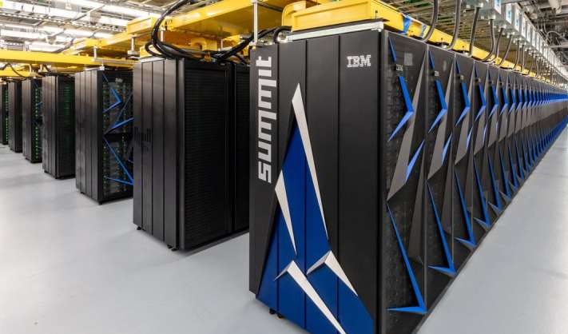
This research was supported by the Exascale Computing Project (17-SC-20-SC), a joint project of the U.S. Department of Energy’s Office of Science and National Nuclear Security Administration, responsible for delivering a capable exascale ecosystem, including software, applications, and hardware technology, to support the nation’s exascale computing imperative.

Slide 3
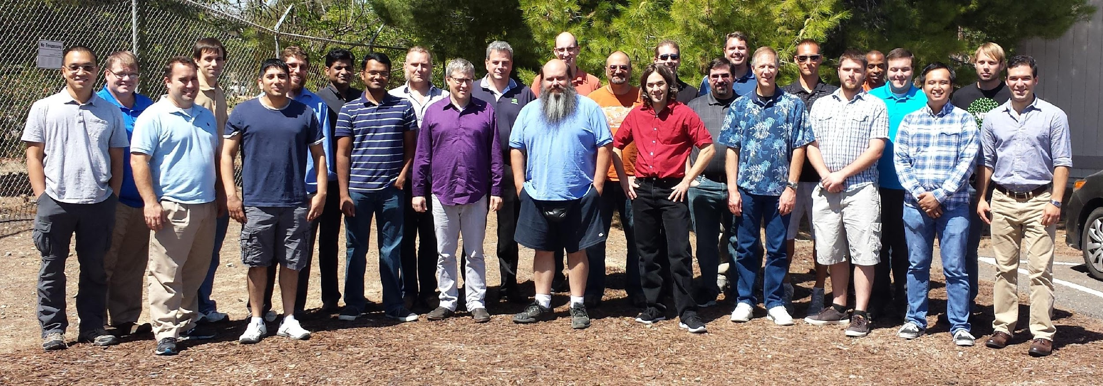
A single place for the visualization community to collaborate, contribute, and leverage massively threaded algorithms.
Code Sprint, September 2015, LLNL
Code Sprint, April 2017, University of Oregon

Slide 4
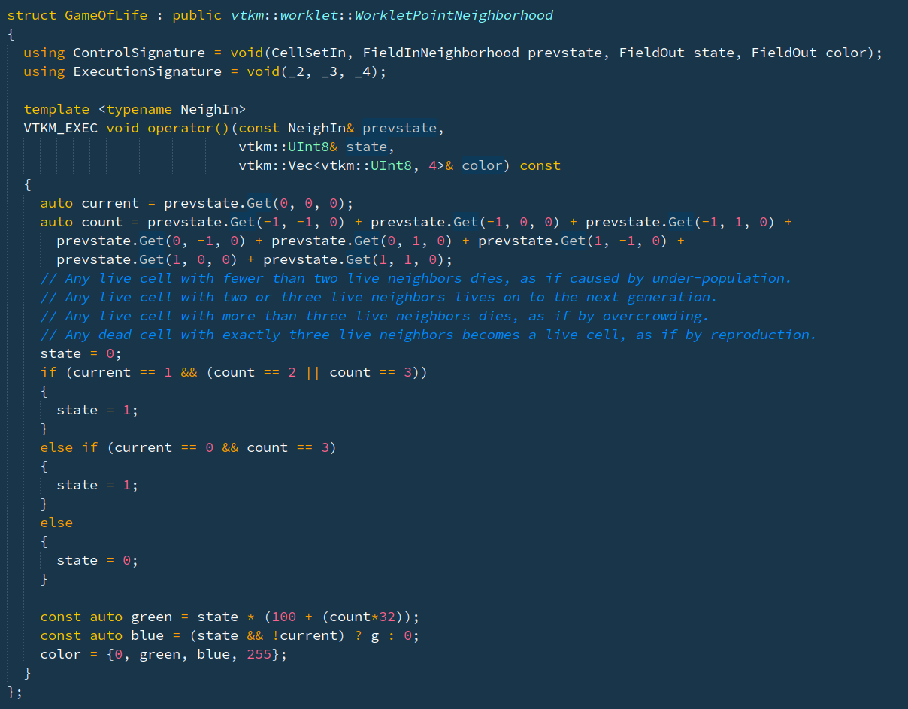
Reduce the challenges of writing highly concurrent algorithms by using data parallel algorithms
Done by writing ‘worklets’

Slide 5
Reduce the challenges of writing highly concurrent algorithms by using data parallel algorithms

Slide 6
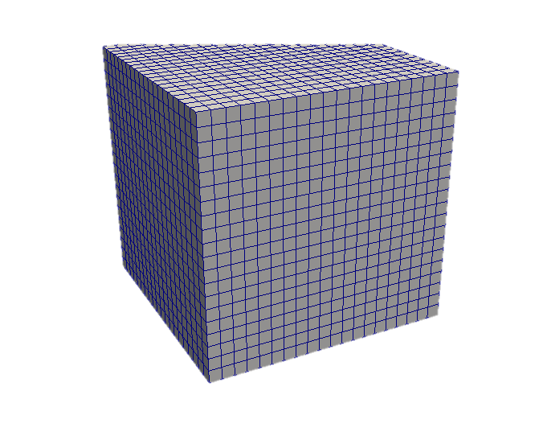
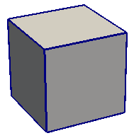
Control
Execution
Filters
Control
DataModel
Worklets
Execution
DataModel
Data Parallel Algorithms
Arrays
CUDA
OpenMP
TBB

Slide 7
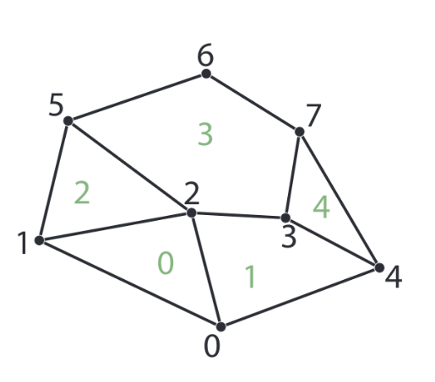
WorkletMapField
Iterates over any array (Point, Cell)
Read/Write access
Parallel for_each

Slide 8
WorkletMapCellToPoint
Iterates over all points
Read access to cell fields
Read/Write access to point fields
Point 3 has access to cells 1,3,4

Slide 9
WorkletMapPointToCell
Iterates over all cells
Read access to point fields
Read/Write access to cell fields
Cell 1 has access to points 0,2,3,4

Slide 10
Scattering
Many algorithms need more than 1 to 1 mapping. The operations might need to pass over elements that produce no value or the operation might need to produce multiple values for a single input element.
Scatter Counting
Scatter Uniform

Slide 11
Masking
Some algorithms need to be iterative on subsets of the input while maintaining a single output. For these kind of problems VTK-m provides the ability to enable/disable a worklet execution based on a input mask.
Active
Masked
Masked
Active

Slide 12
WorkletPointNeighborhood
Iterates over all points
Read access to points field neighborhood
Write access to center point

Slide 13
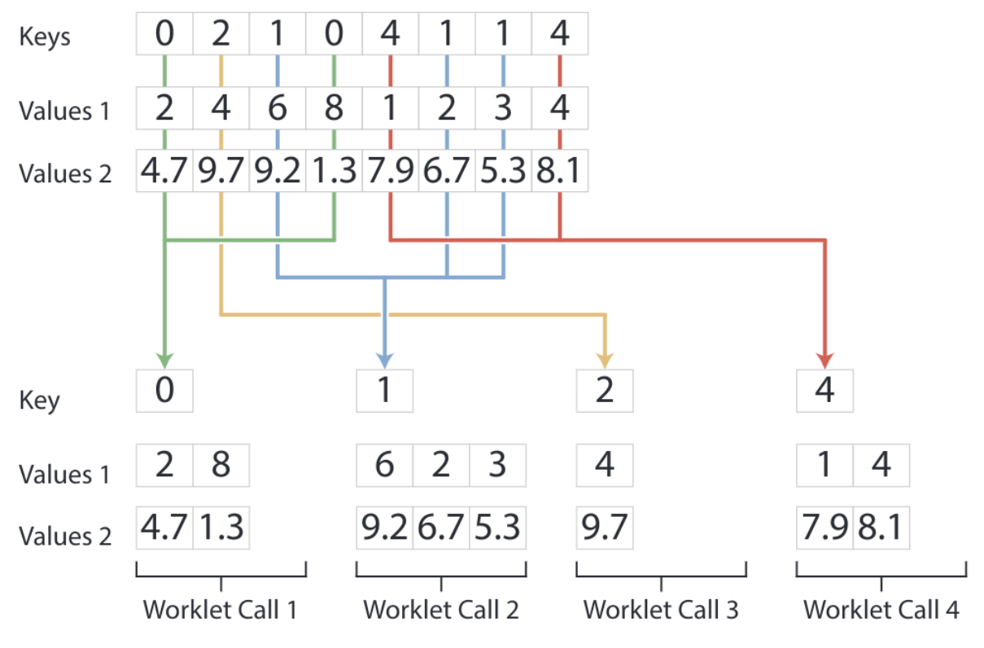
WorkletReduceByKey
Iterates over a key/value(s) array
Read access to all values of a given key
Write access for a given key

Slide 14
Reduce the challenges of writing highly concurrent algorithms by using data parallel algorithms
ForEach / ForEach3D
Transform
Sort / SortByKey
Reduce / ReduceByKey
Copy / CopyIf / CopySubRange
LowerBounds / UpperBounds
ScanInclusive / ScanInclusiveByKey
ScanExclusive / ScanExclusiveByKey
Unique / UniqueByKey

Slide 15
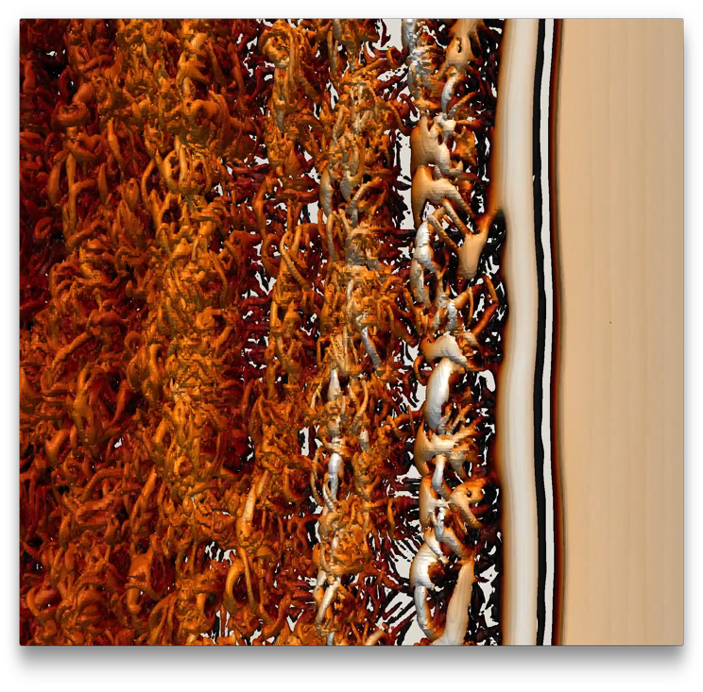
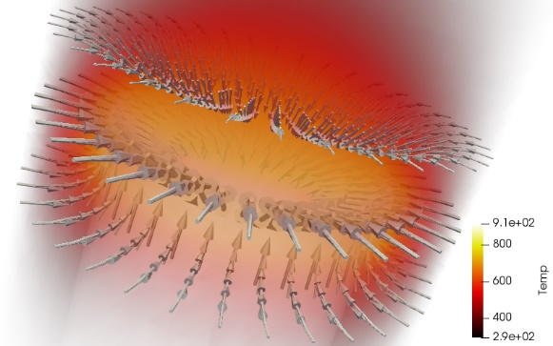
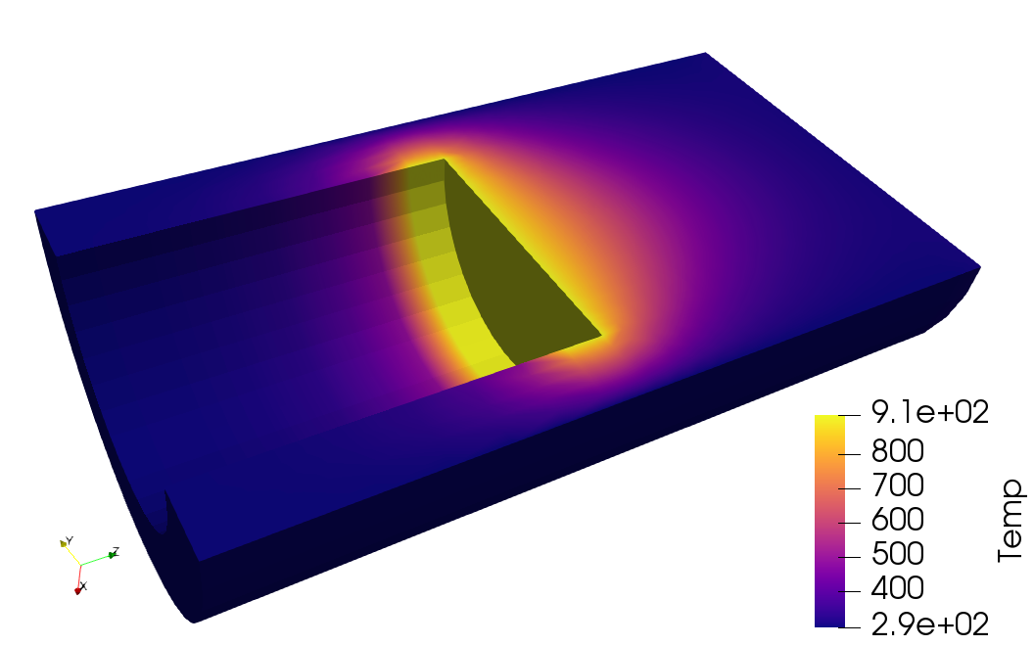
Make it easier for simulation codes to take advantage of these parallel visualization and analysis tasks on a wide range of current and next-generation hardware.

Slide 16
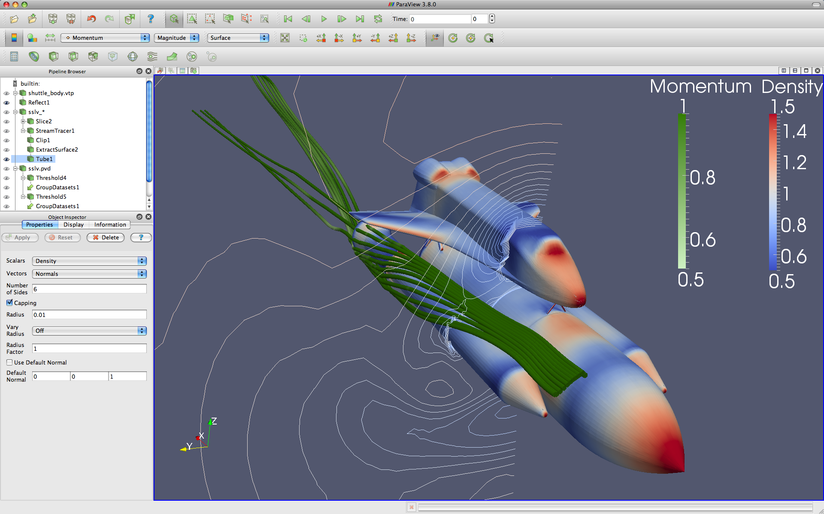
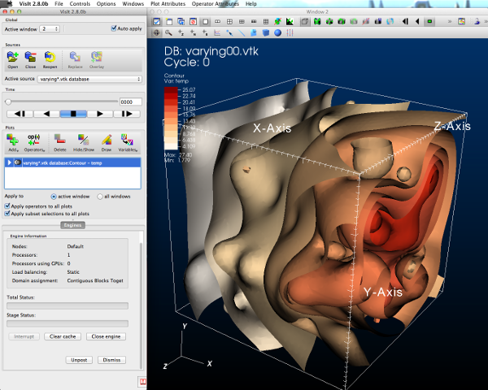
GUI / Parallel Management
In Situ Vis Library
(Integration with Sim)
Base Vis Library
(Algorithm Implementation)
Simulations
Libsim
Multithreaded Algorithms
Processor Portability

Slide 17
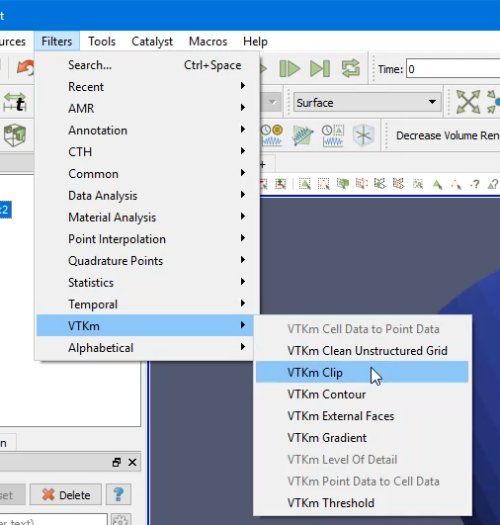
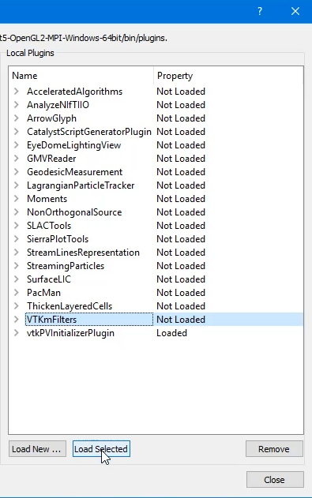
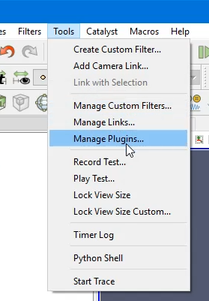
In ParaView
2. Use a VTK-m filter like any other
1. Load VTK-m Plugin
Slide Credit: Ken Moreland

Slide 18
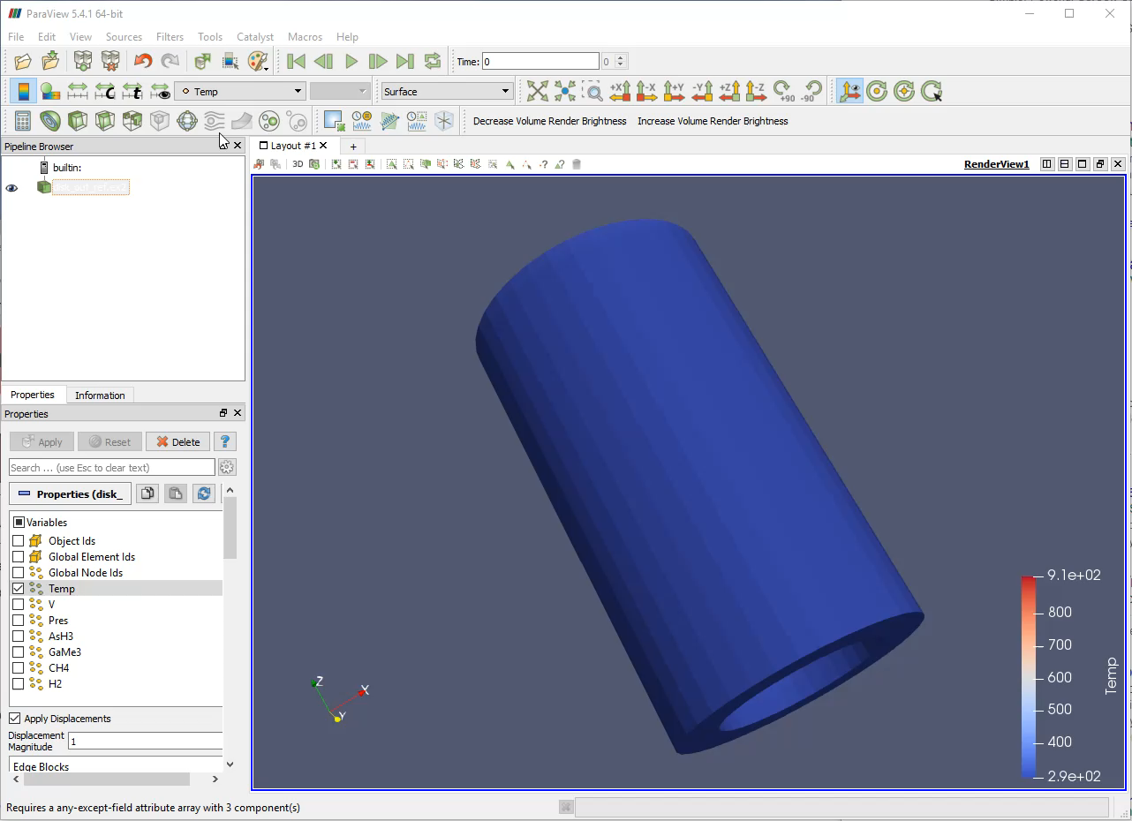
Slide Credit: Ken Moreland

Slide 19
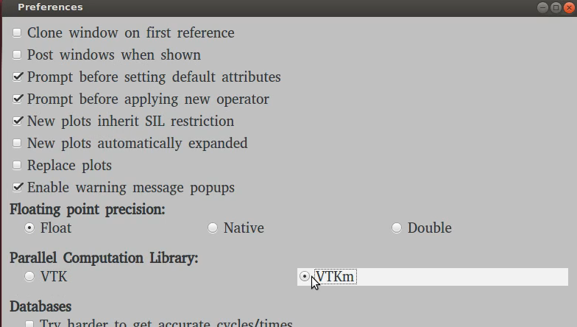
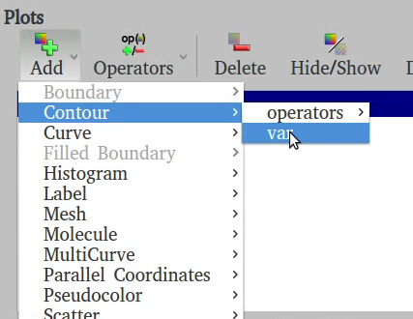
In VisIt
1. Turn on VTK-m in Preferences
2. Use VTK-m enabled plots as normal
Slide Credit: David Pugmire

Slide 20
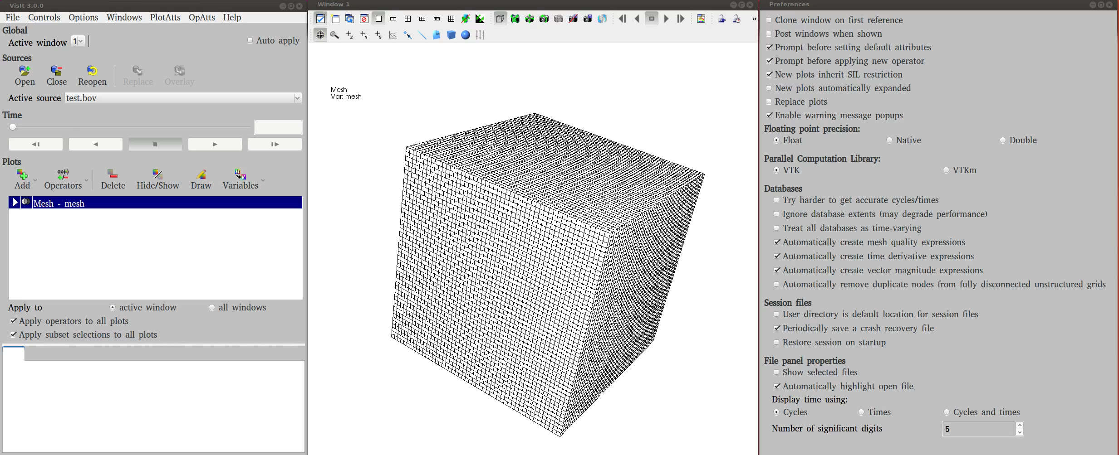
Slide Credit: David Pugmire

Slide 21
External Evolution

Slide 22
Filters
Cell Average
Cell Measurements
Clean Grid
Clip by Field or Implicit Function
Contour Trees
External Faces
Lagrangian
Mask Points
Point Average
Point Elevation
Probe
Streamlines

Slide 23
Filters
Extract Geometry, Points, Structured
FieldToColors
Gradient
Histogram and Entropy
Marching Cubes
Hex and Voxel Done
Other Cell Types In-Progress
Split Sharp Edges
Surface Normals
Surface Simplification
Tetrahedralize
Threshold
Triangulate
Warp
ZFP

Slide 24
Worklet Control Signature
VTK-m no longer requires the list of allowed types for each worklet parameter

Slide 25
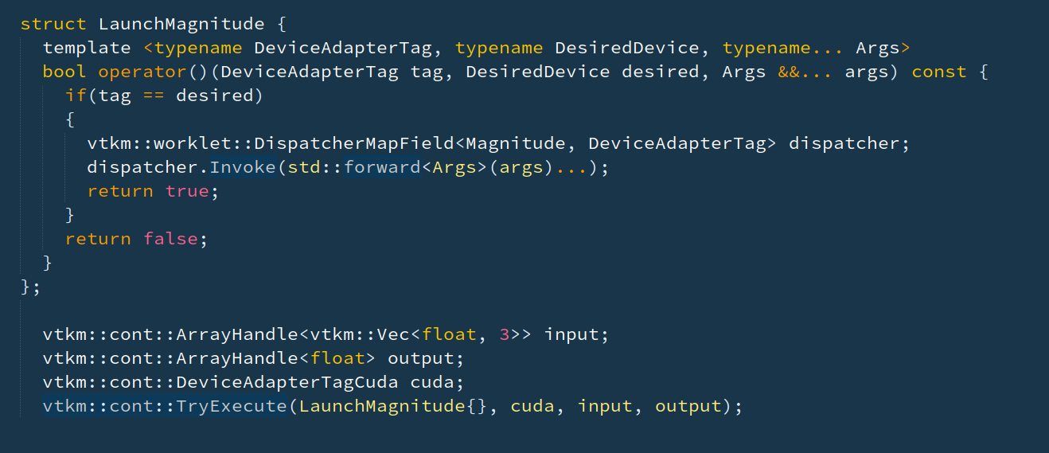
Runtime Device Selection
VTK-m supports compilation of any number of device adapters in a single library. Previously it was only possible to get runtime selection by jumping through hoops

Slide 26
Runtime Device Execution
VTK-m has removed the Device template from all Dispatchers and instead builds all device versions and can easily switch between them

Slide 27
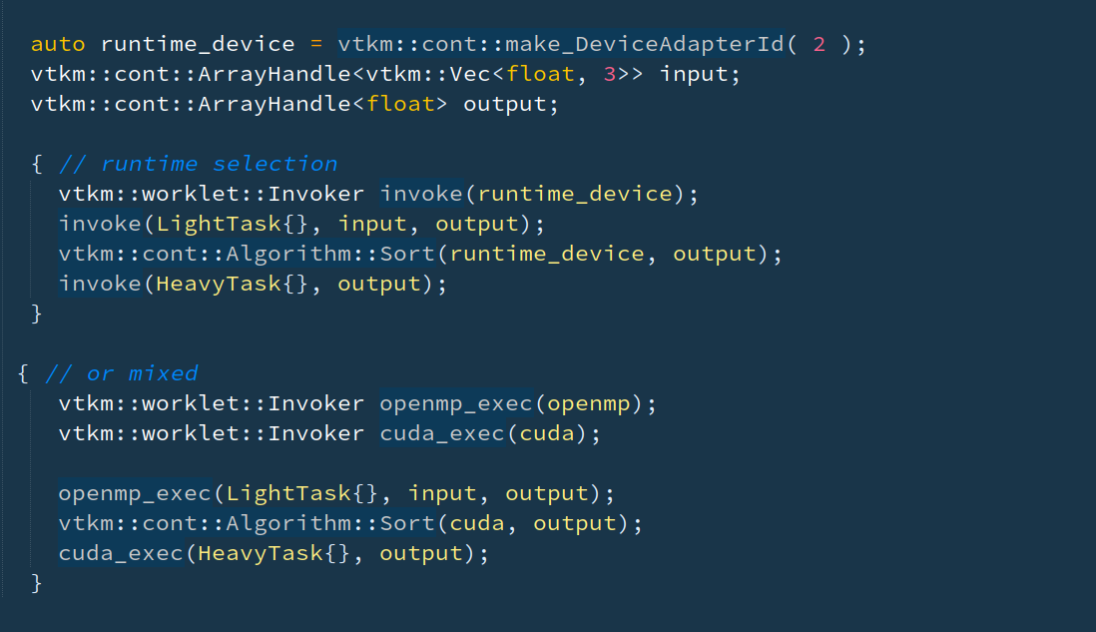
Runtime Device Selection
ArrayHandle, Algorithms, Worklet, and Filter now all support runtime selection

Slide 28
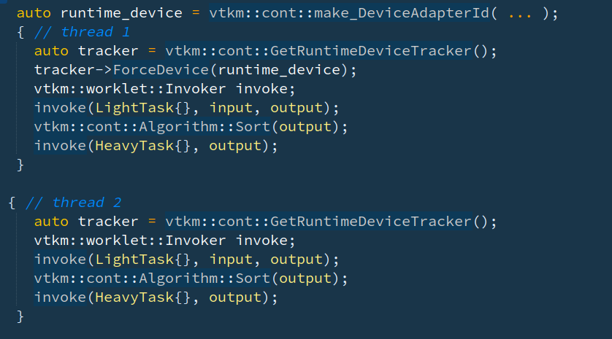
Runtime Device Tracking
Runtime selection supports the ability to use an Any device which selects the active device at runtime. Any supports graceful degradation for when a device crashes

Slide 29
Future Runtime Device Tracking
Since VTK-m defers location of execution to runtime this opens up future research work on task locality
Should execution over small domains happen in serial?
When should execution move to the memory space of the allocation?
Can we map this to multi-gpu machines and allocations?
What to do when inputs are spread across multiple memory spaces?

Slide 30
Logging
For better reporting of runtime performance and errors VTK-m has a fully integrated logging framework. Allows us to log:
Errors
Warnings
Dynamic Cast Failures
Control Side Memory Allocations
Execution Side Memory Allocations
Memory Transfers
Performance

Slide 31
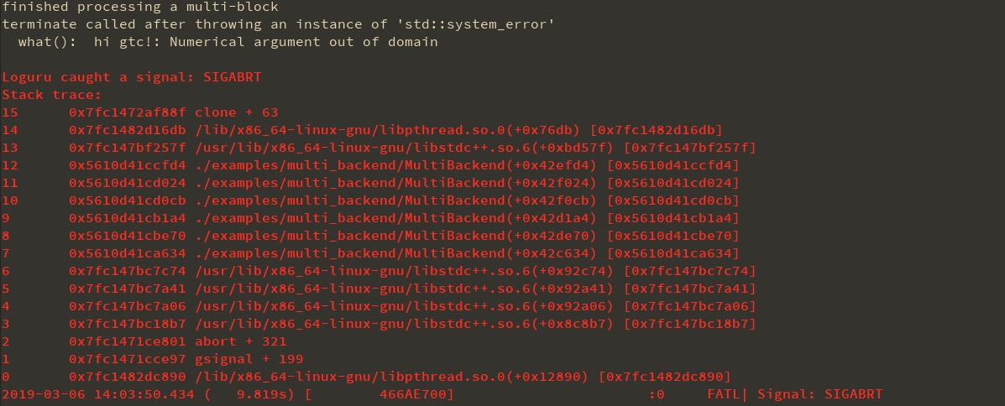
Logging

Slide 32
Original Filter Policy Design
Filter Policies are how callers of VTK-m control what compile time type expansions will be done for:
CellSets [ Structured, Unstructured, … ]
Field Types [ are they float, double, vec3f? ]
Field Storage [ Basic, Counting, Implicit, … ]
Coordinates Types
Coordinates Storage

Slide 33
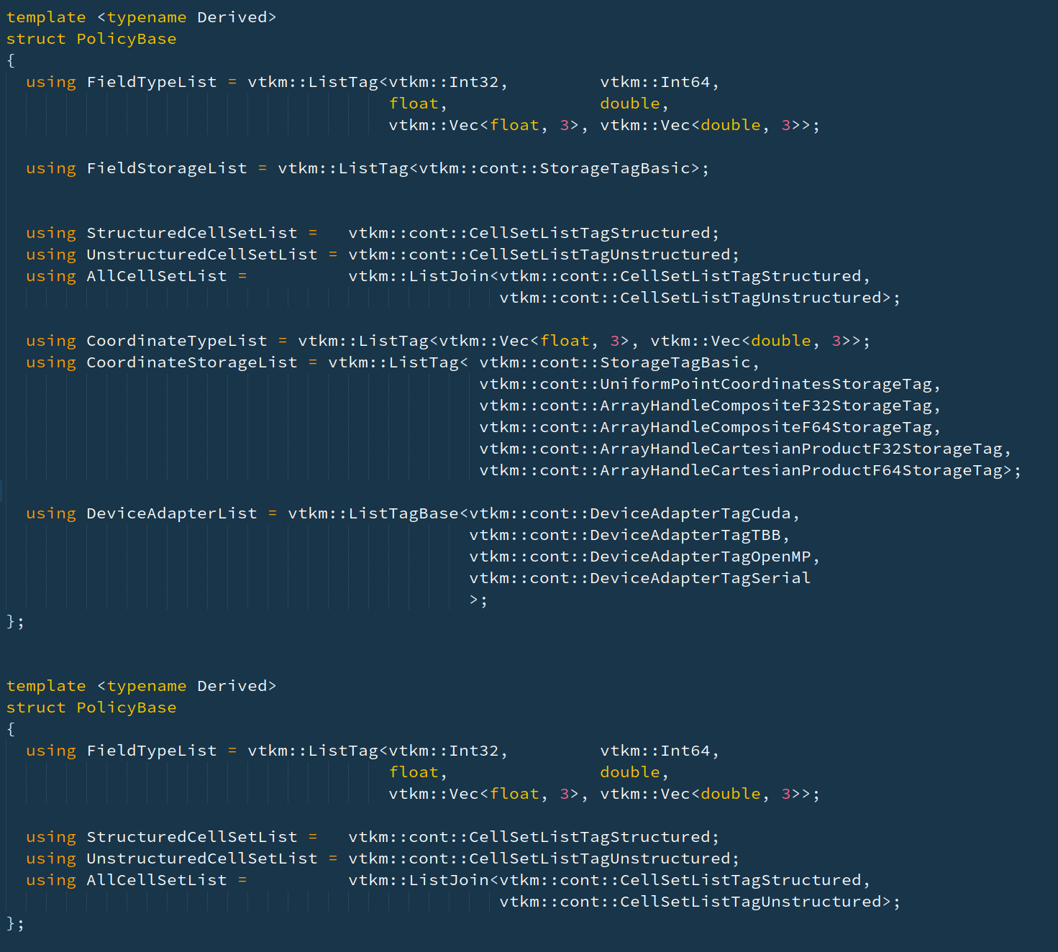
Original Filter Policy Design

Slide 34
New Filter Policy Design

Slide 35
Virtual Arrays
VTK-m has identified a need to have certain execution objects leverage virtual methods. Things such as array handle storage, implicit functions and coordinate systems now use virtuals.
7 types
3 types

Slide 36
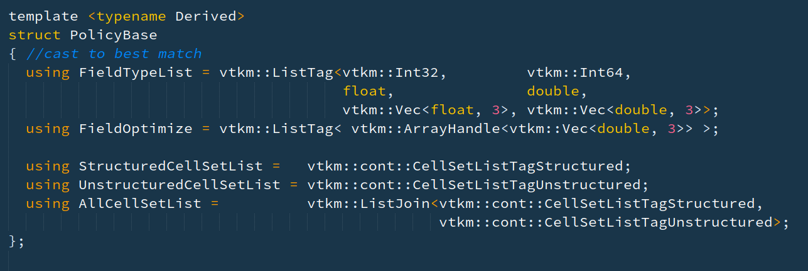
New++ Filter Policy [In Design]
VTK-m currently only exactly matches FieldTypes. Going forward we are going to cast to best matching and provide
explicit de-virtualization.

Slide 37
MultiBlock
VTK-m MultiBlock is very similar to vtkPartitionedDataSet
VTK-m MultiBlock entries can only be DataSets, no support for nested MultiBlocks
In VTK-m a MultiBlock can span multiple nodes (MPI/DIY), but a block must be fully contained on a single node

Slide 38
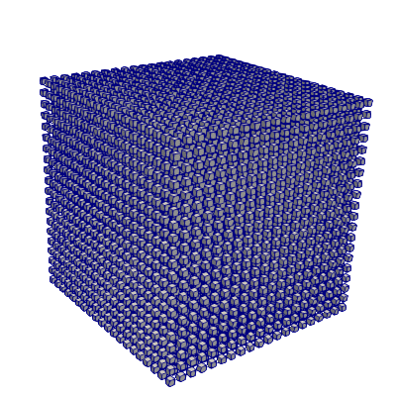
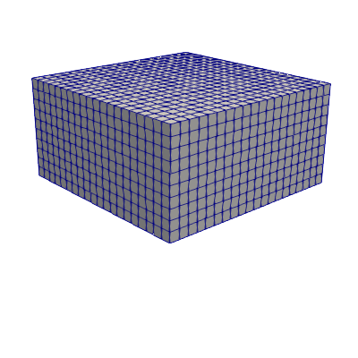
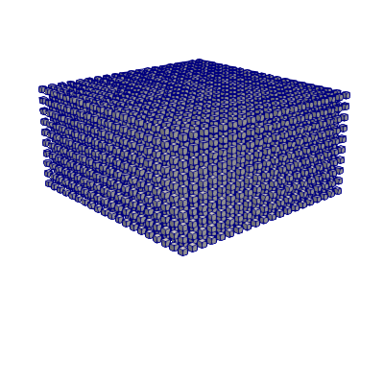
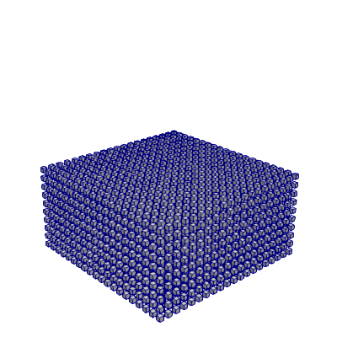
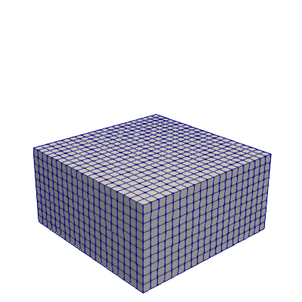
Hybrid Parallelism

Slide 39
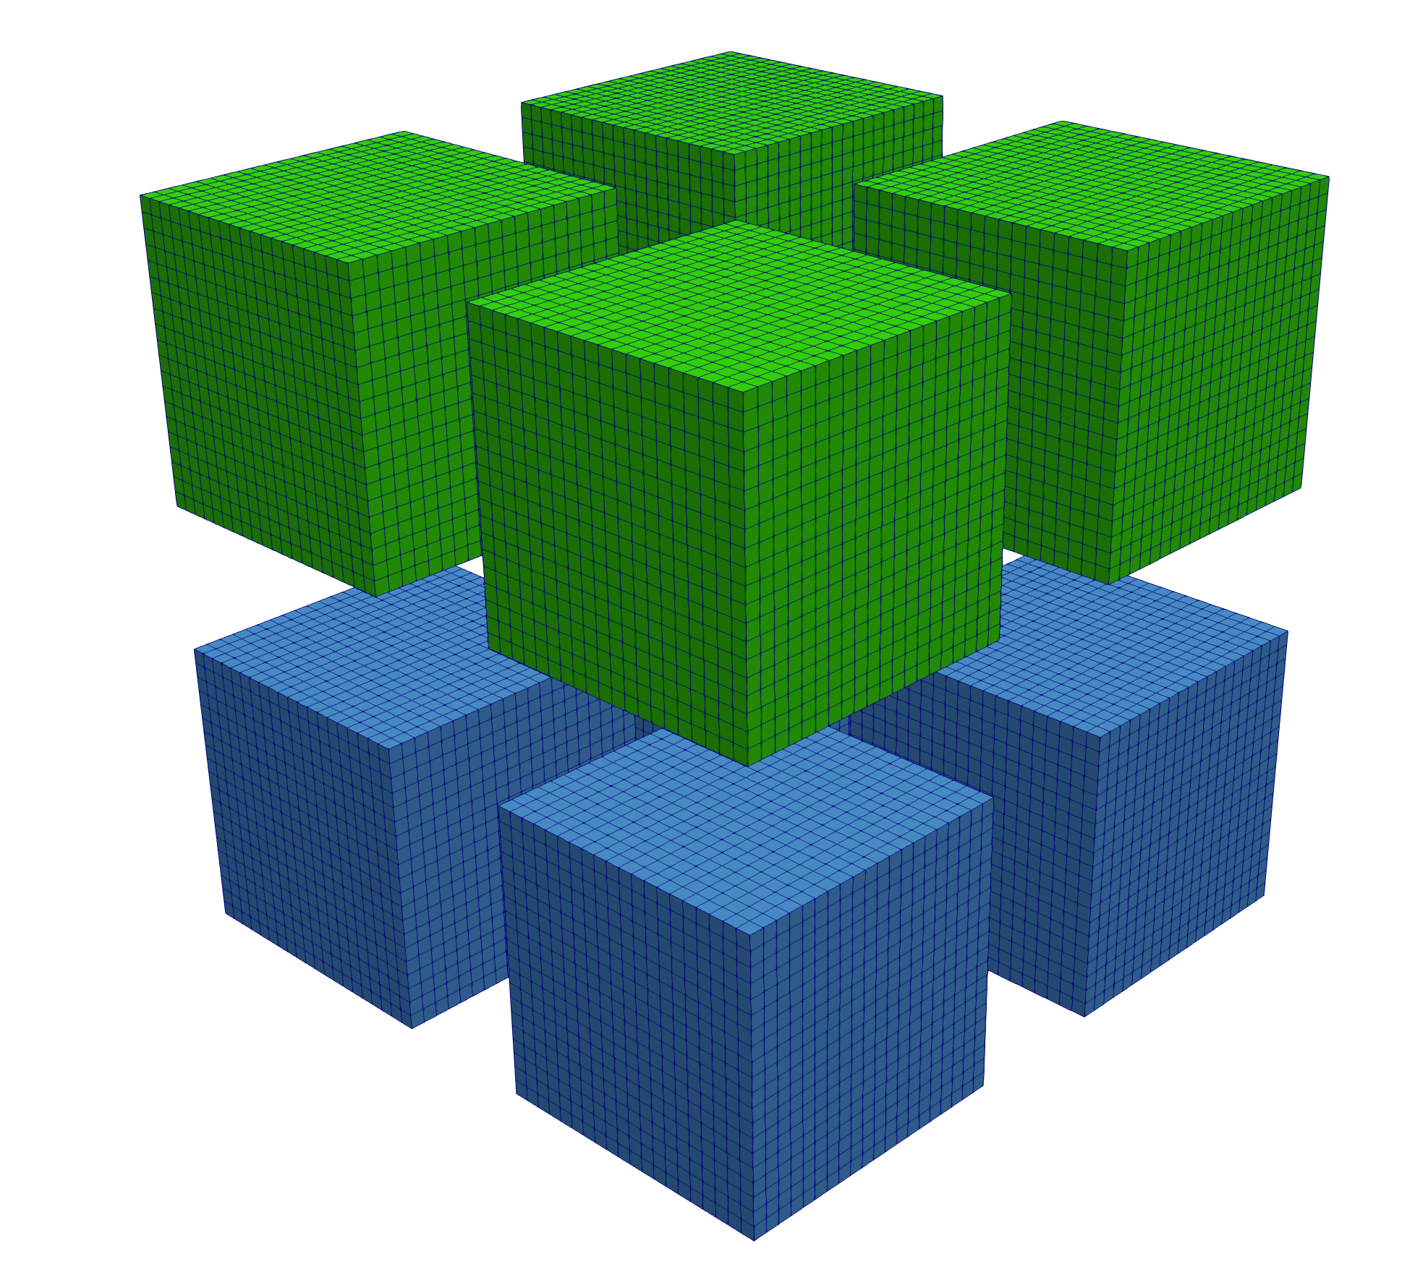
Drive Towards Hybrid Async

Slide 40
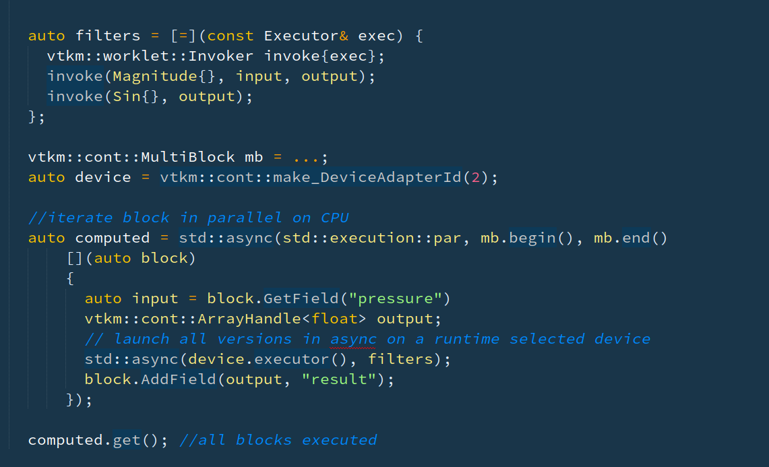

Slide 41
WorkletReduceByKey
VTK-m provides a custom reduce by key since we needed the following functionality:
Multi value reduction
Access to all values per key

Slide 42
Internal Evolution

Slide 43
CUDA Streams
When ever VTK-m executes using the CUDA device adapter all kernels and memory transfers now use per-thread default streams explicitly
This work allows for better in-situ integration, and for VTK-m to provide the option of coarse grained block level parallelism.

Slide 44
CUDA
VTK-m ArrayHandle now properly handles users passing CUDA allocated pointers for input data.
No extra data transfers or copies
If UVM allocated can also be used with other devices
When VTK-m executes on Pascal+ hardware all device memory will be allocated using UVM.
Includes hints to the UVM system if the memory is read, write, or r+w
If the ArrayHandle doesn’t have host data, will use the UVM memory
Controllable with environment variables

Slide 45
CUDA
VTK-m ArrayHandle reads now use __ldg loads automatically on any read only input
VTK-m tries for all cuda operations to happen asynchronously
Allows for overlapping control and device
Goal of reducing host / device synchronizations.
We use Thrust for parallel primitives ( expect worklet launches )
We don’t sync after each worklet
We only use event syncs
We explicitly event sync only for host memory access
We batch small cuda memory free’s

Slide 46
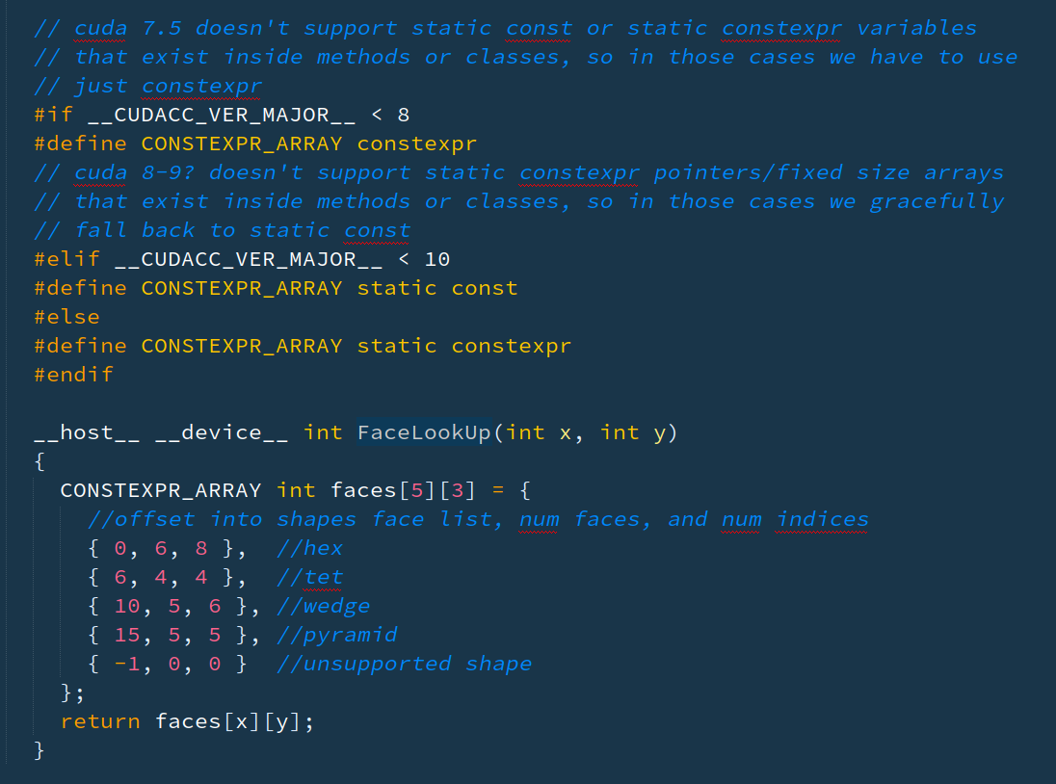
CUDA Lookup Tables
VTK-m uses lots of predefined lookup tables
These are challenging to write correctly when you want the same table to be used for host and device (E.3.13. Const-qualified variables && F.3.16.5. Constexpr variables)
Notes:
Next side has code full screen

Slide 47
CUDA Lookup Tables

Slide 48
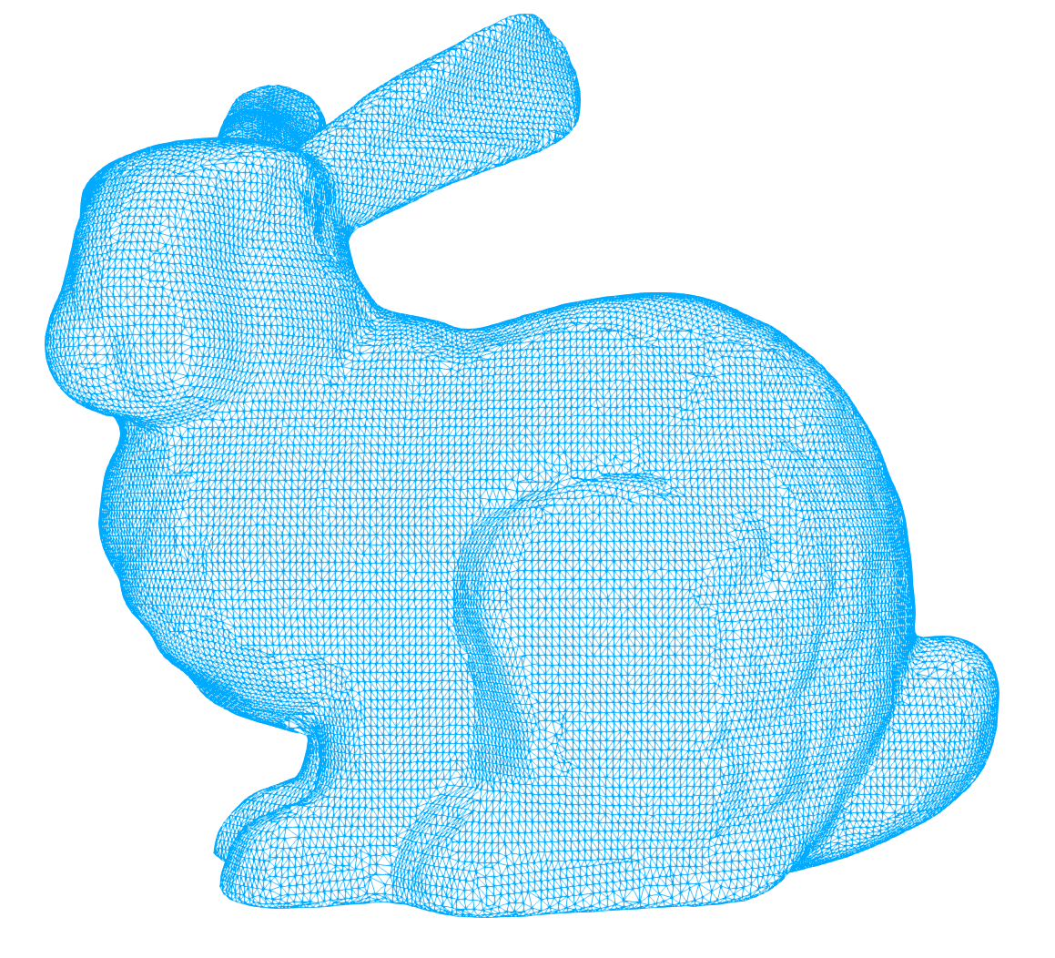
CUDA Worklet Execution
VTK-m Topology based worklets are always executed in the context of a topology.
worklet
worklet
worklet
worklet
0,1,0
1,1,0
worklet
Task Launcher
worklet
Task Launcher
worklet
worklet
worklet
Task
worklet
worklet
0,0,0
1,0,0

Slide 49
CUDA 1D Worklet Execution
VTK-m has explored using different strategies over the years for 1D execution.
We use grid stride loops
We launch a fixed number of blocks and threads and stride over the total work
Number of blocks is based on a function of the number of SM’s (32 per)
We use 128 threads per block
We want as many register per thread as our worklets are ‘large’
worklet
worklet
worklet
Task Launcher
worklet
worklet
worklet
worklet
Task

Slide 50
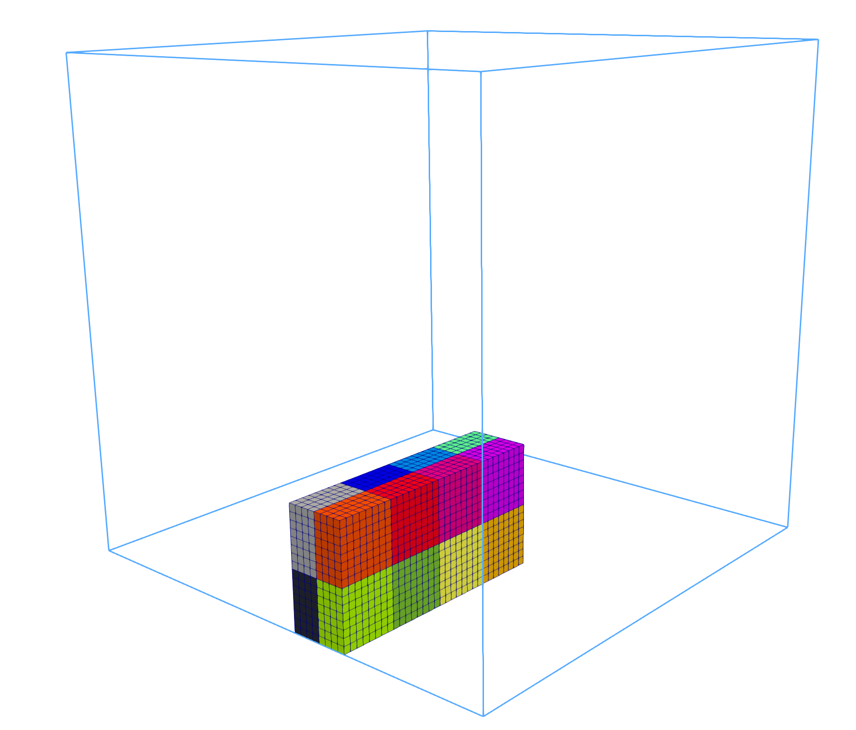
CUDA 3D Worklet Execution
VTK-m uses a similar strategies over the years for 3D execution.
We use grid stride loops
Number of blocks is based on a function of the number of SM’s (32 per)
We use 256 threads per block in a <8,8,4> layout
worklet
worklet
Task Launcher
0,1,0
1,1,0
worklet
worklet
0,0,0
1,0,0

Slide 51
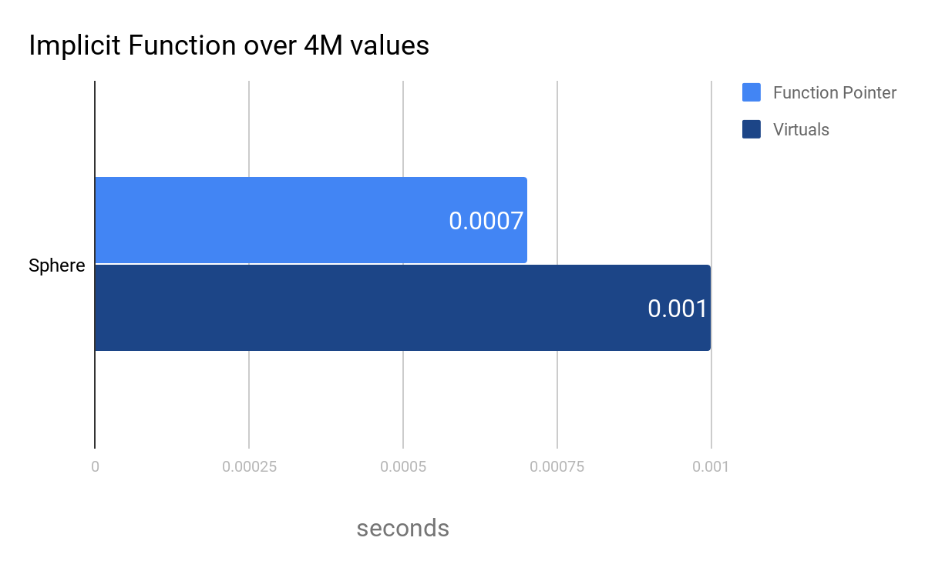
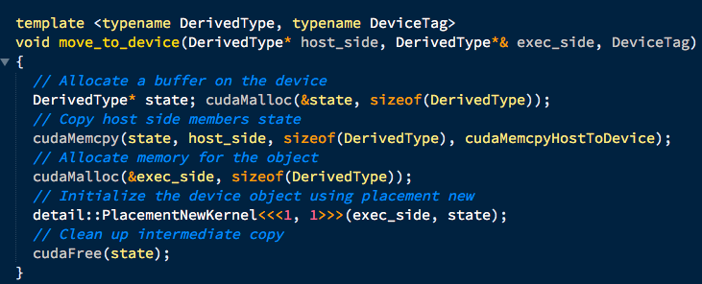
Virtual Methods
CUDA: NVIDIA GP100 TBB: 2x Intel Xeon CPU E5-2620 v3 [24 cores]

Slide 52
Atomic Performance
VTK-m originally avoided using atomics due to presumptions on performance. Starting in 2018 we have slowly moved algorithms over to atomics on a case by case basis
CellToPoint Table Gen | Time (s) |  |  |  | Mem (GiB)
Backend | Serial | TBB | OpenMP | CUDA
VTK | 2.535 | (N/A) | (N/A) | (N/A) | 2.711
VTK-m (Sort) | 17.940 | 8.169 | 8.125 | 1.606* | 8.166*
VTK-m (Atomic Histogram) | 6.673 | 1.428 | 1.445 | 0.547 | 2.505
CUDA: Quadro K5100M CPU: Intel Core i7-4710MQ CPU @ 2.50GHz

Slide 53
Conformance && Performance

Slide 54
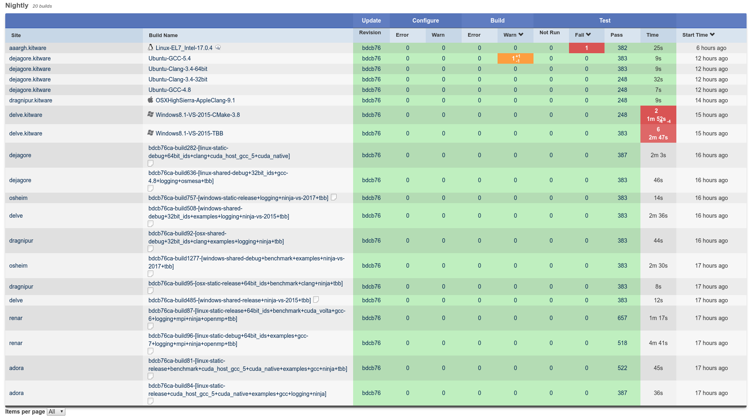
Testing

Slide 55
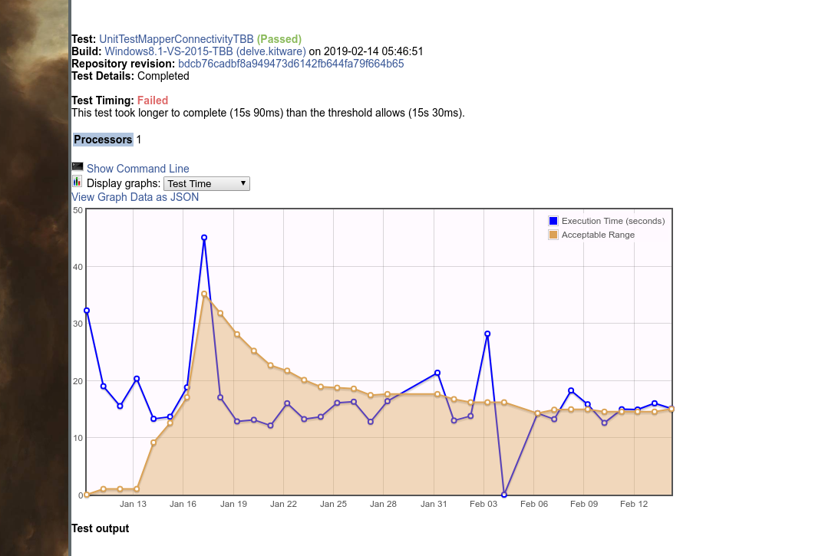
Testing
Testing is used to catch serious changes in baseline performance

Slide 56
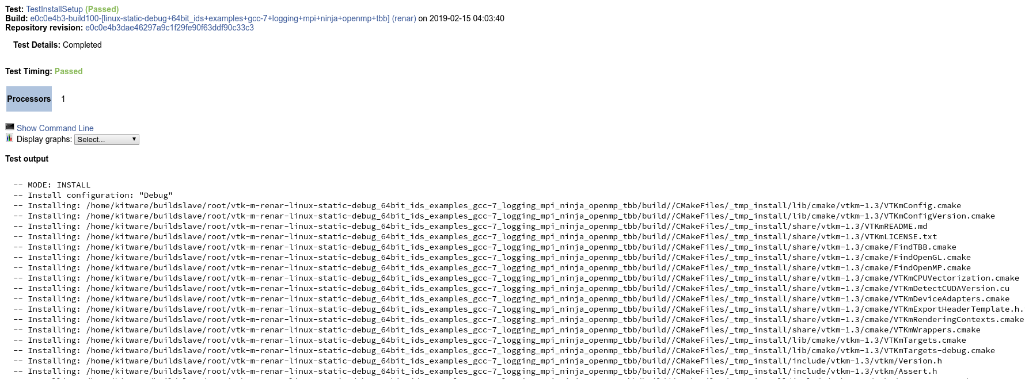
Testing
Testing is used to verify install layout
WIP: Building code against the installed vtk-m as part of the testing process

Slide 57
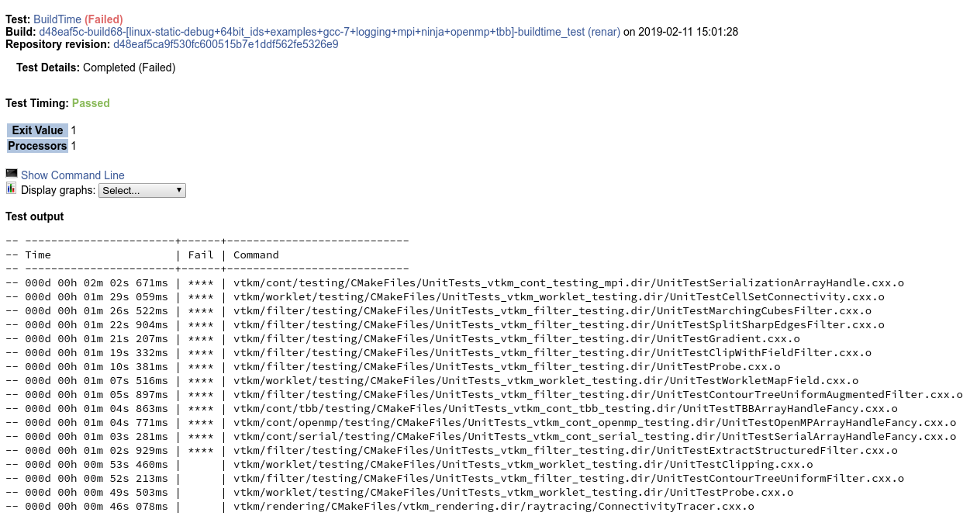
Testing
Testing will be used to monitor compile times leverages Ninja ability to report per TU compilation times

Slide 58
Device Level Benchmarks
VTK-m has a collection of device adapter level benchmarks used for micro performance comparisons.
Allows developers to test new implementations for parallel primitives
Allows VTK-m to get a baseline for new hardware
Allows device adapters to be compared against each other
AtomicArray
CopySpeeds
DeviceAdapter

Slide 59
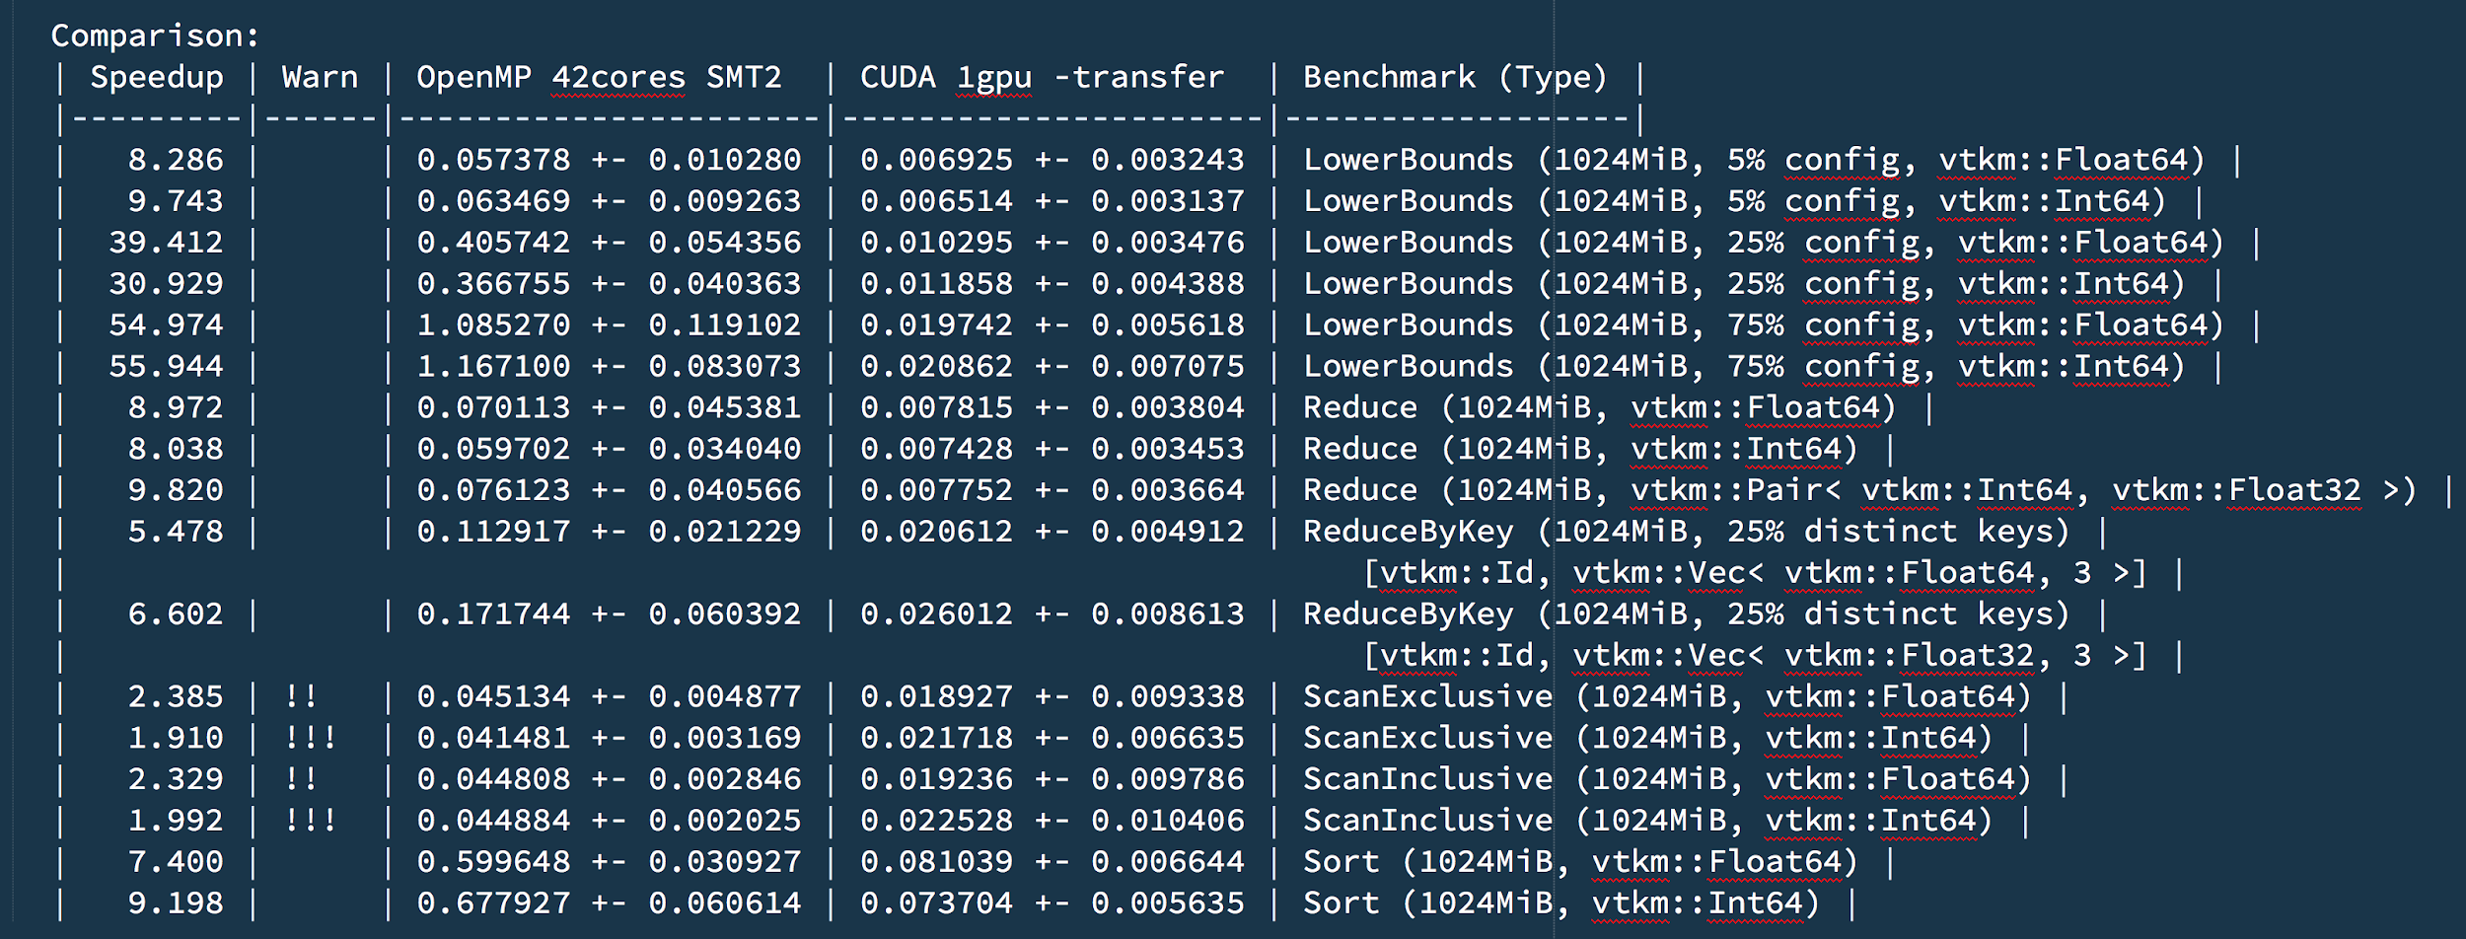
Device Level Benchmarks
IBM Power System AC922 node (SUMMIT) GPU: Volata V100 CPU: 2x Power9 [42 cores, SMT2]

Slide 60
Algorithm Level Benchmarks
VTK-m has a collection of filter and worklet level benchmarks. These are generally used to verify whole algorithm or application performance.
Allows developers to test new implementations for algorithms
Allows VTK-m to get a baseline for new hardware
FieldWorklets
ToplogyWorklets
Filters

Slide 61
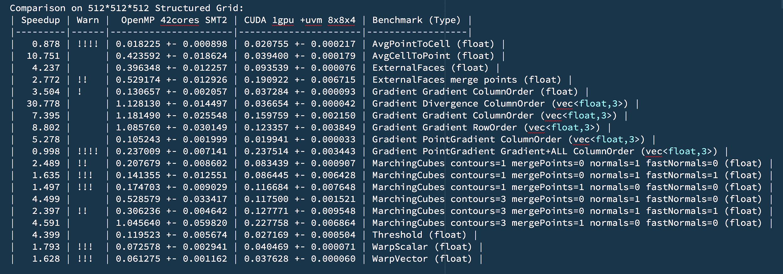
Filter Benchmarks
IBM Power System AC922 node (SUMMIT) GPU: Volata V100 CPU: 2x Power9 [42 cores, SMT2]

Slide 62
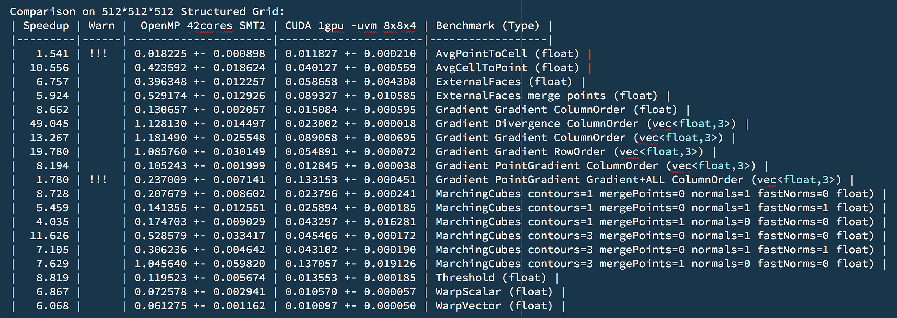
Filter Benchmarks
IBM Power System AC922 node (SUMMIT) GPU: Volata V100 CPU: 2x Power9 [42 cores, SMT2]

Slide 63
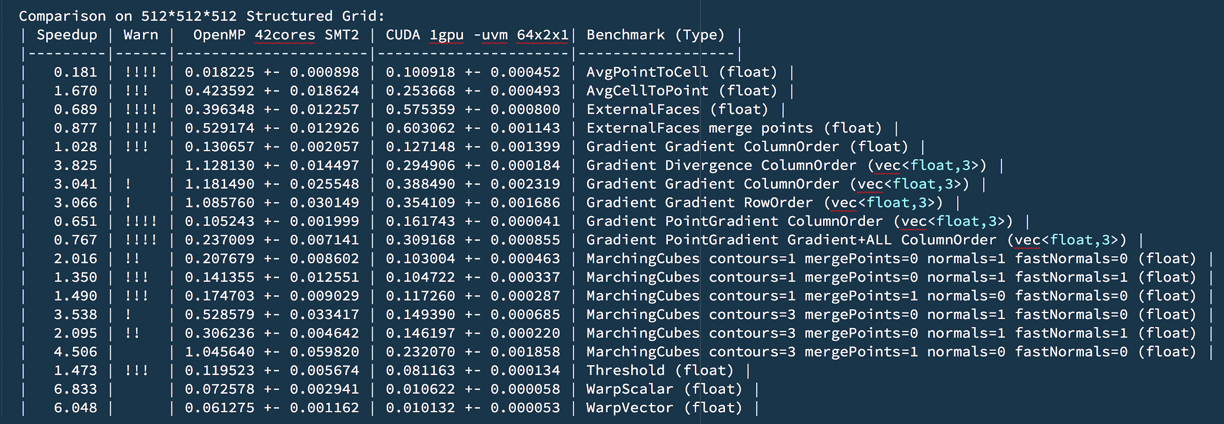
Filter Benchmarks [Old 3D Scheduling]
IBM Power System AC922 node (SUMMIT) GPU: Volata V100 CPU: 2x Power9 [42 cores, SMT2]

Slide 64
Thank You!
This research was supported by the Exascale Computing Project (http://www.exascaleproject.org), a joint project of the U.S. Department of Energy’s Office of Science and National Nuclear Security Administration, responsible for delivering a capable exascale ecosystem, including software, applications, and hardware technology, to support the nation’s exascale computing imperative. Project Number: 17-SC-20-SC
Robert Maynard
robert.maynard@kitware.com
@robertjmaynard
Checkout out VTK-m @ gitlab.kitware.com/vtk/vtk-m and Kitware @ www.kitware.com
Please complete the Presenter Evaluation sent to you by email or through the GTC Mobile App.
Your feedback is important!

