Slide 1
A ToolKit for Scientific Visualization on Many-Core Processors
Hank Childs Kenneth Moreland David Pugmire Robert Maynard
University of Oregon Sandia National Laboratories Oak Ridge National Laboratory Kitware, Inc.
More Advanced Algorithm #1
Sandia National Laboratories is a multi-mission laboratory managed and operated by National Technology and Engineering Solutions of Sandia, LLC., a wholly owned subsidiary of Honeywell International, Inc., for the U.S. Department of Energy’s National Nuclear Security Administration under contract DE-NA0003525. SAND 2019-12456 PE

Slide 2
Motivating Example: Average Point Data to Cells
1.4
2.3
2.6
4.1
4.5
5.0
5.3
6.7

Slide 3
Motivating Example: Average Point Data to Cells
1.4
2.3
2.6
4.1
4.5
5.0
5.3
6.7

Slide 4
Motivating Example: Average Point Data to Cells
1.4
2.3
2.6
3.0
3.8
4.1
4.1
4.5
5.0
5.3
5.1
5.3
6.7

Slide 5
To follow along…
The source code shown in this session is in the tut_point_to_cell.cxx file.

Slide 6
struct ConvertPointFieldToCells
{

Slide 7
struct ConvertPointFieldToCells : vtkm::worklet::WorkletVisitCellsWithPoints
{

Slide 8
struct ConvertPointFieldToCells : vtkm::worklet::WorkletVisitCellsWithPoints
{
Worklet semantics visits a cell in each thread with access to points.
1.4
2.3
2.6
3.0
3.8
4.1
4.1
4.5
5.0
5.3
5.1
5.3
6.7

Slide 9
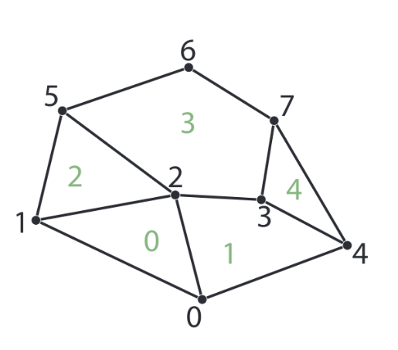
VTK-m Parallel Pattern: Visit Cells with Points
0
1
2
3
4
5
6
7
Input Array #1
W
W
W
W
W
Output Array #1
0
1
2
3
4

Slide 10
VTK-m Parallel Pattern: Visit Cells with Points
0
1
2
3
4
5
6
7
Input Array #1
W
W
W
W
W
Output Array #1
0
1
2
3
4

Slide 11
struct ConvertPointFieldToCells : vtkm::worklet::WorkletVisitCellsWithPoints
{

Slide 12
struct ConvertPointFieldToCells : vtkm::worklet::WorkletVisitCellsWithPoints
{
using ControlSignature = void(CellSetIn topology,
FieldInPoint inPointField,
FieldOutCell outCellField);

Slide 13
struct ConvertPointFieldToCells : vtkm::worklet::WorkletVisitCellsWithPoints
{
using ControlSignature = void(CellSetIn topology,
FieldInPoint inPointField,
FieldOutCell outCellField);
To follow topology connections, VTK-m must be given the cell set.

Slide 14
struct ConvertPointFieldToCells : vtkm::worklet::WorkletVisitCellsWithPoints
{
using ControlSignature = void(CellSetIn topology,
FieldInPoint inPointField,
FieldOutCell outCellField);
To follow topology connections, VTK-m must be given the cell set.
Field in/out now has to specify whether they come from the points or the cells.

Slide 15
struct ConvertPointFieldToCells : vtkm::worklet::WorkletVisitCellsWithPoints
{
using ControlSignature = void(CellSetIn topology,
FieldInPoint inPointField,
FieldOutCell outCellField);

Slide 16
struct ConvertPointFieldToCells : vtkm::worklet::WorkletVisitCellsWithPoints
{
using ControlSignature = void(CellSetIn topology,
FieldInPoint inPointField,
FieldOutCell outCellField);
using InputDomain = _1;

Slide 17
struct ConvertPointFieldToCells : vtkm::worklet::WorkletVisitCellsWithPoints
{
using ControlSignature = void(CellSetIn topology,
FieldInPoint inPointField,
FieldOutCell outCellField);
using InputDomain = _1;
Specifies which argument of the ControlSignature is used for scheduling.

Slide 18
struct ConvertPointFieldToCells : vtkm::worklet::WorkletVisitCellsWithPoints
{
using ControlSignature = void(CellSetIn topology,
FieldInPoint inPointField,
FieldOutCell outCellField);
using InputDomain = _1;

Slide 19
struct ConvertPointFieldToCells : vtkm::worklet::WorkletVisitCellsWithPoints
{
using ControlSignature = void(CellSetIn topology,
FieldInPoint inPointField,
FieldOutCell outCellField);
using ExecutionSignature = void(_2, _3);
using InputDomain = _1;

Slide 20
struct ConvertPointFieldToCells : vtkm::worklet::WorkletVisitCellsWithPoints
{
using ControlSignature = void(CellSetIn topology,
FieldInPoint inPointField,
FieldOutCell outCellField);
using ExecutionSignature = void(_2, _3);
using InputDomain = _1;
Specifies which arguments of the ControlSignature are passed to the worklet’s operator.

Slide 21
struct ConvertPointFieldToCells : vtkm::worklet::WorkletVisitCellsWithPoints
{
using ControlSignature = void(CellSetIn topology,
FieldInPoint inPointField,
FieldOutCell outCellField);
using ExecutionSignature = void(_2, _3);
using InputDomain = _1;
template <typename InPointFieldVecType, typename OutCellFieldType>
void operator()(const InPointFieldVecType& inPointFieldVec,
OutCellFieldType& outCellField) const
{

Slide 22
struct ConvertPointFieldToCells : vtkm::worklet::WorkletVisitCellsWithPoints
{
using ControlSignature = void(CellSetIn topology,
FieldInPoint inPointField,
FieldOutCell outCellField);
using ExecutionSignature = void(_2, _3);
using InputDomain = _1;
template <typename InPointFieldVecType, typename OutCellFieldType>
void operator()(const InPointFieldVecType& inPointFieldVec,
OutCellFieldType& outCellField) const
{

Slide 23
struct ConvertPointFieldToCells : vtkm::worklet::WorkletVisitCellsWithPoints
{
using ControlSignature = void(CellSetIn topology,
FieldInPoint inPointField,
FieldOutCell outCellField);
using ExecutionSignature = void(_2, _3);
using InputDomain = _1;
template <typename InPointFieldVecType, typename OutCellFieldType>
void operator()(const InPointFieldVecType& inPointFieldVec,
OutCellFieldType& outCellField) const
{
Input point field is passed in a Vec-like object containing the values for all connected points.

Slide 24
struct ConvertPointFieldToCells : vtkm::worklet::WorkletVisitCellsWithPoints
{
using ControlSignature = void(CellSetIn topology,
FieldInPoint inPointField,
FieldOutCell outCellField);
using ExecutionSignature = void(_2, _3);
using InputDomain = _1;
template <typename InPointFieldVecType, typename OutCellFieldType>
void operator()(const InPointFieldVecType& inPointFieldVec,
OutCellFieldType& outCellField) const
{
vtkm::IdComponent numPoints = inPointFieldVec.GetNumberOfComponents();
outCellField = OutCellFieldType(0);
for (vtkm::IdComponent pointIndex = 0; pointIndex < numPoints; ++pointIndex)
{
outCellField = outCellField + inPointFieldVec[pointIndex];
}
outCellField = outCellField / OutCellFieldType(numPoints);
}
};

Slide 25
template<typename ArrayHandleType, typename Policy>
VTKM_CONT cont::DataSet ConvertPointFieldToCells::DoExecute(
const vtkm::cont::DataSet& inDataSet,
const ArrayHandleType& inField,
const vtkm::filter::FieldMetadata& fieldMetadata,
vtkm::filter::PolicyBase<Policy> policy)
{
VTKM_IS_ARRAY_HANDLE(ArrayHandleType);
using ValueType = typename ArrayHandleType::ValueType;
vtkm::cont::ArrayHandle<ValueType> outField;
this->Invoke(vtkm::worklet::ConvertPointFieldToCells{},
vtkm::filter::ApplyPolicyCellSet(inDataSet.GetCellSet(), policy),
inField,
outField);

Slide 26
template<typename ArrayHandleType, typename Policy>
VTKM_CONT cont::DataSet ConvertPointFieldToCells::DoExecute(
const vtkm::cont::DataSet& inDataSet,
const ArrayHandleType& inField,
const vtkm::filter::FieldMetadata& fieldMetadata,
vtkm::filter::PolicyBase<Policy> policy)
{
VTKM_IS_ARRAY_HANDLE(ArrayHandleType);
using ValueType = typename ArrayHandleType::ValueType;
vtkm::cont::ArrayHandle<ValueType> outField;
this->Invoke(vtkm::worklet::ConvertPointFieldToCells{},
vtkm::filter::ApplyPolicyCellSet(inDataSet.GetCellSet(), policy),
inField,
outField);
You should apply the policy to the cell set. (Specifies which cell set types to build for.)

Slide 27
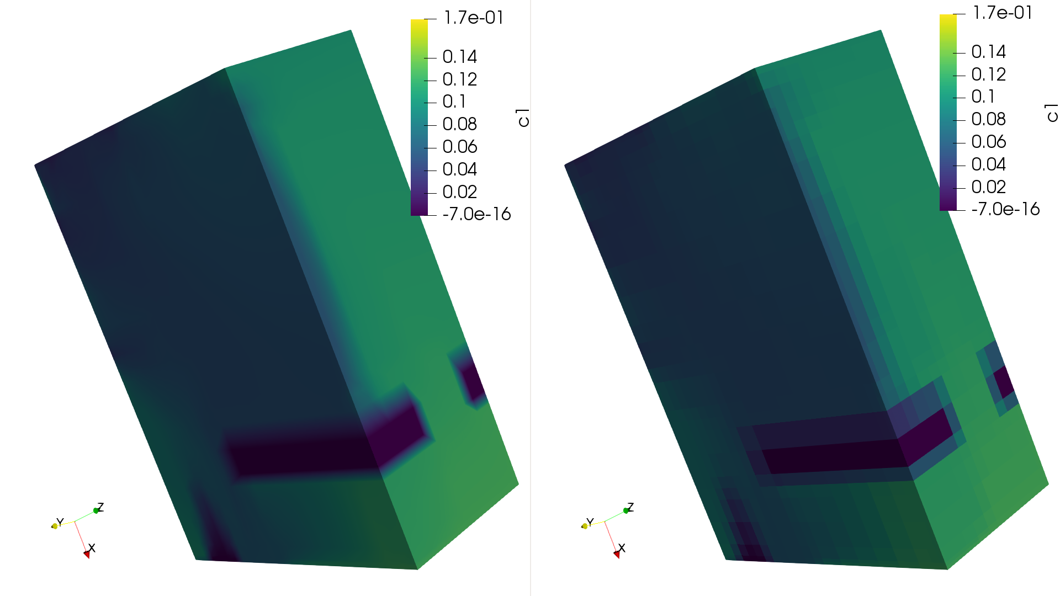

Slide 28
An assignment for you: convert cell data to point data
Can use tut_point_to_cell.cxx as a starting point.

Slide 29
struct ConvertPointFieldToCells : vtkm::worklet::WorkletVisitCellsWithPoints
{
using ControlSignature = void(CellSetIn topology,
FieldInPoint inPointField,
FieldOutCell outCellField);
using ExecutionSignature = void(_2, _3);
using InputDomain = _1;
template <typename InPointFieldVecType, typename OutCellFieldType>
void operator()(const InPointFieldVecType& inPointFieldVec,
OutCellFieldType& outCellField) const
{
vtkm::IdComponent numPoints = inPointFieldVec.GetNumberOfComponents();
outCellField = OutCellFieldType(0);
for (vtkm::IdComponent pointIndex = 0; pointIndex < numPoints; ++pointIndex)
{
outCellField = outCellField + inPointFieldVec[pointIndex];
}
outCellField = outCellField / OutCellFieldType(numPoints);
}
};

Slide 30
struct ConvertPointFieldToCells : vtkm::worklet::WorkletVisitCellsWithPoints
{
using ControlSignature = void(CellSetIn topology,
FieldInPoint inPointField,
FieldOutCell outCellField);
using ExecutionSignature = void(_2, _3);
using InputDomain = _1;
template <typename InPointFieldVecType, typename OutCellFieldType>
void operator()(const InPointFieldVecType& inPointFieldVec,
OutCellFieldType& outCellField) const
{
vtkm::IdComponent numPoints = inPointFieldVec.GetNumberOfComponents();
outCellField = OutCellFieldType(0);
for (vtkm::IdComponent pointIndex = 0; pointIndex < numPoints; ++pointIndex)
{
outCellField = outCellField + inPointFieldVec[pointIndex];
}
outCellField = outCellField / OutCellFieldType(numPoints);
}
};
Need to visit points with cells

Slide 31
struct ConvertPointFieldToCells : vtkm::worklet::WorkletVisitCellsWithPoints
{
using ControlSignature = void(CellSetIn topology,
FieldInPoint inPointField,
FieldOutCell outCellField);
using ExecutionSignature = void(_2, _3);
using InputDomain = _1;
template <typename InPointFieldVecType, typename OutCellFieldType>
void operator()(const InPointFieldVecType& inPointFieldVec,
OutCellFieldType& outCellField) const
{
vtkm::IdComponent numPoints = inPointFieldVec.GetNumberOfComponents();
outCellField = OutCellFieldType(0);
for (vtkm::IdComponent pointIndex = 0; pointIndex < numPoints; ++pointIndex)
{
outCellField = outCellField + inPointFieldVec[pointIndex];
}
outCellField = outCellField / OutCellFieldType(numPoints);
}
};
Need to visit points with cells
Reverse point/cell semantics

