Slide 1
Tutorial Schedule
25m
65m
30m
20m
60m
10m
Introduction / software install
Using VTK-m (+hands on)
Break
Concepts behind VTK-m development
3 VTK-m filters (description + hands on)
Discussion of upcoming activities / wrap up / Q&A

Slide 2
Design of VTK-m (SLIDE REPEAT)
VTK-m split into two environments: control and execution
Each has its own API
Direct interaction between the environments is disallowed

Slide 3
Execution Environment (SLIDE REPEAT)
Where computational portion of algorithms are executed
Code for the execution environment is designed to always execute on a very large number of threads
VTK-m supports multiple parallel processing patterns
Each pattern is customized via a “worklet” (sometimes called functors)
VTK-m algorithm developers decide which patterns to use and write worklets for these patterns
→ this is the subject of the tutorial after the break (NOW!)

Slide 4
Typical pattern for developing code
Select parallel pattern
Write worklet to customize parallel pattern
Invoke parallel pattern with worklets, input and outputs

Slide 5
Let’s start with a very simple example
Select parallel pattern --- map
Write worklet to customize parallel pattern --- plus
Invoke parallel pattern with worklets, input and outputs

Slide 6
What is the map pattern?
Half of “Map-Reduce”
Input/output:
Input: M arrays --- In_1, In_2, … In_m
Output: N arrays --- Out_1, Out_2, … Out_n
All arrays have same size: || In_1 || = … = || In_M || = || Out_1 || = … = || Out_n ||
How execution works
For each element K,
Out_j[K] = function(In_1[K], In_2[K], …, In_m[K])
→ key point: Out_j[K] does not depend on In_i(X) for any X != K
Why is this good?
each element of the array can be calculated independently

Slide 7
Worklet for Map: Plus
int Plus(int A_i, int B_i)
{
return A_i + B_i;
}

Slide 8
Invoking Map Parallel Pattern With Plus Worklet (Notional)
IntArray A = { 1, 3, 5, 9, 11 };
IntArray B = { 2, 4, 6, 10, 12 };
IntArray C;
C = InvokeMap<Plus>(A, B);

Slide 9
Invoking Map Parallel Pattern With Plus Worklet (Notional)
Map
{ 1, 3, 5, 9, 11 }
Invoke
+
on
{ 2, 4, 6, 10, 12 }
IntArray A = { 1, 3, 5, 9, 11 };
IntArray B = { 2, 4, 6, 10, 12 };
IntArray C;
C = InvokeMap<Plus>(A, B);
Many-Core
Device
Get inputs to each worklet
arranged on each core
1 2 3 4 5 6 9 10 11 12
Get worklet code on each core of the
many-core device
+
+
+
+
+
…
Cause worklet to execute on each core,
creating outputs that are placed in C
3 7 11 19 23
Core 0
Core 1
Core 2
Core 3
Core 4

Slide 10
What is a worklet? (1/2)
Worklet in VTK-m: a programming construct
small functor or kernel designed to operate on a small element of data
What is a functor? – a C struct/class with an overloaded ::operator()
::operator() must be declared const – cannot modify state in main instance
And: significant metadata alongside functor
How data is managed
How execution is structured
The name “worklet” is meant to apply a small amount of work
But: for VTK-m, amount of data is small,
… *not* necessarily the amount of instructions performed

Slide 11
What is a worklet? (2/2)
For VTK-m, worklets must be serial and stateless functions
… but this serial worklet code is invoked in parallel on many cores
Serial/stateless enables three critical goals:
Pervasive parallelism. Allows VTK-m to schedule worklet invocations on many independent concurrent threads.
Thread safety. By controlling the memory access the toolkit can insure that no worklet will have any memory collisions, false sharing, or other parallel programming pitfalls.
Good programming practices. The worklet model provides a natural approach to visualization algorithm design that also has good general performance characteristics.

Slide 12
How do worklets become usable code in VTK-m? (1/2)
Developers write worklets as serial components
VTK-m handles whatever layers of concurrency are necessary, thereby removing the onus from the visualization algorithm developer
Concurrency within CUDA, TBB, OpenMP, etc.

Slide 13
How do worklets become usable code in VTK-m? (2/2)
“A VTK-m algorithm”:
Invoke ParallelPattern1 with Worklet1 on inputs I11, I12, …, I1N to produce outputs O11, O12, …, O1N
Invoke ParallelPattern2 with Worklet2 on inputs I21, I22, …, I2N to produce outputs O21, O22, …, O2N
…
Invoke ParallelPatternM with WorkletM on inputs IM1, IM2, …, IMN to produce outputs OM1, OM2, …, OMN
Key observations:
Parallel patterns and/or worklets may be re-used many times
The outputs of one invocation can be used as inputs in another invocation
The inputs/outputs can be either vtkm DataSet or vtkm Array Handles
Algorithms (i.e., a sequence of invoking patterns with worklets on inputs to create outputs) are typically placed inside filters
This spares users from having to understand details of parallel patterns / worklets, and how inputs/outputs connect
Invocations happen in control environment, but they spawn worklets in execution environment

Slide 14
Array Handles
Array handles:
a link in the control environment to arrays that exist in the execution environment
automate data transfers between host and device
Use cases
Invoking parallel patterns
This occurs in control environment
Invokers take array handles as input
Data access
get results from execution environment back to control environment

Slide 15
What are the parallel patterns?
5 parallel patterns set up to work with worklets (simplifies programming)
Map Field (upcoming slide)
Visit Point With Cells (upcoming slide)
Visit Cell With Points (upcoming slide)
Point Neighborhood
Reduce By Key
Also a wide range of parallel primitive algorithms, but with a lower level API
Copy, CopyIf, CopySubRange, CountSetBits, Fill, LowerBounds, Reduce, ReduceByKey, ScanInclusive, ScanInclusiveByKey, ScanExclusive, ScanExclusiveByKey, ScanExtended, Sort, SortByKey, Synchronize, Transform, Unique, UpperBounds

Slide 16
VTK-m Parallel Pattern: Map Field
Input Array #1
Input Array #2
W
W
W
W
W
W
W
W
W
W
W
W
Output Array #1
All arrays must be the same size.
Arrays can come from cells or points.

Slide 17
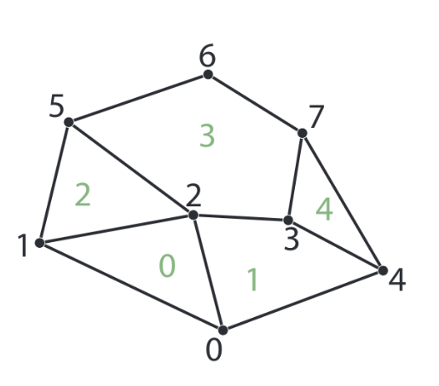
VTK-m Parallel Pattern: Visit Point With Cells
0
1
2
3
4
Input Array #1
W
W
W
W
W
W
W
W
Create output for each point.
Values from incident cells are available to worklet.
Output Array #1
0
1
2
3
4
5
6
7

Slide 18
VTK-m Parallel Pattern: Visit Point With Cells
0
1
2
3
4
Input Array #1
W
W
W
W
W
W
W
W
Create output for point #3.
Values from incident cells --- #’s 1, 3, and 4 --- are available to worklet.
Output Array #1
0
1
2
3
4
5
6
7

Slide 19
VTK-m Parallel Pattern: Visit Cell With Points
0
1
2
3
4
5
6
7
Input Array #1
W
W
W
W
W
Create output for each cell.
Values from incident points are available to worklet.
Output Array #1
0
1
2
3
4

Slide 20
VTK-m Parallel Pattern: Visit Cell With Points
0
1
2
3
4
5
6
7
Input Array #1
W
W
W
W
W
Create output for cell #2.
Values from incident points --- #’s 1, 2, and 5 --- are available to worklet.
Output Array #1
0
1
2
3
4

Slide 21
THE FOLLOWING 20 SILDES ARE KEN’S SUGGESTIONS FOR SIMPLIFYING AND FOLLOWING NEW EXAMPLE CODE

Slide 22
Tutorial Schedule
25m
65m
30m
20m
60m
10m
Introduction / software install
Using VTK-m (+hands on)
Break
Concepts behind VTK-m development
3 VTK-m filters (description + hands on)
Discussion of upcoming activities / wrap up / Q&A

Slide 23
New filter that calculates magnitude of a vector field
Code: tut_mag_grad.cxx
Worklet called ComputeMagnitude
Uses MapField pattern
Filter called FieldMagnitude
Uses Magnitude worklet
Main function
Uses FieldMagnitudeFilter

Slide 24
New filter that calculates magnitude of a vector field
Code: tut_mag_grad.cxx
Worklet called ComputeMagnitude
Uses MapField pattern
Filter called FieldMagnitude
Uses Magnitude worklet
Main function
Uses FieldMagnitudeFilter

Slide 25
Worklet Example
struct ComputeMagnitude : vtkm::worklet::WorkletMapField
{
using ControlSignature = void(FieldIn inputVectors,
FieldOut outputMagnitudes);
VTKM_EXEC void operator()(const vtkm::Vec3f& inVector,
vtkm::FloatDefault& outMagnitude) const
{
outMagnitude = vtkm::Magnitude(inVector);
}
};

Slide 26
Worklet Example
struct ComputeMagnitude : vtkm::worklet::WorkletMapField
{
using ControlSignature = void(FieldIn inputVectors,
FieldOut outputMagnitudes);
VTKM_EXEC void operator()(const vtkm::Vec3f& inVector,
vtkm::FloatDefault& outMagnitude) const
{
outMagnitude = vtkm::Magnitude(inVector);
}
};
Use operator() for functor syntax
The operating function of the worklet

Slide 27
Worklet Example
struct ComputeMagnitude : vtkm::worklet::WorkletMapField
{
using ControlSignature = void(FieldIn inputVectors,
FieldOut outputMagnitudes);
VTKM_EXEC void operator()(const vtkm::Vec3f& inVector,
vtkm::FloatDefault& outMagnitude) const
{
outMagnitude = vtkm::Magnitude(inVector);
}
};
The operating function of the worklet

Slide 28
Worklet Example
struct ComputeMagnitude : vtkm::worklet::WorkletMapField
{
using ControlSignature = void(FieldIn inputVectors,
FieldOut outputMagnitudes);
VTKM_EXEC void operator()(const vtkm::Vec3f& inVector,
vtkm::FloatDefault& outMagnitude) const
{
outMagnitude = vtkm::Magnitude(inVector);
}
};
Use operator() for functor syntax
Don’t forget that output parameters must be references
The operating function of the worklet

Slide 29
Worklet Example
struct ComputeMagnitude : vtkm::worklet::WorkletMapField
{
using ControlSignature = void(FieldIn inputVectors,
FieldOut outputMagnitudes);
VTKM_EXEC void operator()(const vtkm::Vec3f& inVector,
vtkm::FloatDefault& outMagnitude) const
{
outMagnitude = vtkm::Magnitude(inVector);
}
};
Method must be const (thread safety)
Use operator() for functor syntax
Don’t forget that output parameters must be references
The operating function of the worklet

Slide 30
Worklet Example
struct ComputeMagnitude : vtkm::worklet::WorkletMapField
{
using ControlSignature = void(FieldIn inputVectors,
FieldOut outputMagnitudes);
VTKM_EXEC void operator()(const vtkm::Vec3f& inVector,
vtkm::FloatDefault& outMagnitude) const
{
outMagnitude = vtkm::Magnitude(inVector);
}
};
Method must be const (thread safety)
Specifies device code
Use operator() for functor syntax
Don’t forget that output parameters must be references
The operating function of the worklet

Slide 31
VTKM_EXEC, VTKM_CONT, VTKM_EXEC_CONT
These are C macros that instruct compiler what architecture to compile for
VTKM_EXEC: execution environment
VTKM_CONT: control environment
VTKM_EXEC_CONT: both environments

Slide 32
Worklet Example
Defines worklet pattern
struct ComputeMagnitude : vtkm::worklet::WorkletMapField
{
using ControlSignature = void(FieldIn inputVectors,
FieldOut outputMagnitudes);
VTKM_EXEC void operator()(const vtkm::Vec3f& inVector,
vtkm::FloatDefault& outMagnitude) const
{
outMagnitude = vtkm::Magnitude(inVector);
}
};

Slide 33
VTK-m Parallel Pattern: Map Field (SLIDE REPEAT)
Input Array #1
Input Array #2
W
W
W
W
W
W
W
W
W
W
W
W
Output Array #1
All arrays must be the same size.
Arrays can come from cells or points.

Slide 34
Worklet Example
struct ComputeMagnitude : vtkm::worklet::WorkletMapField
{
using ControlSignature = void(FieldIn inputVectors,
FieldOut outputMagnitudes);
VTKM_EXEC void operator()(const vtkm::Vec3f& inVector,
vtkm::FloatDefault& outMagnitude) const
{
outMagnitude = vtkm::Magnitude(inVector);
}
};
Defines input arrays

Slide 35
Worklet Example
struct ComputeMagnitude : vtkm::worklet::WorkletMapField
{
using ControlSignature = void(FieldIn inputVectors,
FieldOut outputMagnitudes);
VTKM_EXEC void operator()(const vtkm::Vec3f& inVector,
vtkm::FloatDefault& outMagnitude) const
{
outMagnitude = vtkm::Magnitude(inVector);
}
};
Input Array
Defines input arrays
Output Array

Slide 36
Worklet Example
Defines worklet pattern
Defines input arrays
struct ComputeMagnitude : vtkm::worklet::WorkletMapField
{
using ControlSignature = void(FieldIn inputVectors,
FieldOut outputMagnitudes);
VTKM_EXEC void operator()(const vtkm::Vec3f& inVector,
vtkm::FloatDefault& outMagnitude) const
{
outMagnitude = vtkm::Magnitude(inVector);
}
};
Method must be const (thread safety)
Specifies device code
Use operator() for functor syntax
Don’t forget that output parameters must be references
The operating function of the worklet

Slide 37
New filter that calculates magnitude of a vector field
Code: tut_mag_grad.cxx
Worklet called ComputeMagnitude
Uses MapField pattern
Filter called FieldMagnitude
Uses Magnitude worklet
Main function
Uses FieldMagnitudeFilter

Slide 38
class FieldMagnitude : public vtkm::filter::FilterField<FieldMagnitude>
{
public:
using SupportedTypes = vtkm::ListTagBase<vtkm::Vec3f>;
template<typename ArrayHandleType, typename Policy>
VTKM_CONT vtkm::cont::DataSet DoExecute(
const vtkm::cont::DataSet& inDataSet,
const ArrayHandleType& inField,
const vtkm::filter::FieldMetadata& fieldMetadata,
vtkm::filter::PolicyBase<Policy>)
{
vtkm::cont::ArrayHandle<vtkm::FloatDefault> outField;
this->Invoke(ComputeMagnitude{}, inField, outField);
std::string outFieldName = this->GetOutputFieldName();
if (outFieldName == "")
{
outFieldName = fieldMetadata.GetName() + "_magnitude";
}
return vtkm::filter::CreateResult(
inDataSet, outField, outFieldName, fieldMetadata);
}
};

Slide 39
New filter that calculates magnitude of a vector field
Code: tut_mag_grad.cxx
Worklet called ComputeMagnitude
Uses MapField pattern
Filter called FieldMagnitude
Uses Magnitude worklet
Main function
Uses FieldMagnitudeFilter

Slide 40
int main(int argc, char** argv)
{
auto opts = vtkm::cont::InitializeOptions::DefaultAnyDevice;
vtkm::cont::InitializeResult config =
vtkm::cont::Initialize(argc, argv, opts);
vtkm::io::reader::VTKDataSetReader reader("data/kitchen.vtk");
vtkm::cont::DataSet ds_from_file = reader.ReadDataSet();
vtkm::filter::Gradient grad;
grad.SetActiveField("c1");
vtkm::cont::DataSet ds_from_grad = grad.Execute(ds_from_file);
FieldMagnitude mag;
mag.SetActiveField("Gradients");
vtkm::cont::DataSet mag_grad = mag.Execute(ds_from_grad);
vtkm::io::writer::VTKDataSetWriter writer("out_mag_grad.vtk");
writer.WriteDataSet(mag_grad);
return 0;
}

Slide 41
Hands-On #1
Modify code tut_mag_grad.cxx
Worklet currently calculates magnitude of a vector
Instead, modify worket to calculate the maximum component.

Slide 42
THE PREVIOUS 20 SILDES ARE KEN’S SUGGESTIONS FOR SIMPLIFYING AND FOLLOWING NEW EXAMPLE CODE

Slide 43
FOLLOWING 9 SLIDES MAY NEED UPDATE B/C OF POSSIBLE CHANGES TO EXECUTION/CONTROL SIGNATURE

Slide 44
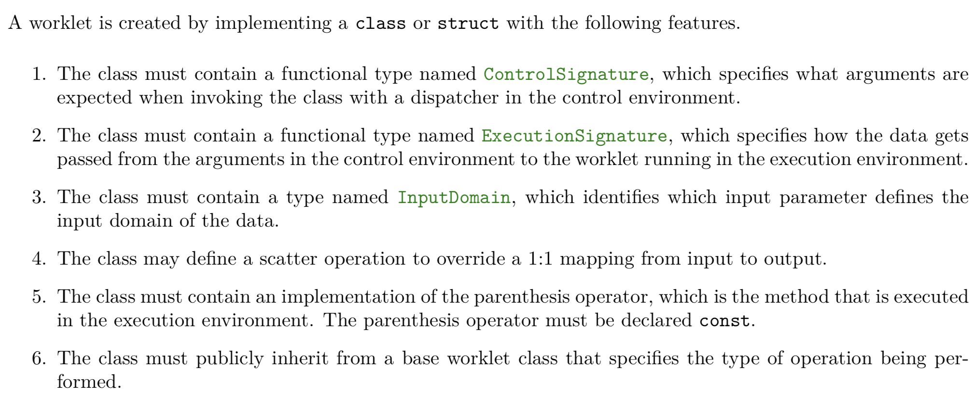
Elements of a worklet
HANK WILL RE-WRITE THIS SLIDE AFTER WEDS TELECON

Slide 45
Control Signature

Slide 46
Execution Signature

Slide 47
Worklet Operator – define the functor!
?
?
?
?
Must be const for thread safety

Slide 48
VTKM_EXEC, VTKM_CONT, VTKM_EXEC_CONT
These are C macros that instruct compiler what architecture to compile for
VTKM_EXEC: execution environment
VTKM_CONT: control environment
VTKM_EXEC_CONT: both environments

Slide 49
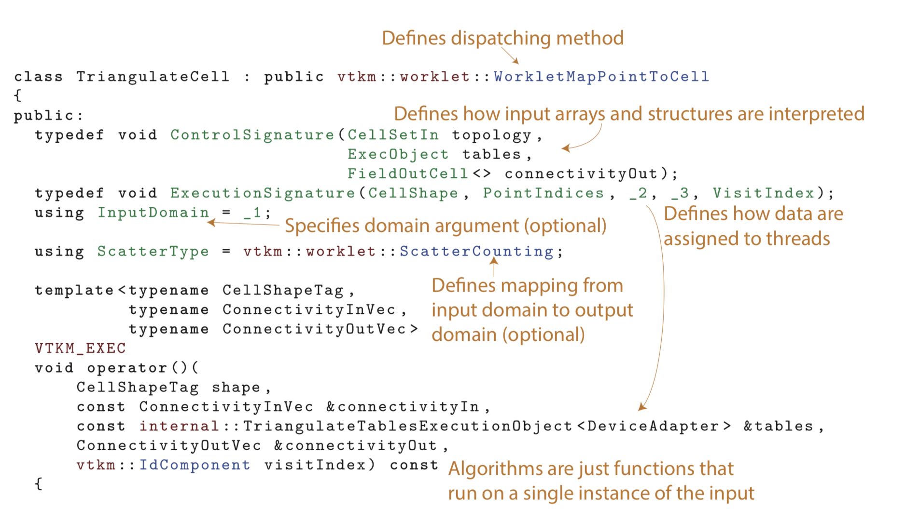
Worklet Example

Slide 50
Worklet Example
struct ComputeMagnitude : vtkm::worklet::WorkletMapField
{
using ControlSignature = void(FieldIn inputVectors,
FieldOut outputMagnitudes);
VTKM_EXEC void operator()(const vtkm::Vec3f& inVector,
vtkm::FloatDefault& outMagnitude) const
{
outMagnitude = vtkm::Magnitude(inVector);
}
};

Slide 51
Worklet Example
struct ComputeMagnitude : vtkm::worklet::WorkletMapField
{
using ControlSignature = void(FieldIn inputVectors,
FieldOut outputMagnitudes);
VTKM_EXEC void operator()(const vtkm::Vec3f& inVector,
vtkm::FloatDefault& outMagnitude) const
{
outMagnitude = vtkm::Magnitude(inVector);
}
};
The operating function of the worklet

Slide 52
Worklet Example
struct ComputeMagnitude : vtkm::worklet::WorkletMapField
{
using ControlSignature = void(FieldIn inputVectors,
FieldOut outputMagnitudes);
VTKM_EXEC void operator()(const vtkm::Vec3f& inVector,
vtkm::FloatDefault& outMagnitude) const
{
outMagnitude = vtkm::Magnitude(inVector);
}
};
Use operator() for functor syntax
The operating function of the worklet

Slide 53
Worklet Example
struct ComputeMagnitude : vtkm::worklet::WorkletMapField
{
using ControlSignature = void(FieldIn inputVectors,
FieldOut outputMagnitudes);
VTKM_EXEC void operator()(const vtkm::Vec3f& inVector,
vtkm::FloatDefault& outMagnitude) const
{
outMagnitude = vtkm::Magnitude(inVector);
}
};
Use operator() for functor syntax
Don’t forget that output parameters must be references
The operating function of the worklet

Slide 54
Worklet Example
struct ComputeMagnitude : vtkm::worklet::WorkletMapField
{
using ControlSignature = void(FieldIn inputVectors,
FieldOut outputMagnitudes);
VTKM_EXEC void operator()(const vtkm::Vec3f& inVector,
vtkm::FloatDefault& outMagnitude) const
{
outMagnitude = vtkm::Magnitude(inVector);
}
};
Method must be const (thread safety)
Use operator() for functor syntax
Don’t forget that output parameters must be references
The operating function of the worklet

Slide 55
Worklet Example
Defines worklet pattern
struct ComputeMagnitude : vtkm::worklet::WorkletMapField
{
using ControlSignature = void(FieldIn inputVectors,
FieldOut outputMagnitudes);
VTKM_EXEC void operator()(const vtkm::Vec3f& inVector,
vtkm::FloatDefault& outMagnitude) const
{
outMagnitude = vtkm::Magnitude(inVector);
}
};
Method must be const (thread safety)
Use operator() for functor syntax
Don’t forget that output parameters must be references
The operating function of the worklet

Slide 56
Worklet Example
Defines worklet pattern
Defines input arrays
struct ComputeMagnitude : vtkm::worklet::WorkletMapField
{
using ControlSignature = void(FieldIn inputVectors,
FieldOut outputMagnitudes);
VTKM_EXEC void operator()(const vtkm::Vec3f& inVector,
vtkm::FloatDefault& outMagnitude) const
{
outMagnitude = vtkm::Magnitude(inVector);
}
};
Method must be const (thread safety)
Use operator() for functor syntax
Don’t forget that output parameters must be references
The operating function of the worklet

Slide 57
Going deep on worklets
Worklet types
Dispatchers
Elements of a worklet
Example reference for one worklet type (FieldMap)

Slide 58
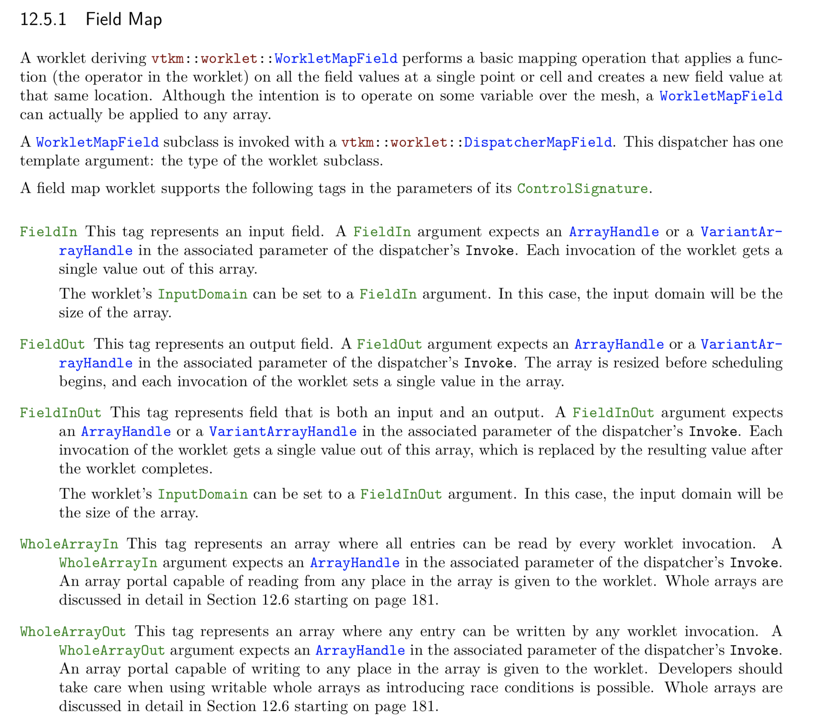
Screenshots from users manual on reference material for Field Map worklet (1/2)
ROB QUESTIONS VALUE OF THIS
SLIDE

Slide 59
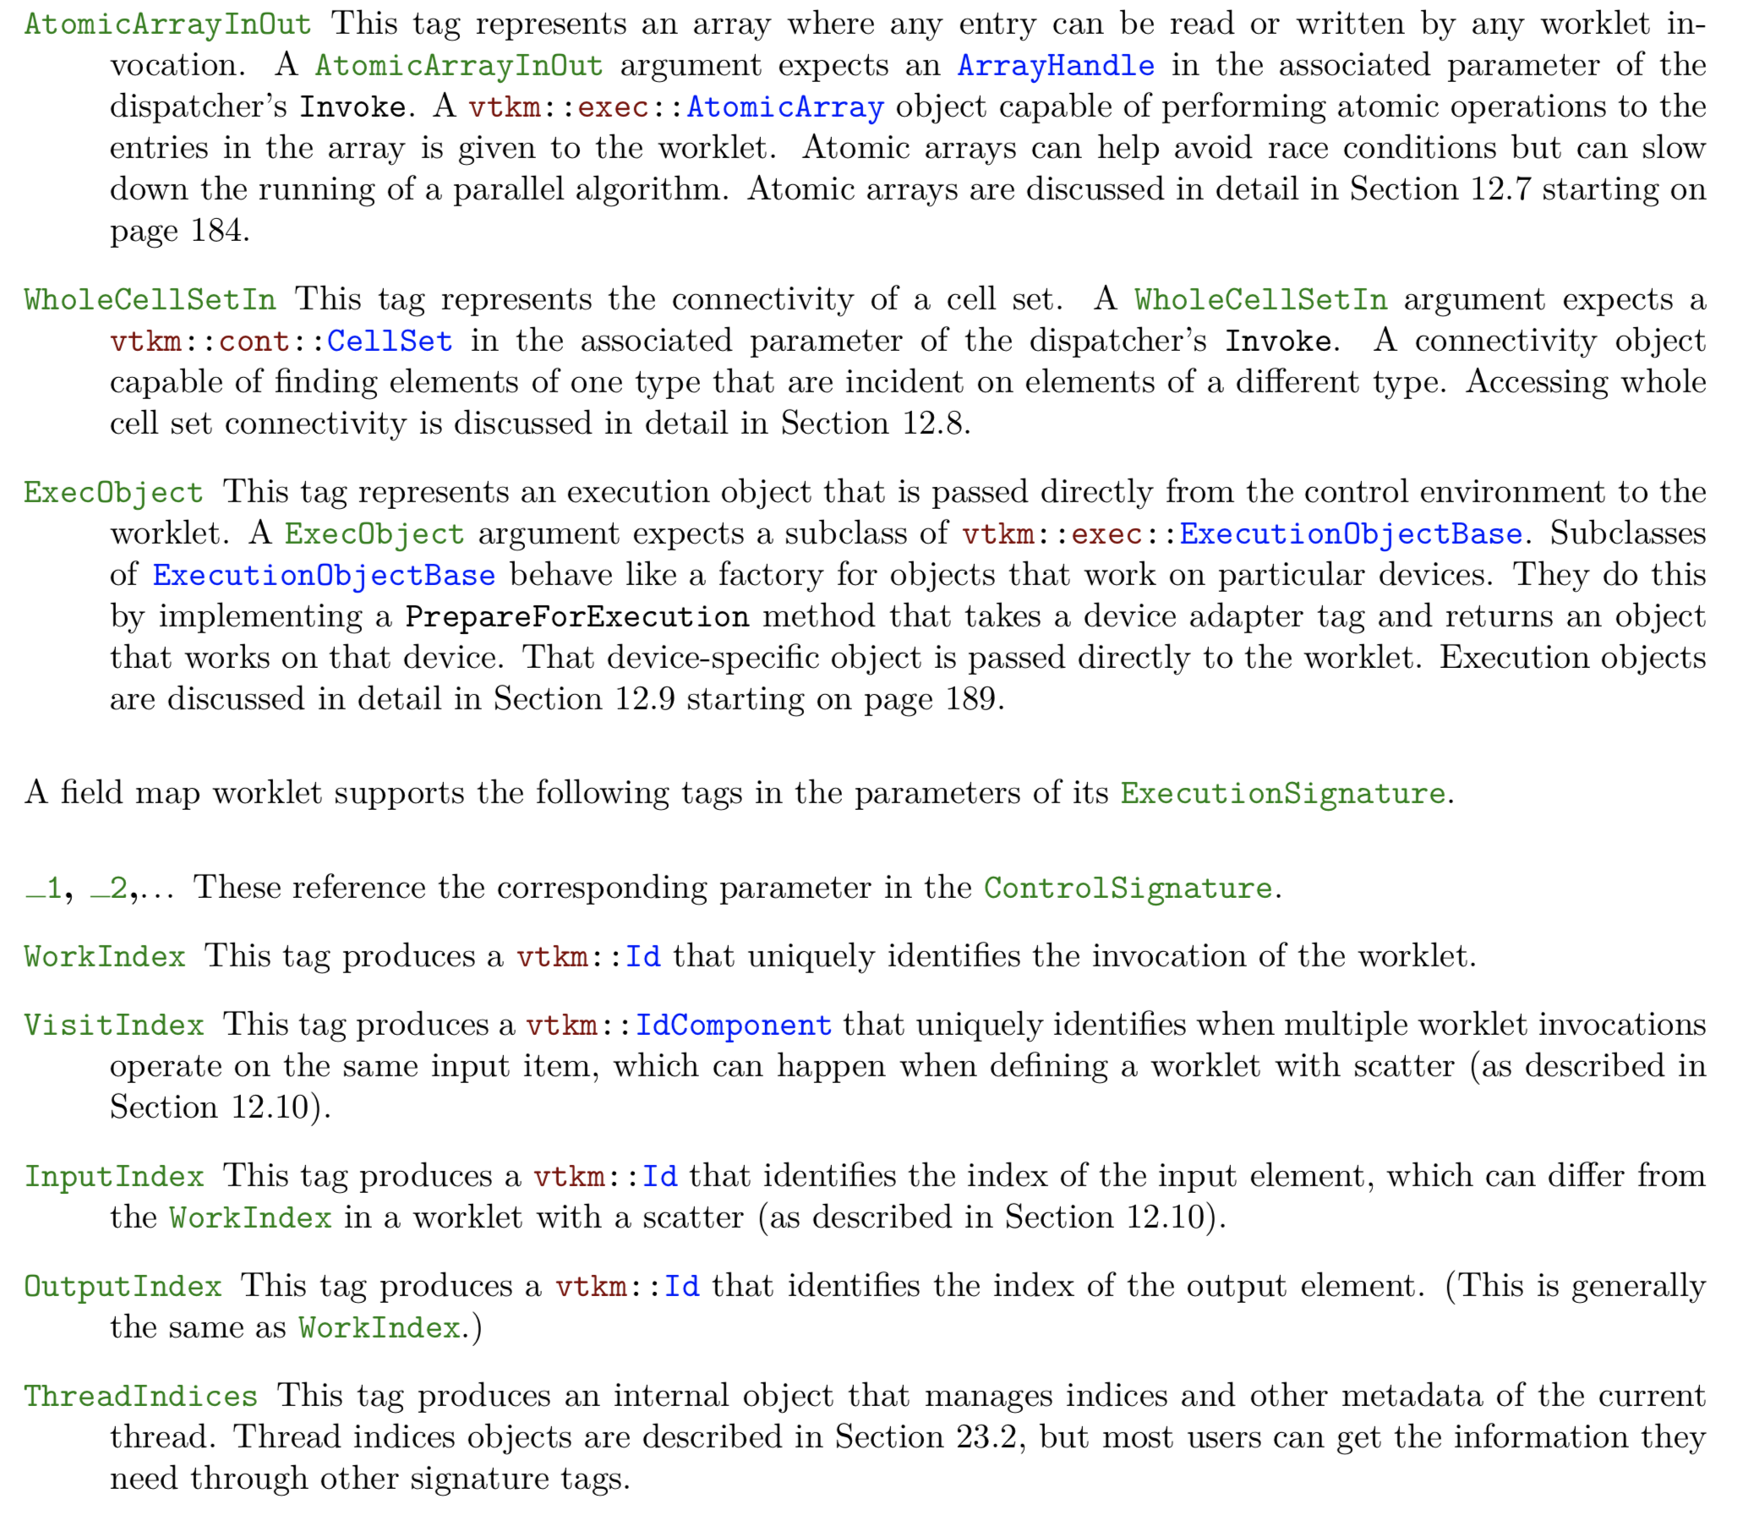
Screenshots from users manual on reference material for Field Map worklet (2/2)
ROB QUESTIONS VALUE OF THIS
SLIDE

Slide 60
PRECEDING 9 SLIDES MAY NEED UPDATE B/C OF POSSIBLE CHANGES TO EXECUTION/CONTROL SIGNATURE

Slide 61
Tutorial Schedule
25m
65m
30m
20m
60m
10m
Introduction / software install
Using VTK-m (+hands on)
Break
Concepts behind VTK-m development
3 VTK-m filters (description + hands on)
Discussion of upcoming activities / wrap up / Q&A

Slide 62
New filter that calculates magnitude of a vector field
Code: tut_mag_grad.cxx
Worklet called ComputeMagnitude
Uses MapField pattern
Filter called FieldMagnitude
Uses Magnitude worklet
Main function
Uses FieldMagnitudeFilter

Slide 63
New filter that calculates magnitude of a vector field
Code: tut_mag_grad.cxx
Worklet called ComputeMagnitude
Uses MapField pattern
Filter called FieldMagnitude
Uses Magnitude worklet
Main function
Uses FieldMagnitudeFilter

Slide 64
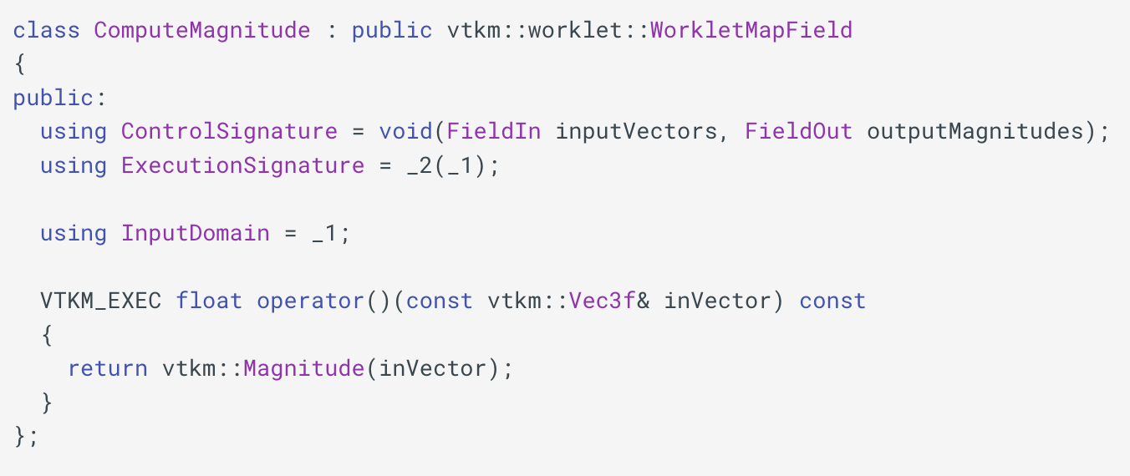
ComputeMagnitude worklet
NEEDS UPDATE AFTER WEDS TELECON

Slide 65
New filter that calculates magnitude of a vector field
Code: tut_mag_grad.cxx
Worklet called ComputeMagnitude
Uses MapField pattern
Filter called FieldMagnitude
Uses Magnitude worklet
Main function
Uses FieldMagnitudeFilter

Slide 66
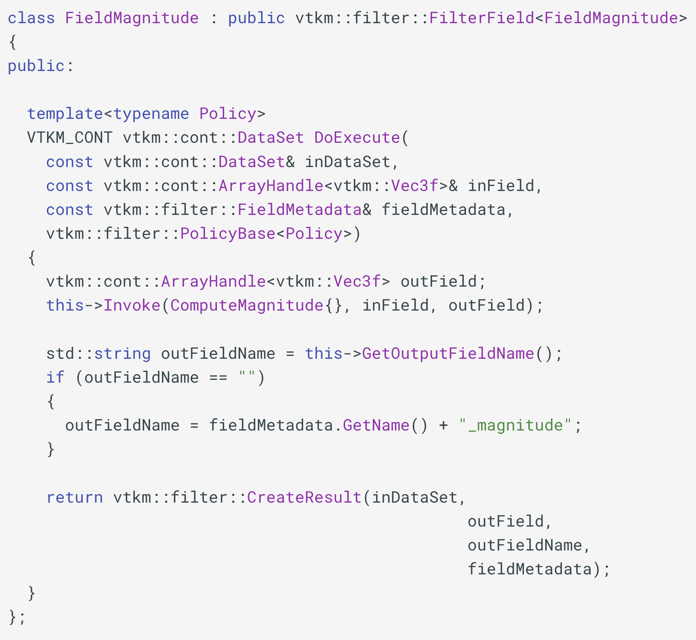
FieldMagnitude filter
NEEDS UPDATE AFTER WEDS TELECON

Slide 67
New filter that calculates magnitude of a vector field
Code: tut_mag_grad.cxx
Worklet called ComputeMagnitude
Uses MapField pattern
Filter called FieldMagnitude
Uses Magnitude worklet
Main function
Uses FieldMagnitudeFilter

Slide 68
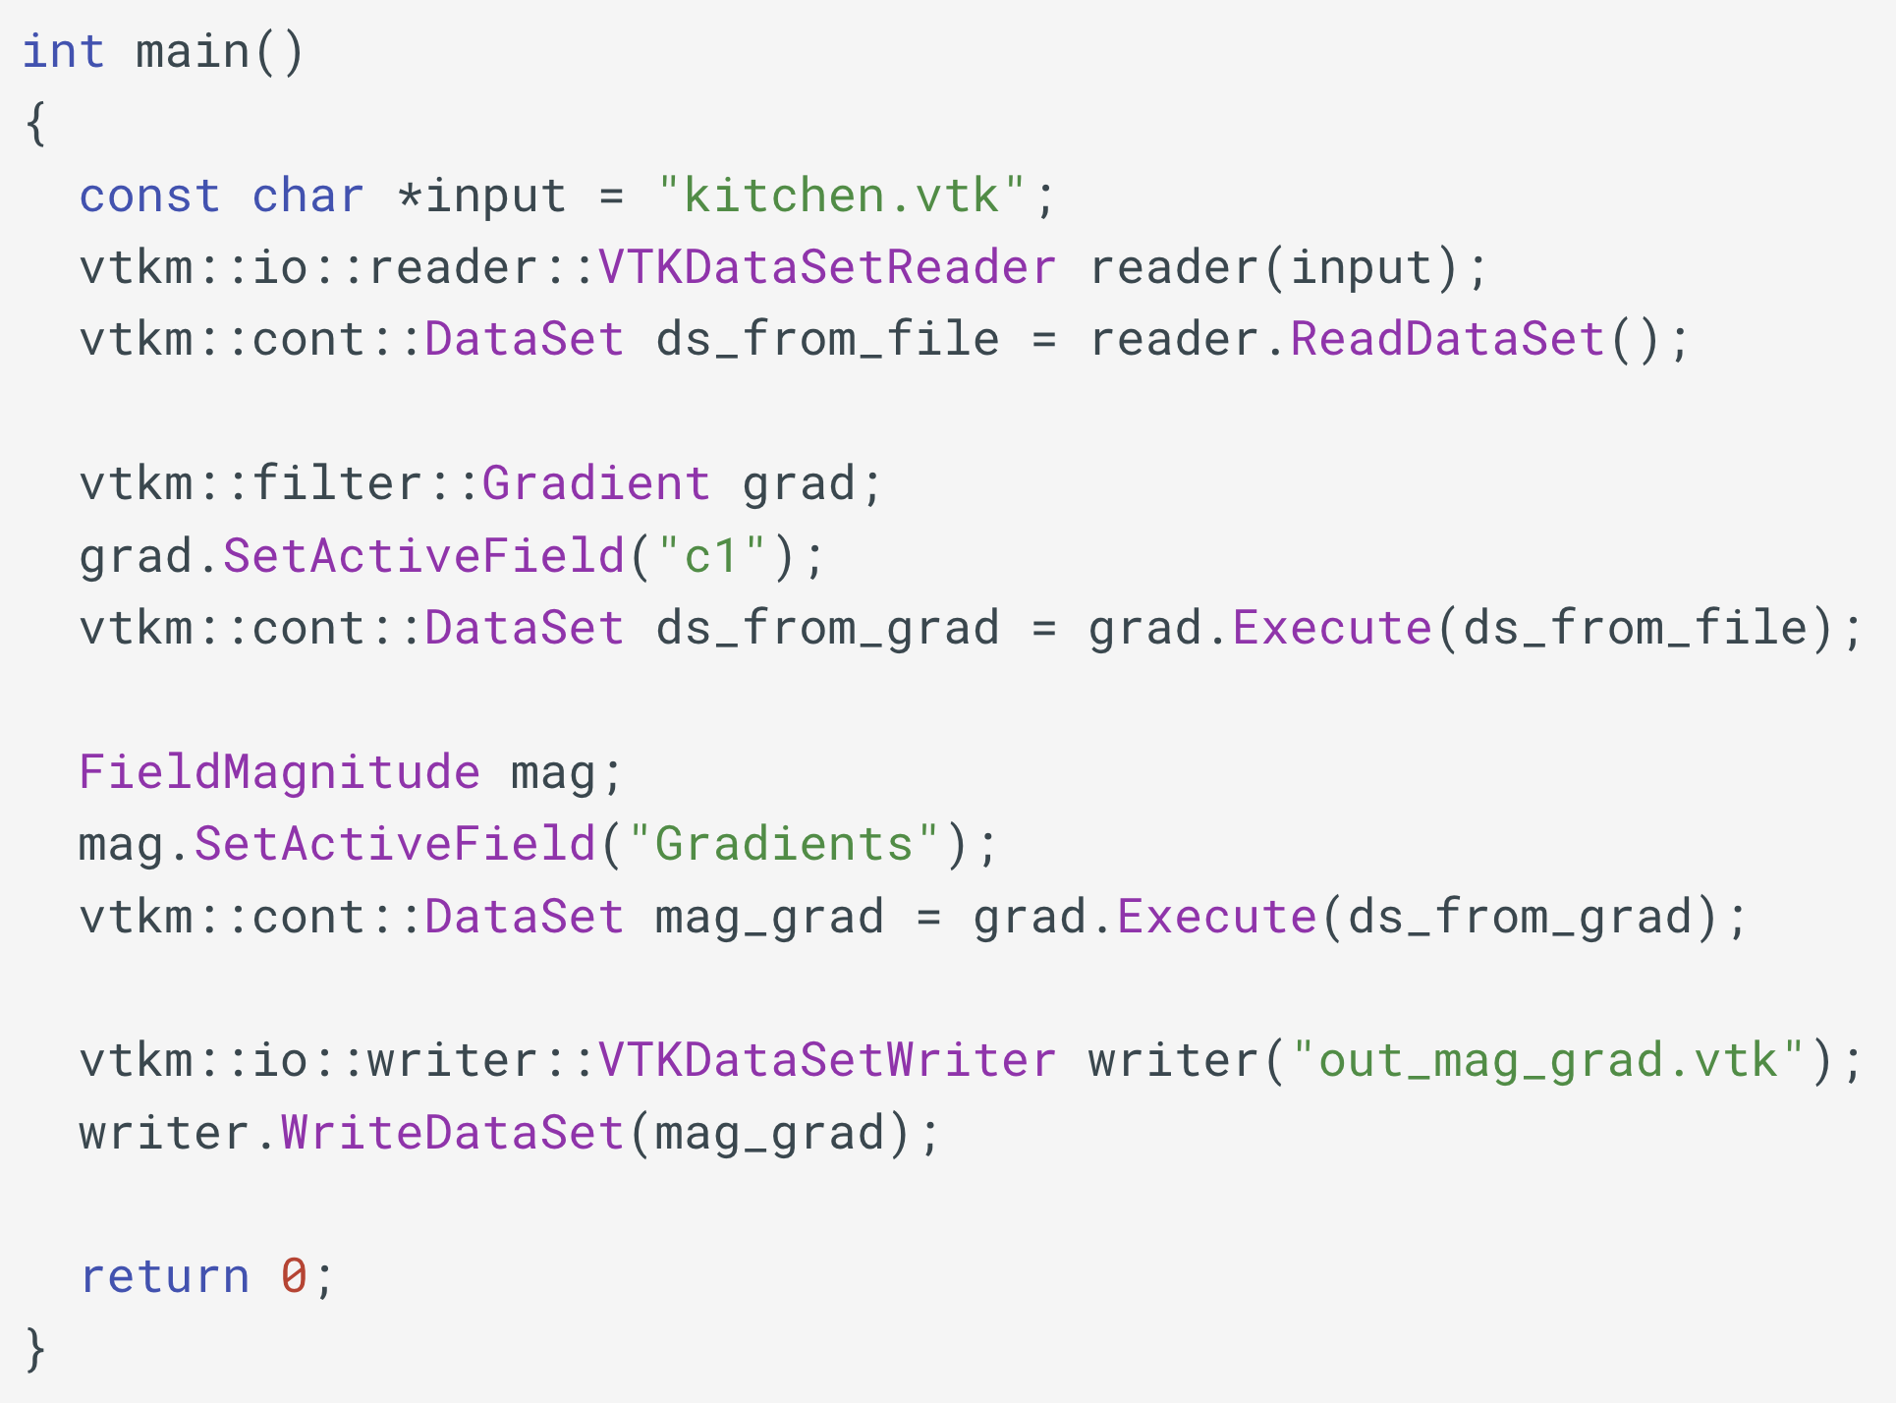
main function
NEEDS UPDATE:
CALL mag.Execute()

Slide 69
Hands-On #1
Modify code tut_mag_grad.cxx
Worklet currently calculates magnitude of a vector
Instead, modify worket to calculate the maximum component.

