Slide 1
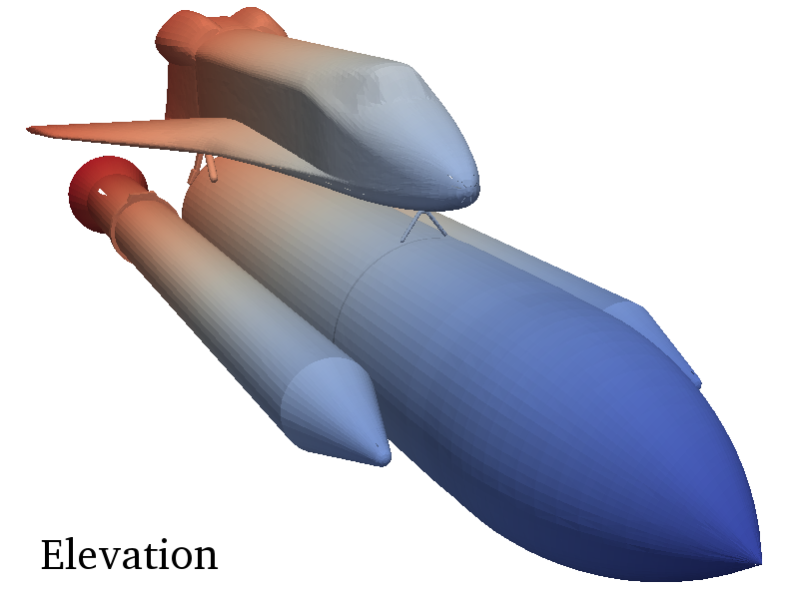
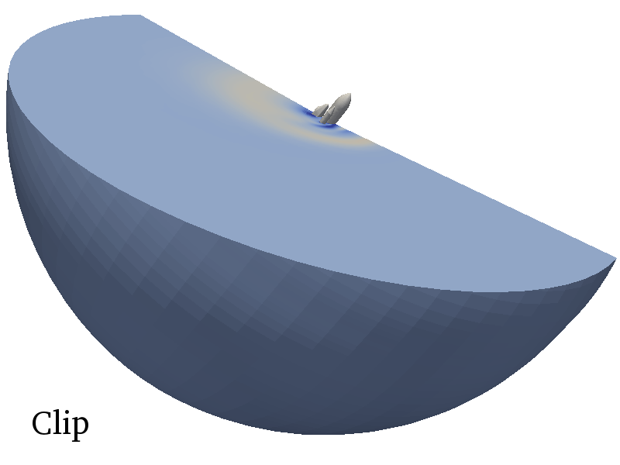
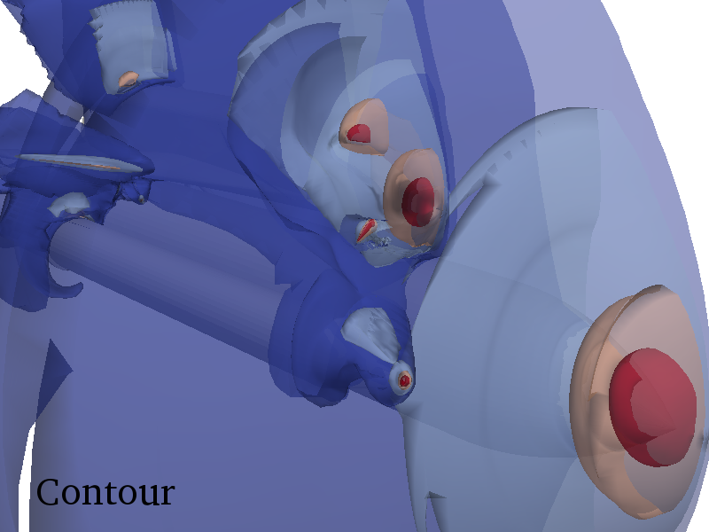
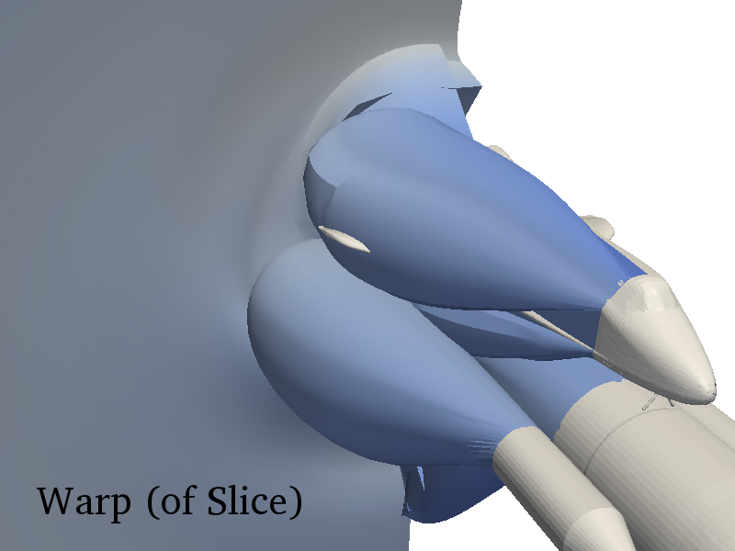
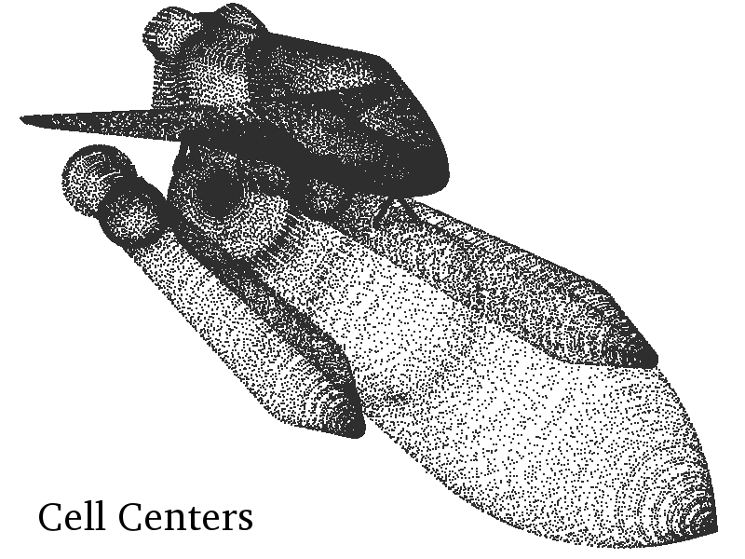
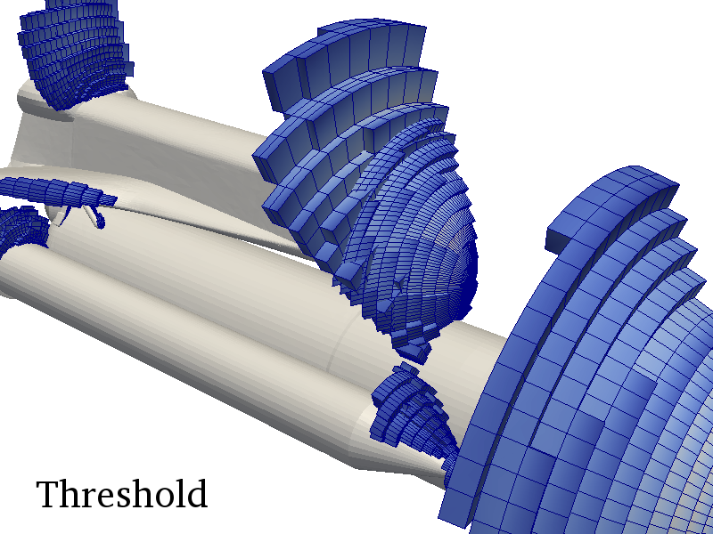
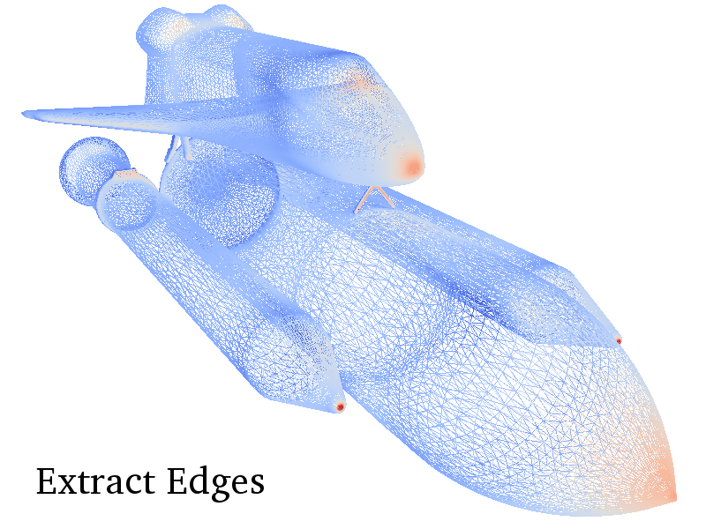
VTK-m Project Goals
A single place for the visualization community to collaborate, contribute, and leverage massively threaded algorithms.
Reduce the challenges of writing highly concurrent algorithms by using data parallel algorithms
Notes:
We want to be one happy family to reduce the re-invention of algorithms. As VTK has become a location for researching classic cpu algorithms we want VTK-m to do the same for data parallel algorithm

Slide 2
VTK-m Project Goals
Make it easier for simulation codes to take advantage these parallel visualization and analysis tasks on a wide range of current and next-generation hardware.
Notes:
Both in-situ and post processing are our targets

Slide 3
VTK-m Architecture
Combines strengths of multiple projects:
EAVL, Oak Ridge National Laboratory
DAX, Sandia National Laboratory
PISTON, Los Alamos National Laboratory
Filters
DataModel
Post Processing
Worklets
In-Situ
Data Parallel Algorithms
Execution
Arrays
Notes:
Red is Pison
Blue is Dax
Green is Eavl
Array and Dynamic is finished,
Data Parallel Algorithms is nearing completion
Device Adapter is nearing completion
Actively working on getting DataModel into the code base
Post Processing is the interface level that VTK and such forth will interface with. This will the library level
The In-Situ tight coupling can use a lower header template library approach maximizes performance

Slide 4
VTK-m Arbitrary Composition
VTK-m allows clients to access different memory layouts through the Array Handle and Dynamic Array Handle.
Allows for efficient in-situ integration
Allows for reduced data transfer
Control Environment
Execution Environment
Transfer
Control Environment
Execution Environment

Slide 5
VTK-m Arbitrary Composition
VTK-m allows clients to construct data sets from cell and point arrangements that exactly match their original data
In effect, this allows for hybrid and novel mesh types
 |  | Point Arrangement
Cells | Coordinates | Explicit | Logical | Implicit
Structured | Strided | ✓ | ✓ | ✓
 | Separated | ✓ | ✓ | ✓
Unstructured | Strided | ✓ | ✓ | ✓
 | Separated | ✓ | ✓ | ✓
VTK-m Data Set

Slide 6
[Baker, et al. 2010]
Functor Mapping
Applied to Topologies
functor()
Notes:
Our basic approach to portable and efficient multicore algorithms is essentially that presented by Baker and colleagues.
Break the algorithm into sections that can be run on single (or small) sections of data and encapsulate that in a C++ functor object.
Using generic programming, provide a mapping function to schedule the functor on many threads to concurrently process a vector.
Dual benefits:
Simplifies algorithm design by placing the bulk of the work in a serial functor.
One porting of the map function to multiple parallel systems can be applied to any number of functor algorithms. Also works well in lightweight thread environment.
However, we find this basic model a bit too simplistic.
We are most interested in mapping operations to connected topologies, which means that the inputs and outputs of the operations are dependent on these connections.
For example, the computation of an operation may depend on a collection of data around a small neighborhood.

Slide 7
[Baker, et al. 2010]
Functor Mapping
Applied to Topologies
functor()
Notes:
We also have to consider that the values created by a functor may not be independent
For example, they might combine together to form a connected topology
If necessary, we might need to rebuild these connections

Slide 8
What We Have So Far
Features
Core Types
Statically Typed Arrays
Dynamically Typed Arrays
Device Interface (Serial, Cuda, TBB)
Data Model
Field and Topology Worklet and Dispatcher

Slide 9
What We Have So Far
Compiles with
gcc (4.8+), clang, msvc (2010+), icc, and pgi
User Guide work in progress
Ready for larger collaboration

Slide 10
2 x Intel Xeon CPU E5-2620 v3 @ 2.40GHz + NVIDIA Tesla K40c
Data: 1024^3 (floats)

Slide 11
2 x Intel Xeon CPU E5-2620 v3 @ 2.40GHz + NVIDIA Tesla K40c
Data: 1024^3 (floats)
Notes:
Note that data is increasing by an order of 4 but performance is only roughly doubling.

Slide 12
struct Sine: public vtkm::worklet::WorkletMapField {
typedef void ControlSignature(FieldIn<>, FieldOut<>);
typedef _2 ExecutionSignature(_1);
template<typename T>
VTKM_EXEC_EXPORT
T operator()(T x) const {
return vtkm::math::Sin(x);
}
};

Slide 13
struct Sine: public vtkm::worklet::WorkletMapField {
typedef void ControlSignature(FieldIn<>, FieldOut<>);
typedef _2 ExecutionSignature(_1);
template<typename T>
VTKM_EXEC_EXPORT
T operator()(T x) const {
return vtkm::math::Sin(x);
}
};

Slide 14
struct Sine: public vtkm::worklet::WorkletMapField {
typedef void ControlSignature(FieldIn<>, FieldOut<>);
typedef _2 ExecutionSignature(_1);
template<typename T>
VTKM_EXEC_EXPORT
T operator()(T x) const {
return vtkm::math::Sin(x);
}
};

Slide 15
struct Sine: public vtkm::worklet::WorkletMapField {
typedef void ControlSignature(FieldIn<>, FieldOut<>);
typedef _2 ExecutionSignature(_1);
template<typename T>
VTKM_EXEC_EXPORT
T operator()(T x) const {
return vtkm::math::Sin(x);
}
};

Slide 16
struct Sine: public vtkm::worklet::WorkletMapField {
typedef void ControlSignature(FieldIn<>, FieldOut<>);
typedef _2 ExecutionSignature(_1);
template<typename T>
VTKM_EXEC_EXPORT
T operator()(T x) const {
return vtkm::math::Sin(x);
}
};

Slide 17
struct Sine: public vtkm::worklet::WorkletMapField {
typedef void ControlSignature(FieldIn<>, FieldOut<>);
typedef _2 ExecutionSignature(_1);
template<typename T>
VTKM_EXEC_EXPORT
T operator()(T x) const {
return vtkm::math::Sin(x);
}
};

Slide 18
struct Sine: public vtkm::worklet::WorkletMapField {
typedef void ControlSignature(FieldIn<>, FieldOut<>);
typedef _2 ExecutionSignature(_1);
template<typename T>
VTKM_EXEC_EXPORT
T operator()(T x) const {
return vtkm::math::Sin(x);
}
};

Slide 19
struct Sine: public vtkm::worklet::WorkletMapField {
typedef void ControlSignature(FieldIn<>, FieldOut<>);
typedef _2 ExecutionSignature(_1);
template<typename T>
VTKM_EXEC_EXPORT
T operator()(T x) const {
return vtkm::math::Sin(x);
}
};
Execution Environment
Control Environment
vtkm::cont::ArrayHandle<vtkm::Float32> inputHandle =
vtkm::cont::make_ArrayHandle(input);
vtkm::cont::ArrayHandle<vtkm::Float32> sineResult;
vtkm::worklet::DispatcherMapField<Sine> dispatcher;
dispatcher.Invoke(inputHandle, sineResult);

Slide 20
struct Sine: public vtkm::worklet::WorkletMapField {
typedef void ControlSignature(FieldIn<>, FieldOut<>);
typedef _2 ExecutionSignature(_1);
template<typename T>
VTKM_EXEC_EXPORT
T operator()(T x) const {
return vtkm::math::Sin(x);
}
};
Execution Environment
Control Environment
vtkm::cont::ArrayHandle<vtkm::Float32> inputHandle =
vtkm::cont::make_ArrayHandle(input);
vtkm::cont::ArrayHandle<vtkm::Float32> sineResult;
vtkm::worklet::DispatcherMapField<Sine> dispatcher;
dispatcher.Invoke(inputHandle, sineResult);

Slide 21
struct Sine: public vtkm::worklet::WorkletMapField {
typedef void ControlSignature(FieldIn<>, FieldOut<>);
typedef _2 ExecutionSignature(_1);
template<typename T>
VTKM_EXEC_EXPORT
T operator()(T x) const {
return vtkm::math::Sin(x);
}
};
Execution Environment
Control Environment
vtkm::cont::ArrayHandle<vtkm::Float32> inputHandle =
vtkm::cont::make_ArrayHandle(input);
vtkm::cont::ArrayHandle<vtkm::Float32> sineResult;
vtkm::worklet::DispatcherMapField<Sine> dispatcher;
dispatcher.Invoke(inputHandle, sineResult);

Slide 22
struct Sine: public vtkm::worklet::WorkletMapField {
typedef void ControlSignature(FieldIn<>, FieldOut<>);
typedef _2 ExecutionSignature(_1);
template<typename T>
VTKM_EXEC_EXPORT
T operator()(T x) const {
return vtkm::math::Sin(x);
}
};
Execution Environment
Control Environment
vtkm::cont::ArrayHandle<vtkm::Float32> inputHandle =
vtkm::cont::make_ArrayHandle(input);
vtkm::cont::ArrayHandle<vtkm::Float32> sineResult;
vtkm::worklet::DispatcherMapField<Sine> dispatcher;
dispatcher.Invoke(inputHandle, sineResult);

Slide 23
struct Sine: public vtkm::worklet::WorkletMapField {
typedef void ControlSignature(FieldIn<>, FieldOut<>);
typedef _2 ExecutionSignature(_1);
template<typename T>
VTKM_EXEC_EXPORT
T operator()(T x) const {
return vtkm::math::Sin(x);
}
};

Slide 24
Dispatcher Invoke Operations
Convert polymorphic types to static types
Check types
Dispatcher-specific operations
Find domain length
Build index arrays
Transport data from control to execution
Run worklet invoke kernel
Fetch thread-specific data
Invoke worklet
Push thread-specific data
DispatcherMapField<Sine> dispatcher;
dispatcher.Invoke(inputHandle, sineResult);

Slide 25
struct ImagToPolar: public vtkm::worklet::WorkletMapField {
typedef void ControlSignature(
FieldIn<vtkm::TypeListTagScalar>,
FieldIn<vtkm::TypeListTagScalar>,
FieldOut<vtkm::TypeListTagScalar>,
FieldOut<vtkm::TypeListTagScalar>);
typedef void ExecutionSignature(_1, _2, _3, _4);
template<typename RealType,
typename ImaginaryType,
typename MagnitudeType,
typename PhaseType>
VTKM_EXEC_EXPORT
void operator()(RealType real,
ImaginaryType imag,
MagnitudeType &magnitude,
PhaseType &phase) const {
magnitude = vtkm::math::Sqrt(real*real + imag*imag);
phase = vtkm::math::ATan2(imaginary, real);
}
};

Slide 26
Coprocessing/In-situ
Use of VTK and VTK-m
Process data in place using VTK-m
Visualize and analyze using VTK
Bringing highly parallelized visualization and analytics in science to all
Create bridges between VTK and VTK-m

